Slide 1
Coordinating Care Across Clinical Settings
ICWB Shared Learning Call
April 24th, 2023

Slide 2
Objectives
Review Plan of Safe Care components
Discuss implementation of POSC during prenatal period
Explain how prenatal POSC creation is patient-centered and improves coordination between inpatient and outpatient care settings
Brainstorm ways of connecting OP and IP care settings on an ongoing basis, and discuss one new strategy implemented at UCH

Slide 3
Plan of Safe Care
A Plan of Safe Care is meant to be a community safety net for families affected by substance use. Ideally, the plan is established during pregnancy, prior to child welfare involvement and the plan is developed by a multidisciplinary team. Plans of Safe Care include the following elements:
Physical health (postpartum care, support with breastfeeding, medication and pain management)
Behavioral health (engagement, treatment, recovery supports and retention; treatment for partner/other family members)
Infant health and development (high-risk follow-up care, with referral to specialty care; developmental screening and early intervention services; early care and education programs)
Parenting/family support (coordinated case management; home visiting/Head Start; Housing, employment support, child care and transportation)

Slide 4
What is the Colorado Plans of Safe Care?
The Comprehensive Addiction and Recovery Act (CARA) of 2016 requires state child welfare systems develop a Plans of Safe Care to address the needs of infants who are identified as affected by substance abuse, experience withdrawal symptoms, or have fetal alcohol spectrum disorders (FASD). It also stipulates the development of a services plan for the infant and their family/caregiver to ensure the safety and well-being of infants following the release from the health care provider.
What is included in the Colorado Plans of Safe Care?
Physiological Readiness of the Infant
The impact of substance exposure on the infant and identifies the need for special care, medical treatment or pharmacological care.
Discharge Planning/Consultation
Nutritional and medical care needs and supplies, in-home caregivers, community resources, emergency care and transportation and assesses for safety of the home and financial resources.
Follow-up Care
Coordination and follow-up with PCP, pediatrician, treatment provider, counselor, home nursing care, housing, food and parenting resources.
Parent/Caregiver Education
Readiness of parent/caregiver to care for infant, education and skills needed to care for the infant and identifies support system.

Slide 5
Who is Involved in Developing the Colorado Plans of Safe Care (PoSC)?
The PoSC is developed with the input of a multidisciplinary-team before the mother’s discharge from the hospital. According to best practices, the PoSC should be started prenatally and serve as a living document throughout the pregnancy and after birth. If that is not possible, the PoSC must be developed after birth and completed before the mother’s discharge. This team may include:
Medical staff
Treatment providers
Mental health experts
Early childhood staff
Child welfare
Others: Probation or Parole Officers, community health case managers, religious or spiritual supports, etc
Get Releases of Information and Save names and contact info in Plan of Safe Care Document!
Patients have the right to revoke Releases of Information at any time, as well as specify what information is ok to share with whom

Slide 6
Prenatal POSC Development
Physical Health: medication optimization, establishment with primary care (even while receiving prenatal care if not one in the same), NFP/Home visitation programs
Behavioral Health: establishment with treatment services, stabilization in integrated setting → connection to long term treatment services, Peer Support Services, home visitation services
Infant Health and Development: introducing Early Intervention: what and why, establishing with pediatrician/family medicine prior to delivery to strengthen SEN warm hand off
Parenting/Family Services: HOUSING, TANF, SNAP, WIC, transportation, parenting classes, Circle of Parents,

Slide 7
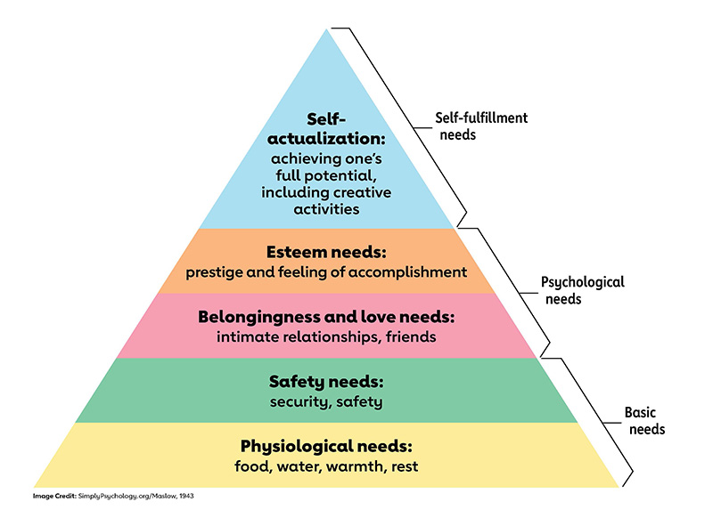
Maslow’s Hierarchy of Needs

Slide 8
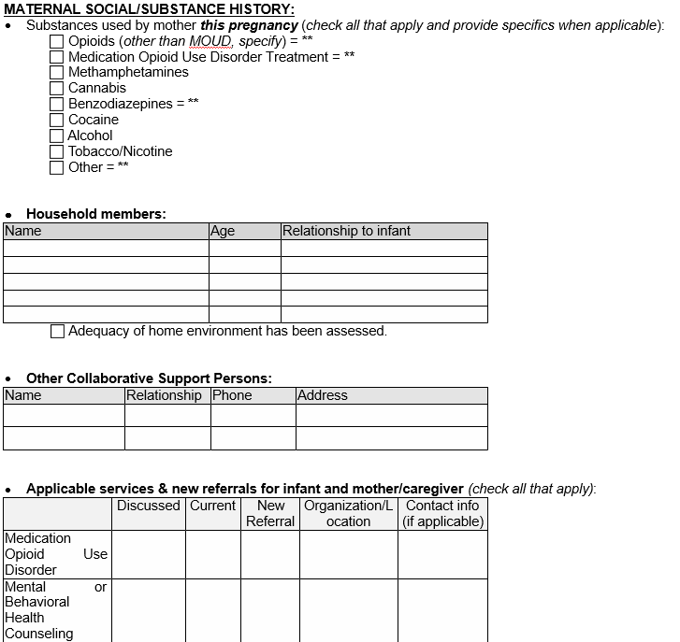
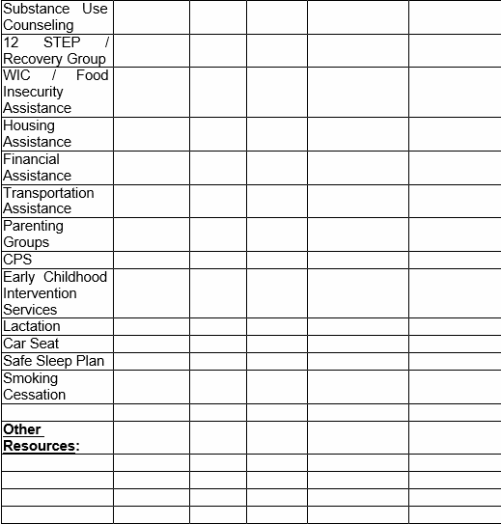
DH POSC Example

Slide 9
UCH PeAR Collaborative Committee
Mission (a statement focused on today’s goal and what we as a group are doing to achieve it): The PCC exists to strengthen collaboration and coordination of care between the interdisciplinary teams who provide care for pregnant and parenting people, and their families, impacted by substance use across the outpatient and inpatient clinical care settings.
Vision (where we aspire to see this work go): By successfully fulfilling our mission, the PCC will provide care for patients and families impacted by perinatal substance use that is compassionate, trauma-informed, and equitable—creating the space to receive healthcare that is safe, respectful, and healing.

Slide 10
PeAR Collaborative Committee
Includes:
Outpatient prenatal care providers (MD, PA, CNM)
Outpatient RN Care Management
Outpatient OB SW
Outpatient Integrated Behavioral Health/Psychology/Psychiatry
Inpatient Mom-Baby RN Manager
Inpatient SW
Inpatient Peds/NICU MD, NP
Inpatient Integrated Psychology/Psychiatry
Inpatient Addiction Medicine Consult Team
Lactation
Format:
Monthly recurring meeting
policy, workflow, implementation updates
Patient case discussion and care planning
To Come: Shared Epic Patient List

Slide 11
Discussion
Questions
Thank you!

