Slide 1
The Challenge of Fentanyl in Buprenorphine Treatment
Kaylin A Klie, MD, MA, FASAM
Addiction Medicine
University of Colorado and Denver Health
ICWB Shared Learning
March 28th, 2022

Slide 2
Discussion Today:
Low Dose Buprenorphine Initiation Strategies
Inpatient
Outpatient
Pregnancy Considerations

Slide 3
Low Dose (“microdosing”)buprenorphine
Current guidelines recommend leaving a sufficient time period since the last full agonist use to monitor for withdrawal
This time period limits the risk of precipitated withdrawal
Patients struggle with withdrawal symptoms to begin a buprenorphine induction in general
This is especially the case with longer acting opioids, including methadone
Tapering full agonist opioids in anticipation of beginning a buprenorphine induction can lead to relapse
May be most difficult with fentanyl: both short and long-acting properties
Hammig et al, Substance Abuse and Rehabilitation, 2016

Slide 4
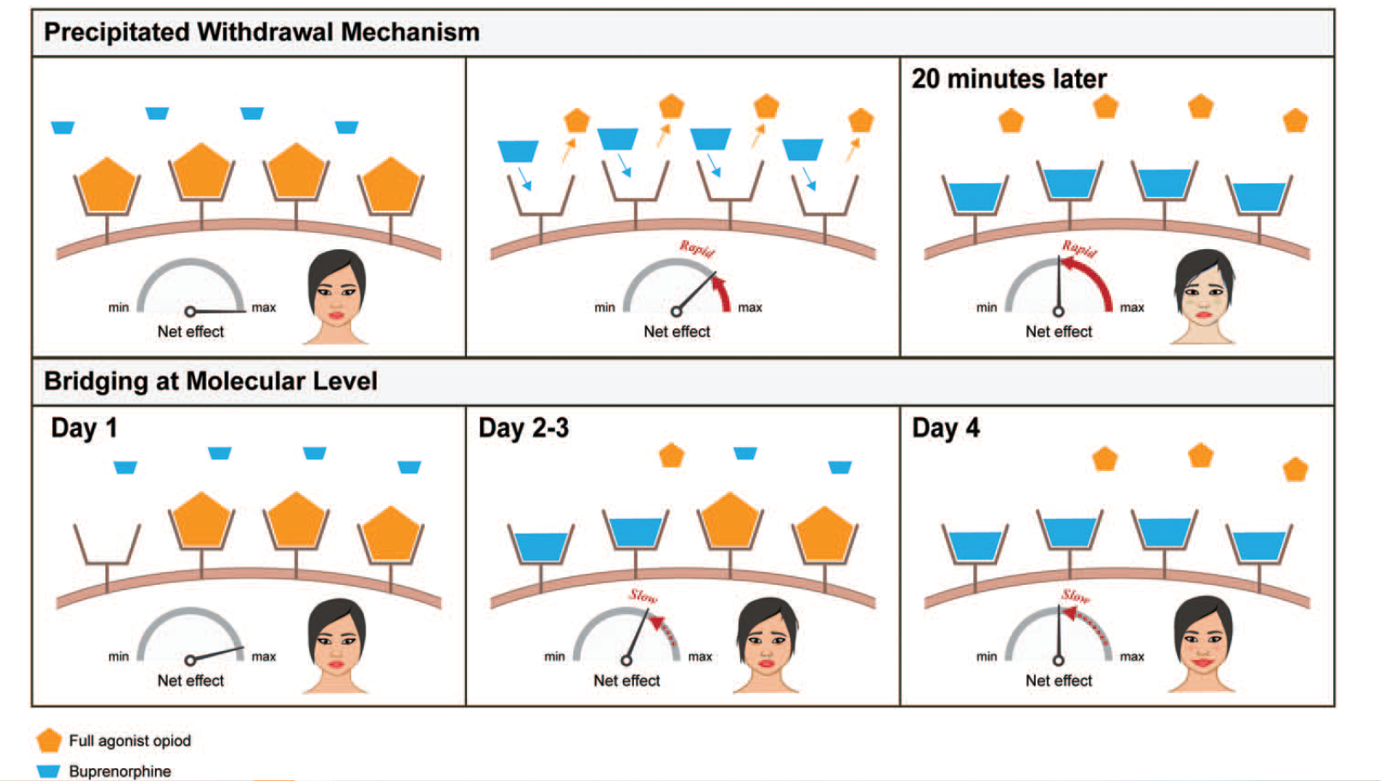
Ghosh SM et al, Canadian J of Addiction, 2019

Slide 5
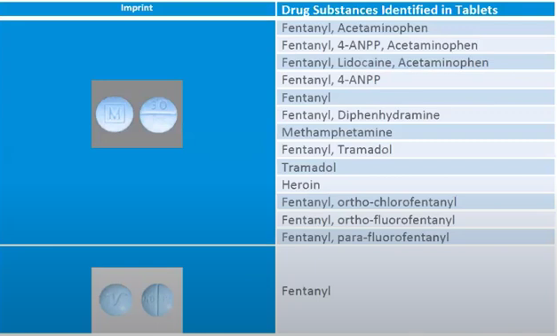
Patient Case: Inpatient
Pt is 32 yo F G3P1011 at 28 w4d, presents to OB triage with vaginal discharge and cramping.
Reports 10-20 “blues” per day, smoked
Taking 100mg methadone “every few days, when I can make it to the clinic, I don’t have a car”
Strongly desires treatment, inquires about buprenorphine so does not have to come to methadone clinic daily
Admitted to antepartum service
Last use 4 hours prior to admission, COWS on admit 14
It is now 12am on a Saturday night, naturally

Slide 6
Goal #1: Manage Withdrawal
While in the hospital or ER setting, it is completely legal to give ANY opioid for the treatment of opioid withdrawal
Not all opioids are created equally: may need to give both IR and ER formulations to prevent having to rescore and dose every 2 hours
Want to ensure providing enough coverage with whatever opioid you choose to reduce COWS to <4, hopefully to 0 without over-medicating/sedating
Use all the adjuvants
Ondansetron
Hydroxyzine
Tizanidine
Clonidine
etc

Slide 7
Goal #2: Shared Decision Treatment Plan
Option #1: Continue methadone, and titrate to effective dose while in the hospital
Option #2: Continue full agonist opioids for 72 hours from last fentanyl use, then start buprenorphine via traditional route
Option #3: Continue full agonist opioids and start low-dose buprenorphine treatment plan
Plot twist: pt’s Qtc on admission EKG is 505

Slide 8
Buprenorphine Dosing Plan - SL
Day | Buprenorphine Dose | Tab | Full Opioid Agonist Dose
1 | 0.5 mg qd | Quarter of 2 mg tab | Same
2 | 0.5 mg bid | Half of 2 mg tab | Same
3 | 1 mg bid | Full 2 mg tab | Same
4 | 2 mg bid | Two 2 mg tabs | Same
5/6 | 4 mg bid* | Half of 8 mg tab | Same
7 | 8 mg bid | Full 8 mg tab | Off
*Can repeat days if patient develops withdrawal, achiness
Chou et al, J Pain 2014
Terasaki et al Pharmacotherapy 2019

Slide 9
Buprenorphine Dosing Plan - Patch
Day | Buprenorphine Dose | Full Opioid Agonist Dose
1 | 20 mcg patch | Same
2 | 1 mg SL BID | Same
3 | 2 mg SL BID | Same
4 | 4 mg SL BID | Same
5 | 6 mg SL BID | Same
6 | 8 mg SL BID | OFF
Supportive Medications (ondansetron, loperamide, hydroxyzine, tizanidine, clonidine, dicyclomine)
Button D, Hartley J, Robbins J, Levander XA, Smith NJ, Englander H. Low-dose Buprenorphine Initiation in Hospitalized Adults With Opioid Use Disorder: A Retrospective Cohort Analysis. J Addict Med. 2021.

Slide 10
Buprenorphine Dosing Plan - IV
Day | Buprenorphine | Full Opioid Agonist Dose
1 | 0.15 mg IV q6h x2 doses | Same
1 | 0.3 mg IV q6h x2 doses | Same
2 | 0.6 mg IV q6h x2 doses | Same
2 | 4 mg SL q6h x2 doses | Same
3 | 8 mg SL q6h x2 doses | OFF
Supportive Medications (ondansetron, loperamide, hydroxyzine, tizanidine, clonidine, dicyclomine)

Slide 11
Buprenorphine Dosing Plan – Buccal
Day | Buprenorphine Dose | Buccal Buprenorphine | Full Opioid Agonist Dose
1 |  | 225mcg once daily | Same
2 |  | 225mcg BID | Same
3 |  | 450mcg BID | Same
4 | 2 mg BID |  | Same
5 | 4 mg BID |  | Same
6 | 4 mg TID |  | Same
7 | 8 mg BID |  | Off

Slide 12
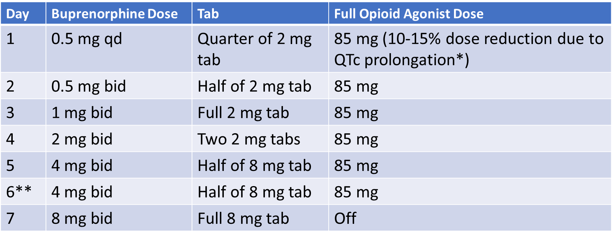
Option #3: Low-Dose Buprenorphine
Continued home methadone 100mg (restarted on admission)
Noted within first 12 hours to be inadequate to control withdrawal
Added MS Contin 30mg TID
Monday am: Addiction Consult

Slide 13
Patient Case #2: Outpatient
Pt is 24 yo G1P0 at 22w by unsure LMP
Presents to prenatal care appointment, reports daily use of fentanyl 5-10 tabs daily
Does not want to try methadone
Has been on buprenorphine within the past year, and worked well, “I just slipped up, then found out I was pregnant last week”.
Desires to restart buprenorphine, declines hospital admission

Slide 14
Outpatient Low Dose Bupe
Not so different from inpatient, except that the full agonist continued is the patient’s own fentanyl (or other opioid), not an additional prescription
It is NOT legal to prescribe any opioid except for buprenorphine in the outpatient office setting for the treatment of opioid withdrawal/use disorder
Thus, need for patient to continue with non-prescribed opioid
Adjuvants!
Narcan!
Family or other loved one support, if possible

Slide 15
Traditional Low Dose Protocol

Slide 16
Rapid Protocol

Slide 18
Pregnancy Considerations
Overall, pregnant people tend to tolerate low dose buprenorphine protocols about as well as non-pregnant people (my clinical observation)
However, it may be preferable to admit patient to the hospital for low dose buprenorphine initiation so that you can give other opioid medications, catch up on prenatal care needs, monitor fetus, etc
As all other treatment decisions, will be highly dependent on that individual’s unique desires, treatment availability in geographic area, etc.

Slide 19
Thank you!
Questions/Discussion?
Cases?

