Slide 1
Long-acting, Injectable Medication for Addiction in Pregnancy

Slide 2
Objectives:
Review the indications and pharmacology of long-acting, injectable Naltrexone and Buprenorphine
Discuss the risks and benefits of long-acting, injectable medications
Identify different processes of accessing this medication for clients

Slide 3
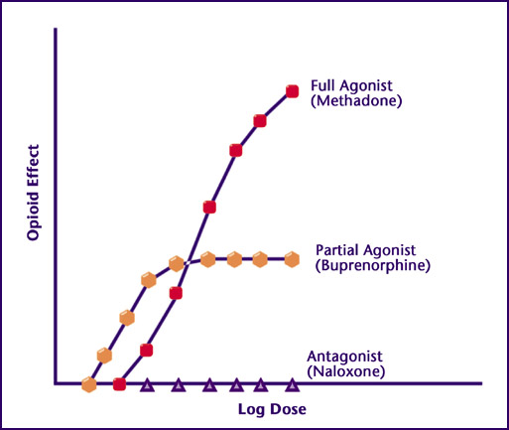
NALTREXONE
FDA-approved indications: Alcohol use disorder, Opioid use disorder
Off label use: methamphetamine use disorder
Mechanism of action: Opioid antagonist.
For alcohol this is thought to reduce a major pathway of reinforcement and thus reduce appetite for alcohol. Cravings generally extinguish with time
For opioid use disorder, due to blockade of the receptor, opioids are unable to have an effect on the individual receptor. Cravings generally extinguish with time.
Start:
For alcohol it can be started while drinking
For opioids it cannot be started until 7-10 days after last opioid use for an opioid dependent person
Outcomes:
For alcohol, use of naltrexone is associated with fewer heavy drinking days, decreased alcohol consumption, and decreased health care utilization (particularly ED visits)
For opioids, use of naltrexone is associated with a significant reduction in opioid use, increased engagement in treatment, and reduction in overdose (if the patient is able to get onto the medication)
Contraindicated in severe liver disease (LFTs > 5x normal)

Slide 4
NALTREXONE - Alcohol
Not pregnant patients
RESULTS We included 122 RCTs and 1 cohort study (total 22 803 participants). Most assessed acamprosate (27 studies, n = 7519), naltrexone (53 studies, n = 9140), or both. The NNT to prevent return to any drinking for acamprosate was 12 (95% CI, 8 to 26; risk difference [RD], −0.09; 95% CI, −0.14 to −0.04) and was 20 (95% CI, 11 to 500; RD, −0.05; 95% CI, −0.10 to −0.002) for oral naltrexone (50 mg/d). The NNT to prevent return to heavy drinking was 12 (95% CI, 8 to 26; RD −0.09; 95% CI, −0.13 to −0.04) for oral naltrexone (50 mg/d). Meta-analyses of trials comparing acamprosate to naltrexone found no statistically significant difference between them for return to any drinking (RD, 0.02; 95% CI, −0.03 to 0.08) or heavy drinking (RD, 0.01; 95% CI, −0.05 to 0.06). For injectable naltrexone, meta-analyses found no association with return to any drinking (RD, −0.04; 95% CI, −0.10 to 0.03) or heavy drinking (RD, −0.01; 95% CI, −0.14 to 0.13) but found an association with reduction in heavy drinking days (weighted mean difference [WMD], −4.6%; 95% CI, −8.5% to −0.56%).

Slide 5
NALTREXONE - Alcohol

Slide 6
Naltrexone - Opioids
2020
A total of 230 patients were studied: 121 patients with naltrexone compared with 109 patients with methadone or buprenorphine. No differences between groups were seen regarding demographics, the use of comedications/drugs, or obstetric outcomes. For newborn outcomes, the rate of neonatal abstinence syndrome in neonates >34 weeks gestation was significantly lower in the naltrexone medication-assisted treatment group (10/119 [8.4%] vs 79/105 [75.2%]; P<.0001). Of 87 patients who received naltrexone up to delivery, no neonates experienced symptoms of neonatal abstinence syndrome. No cases of spontaneous abortion or stillbirth occurred in either group. In 64 patients who started naltrexone therapy at 24 weeks gestation, no changes were seen in the fetal heart monitor tracing with drug initiation. The incidence of birth anomalies was no different between the groups.

Slide 7
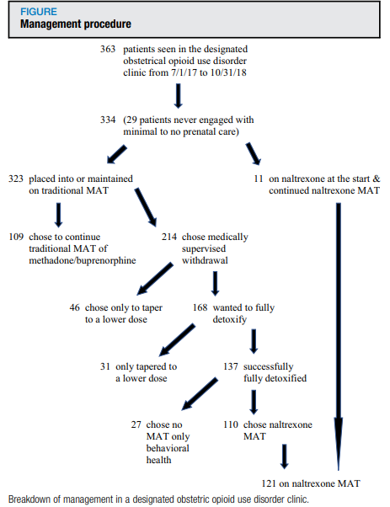
Naltrexone - Opioids
Limitations/Concerns with Naltrexone in patients dependent on opioids who are also pregnant:
Risk of precipitated withdrawal
Need to wait 7-10 days before initiating
Loss to care due to discontinuing medication
Loss of tolerance
Return to use of opioids with risk of overdose, infection, or other co-morbidities
Concerns in animal models
Pain control intrapartum
Breastfeeding safety

Slide 8
Naltrexone - Pregnancy
Methods: In this prospective case series, 7 pregnant individuals with opioid use disorder (OUD) or alcohol use disorder (AUD) treated with naltrexone were followed from pregnancy through 12 months after delivery. Clinical treatment protocols and outcomes related to safety and efficacy during pregnancy, delivery, and the postpartum period are described.
Results: There were 4 pregnant individuals with OUD and 3 with AUD, of which 3 were managed with oral and 4 with extended-release naltrexone. The mean gestational age at study enrollment was 21.7 (SD, 12) weeks. Of the 7 participants, there was no return to nonprescribed opioid use and 2 who experienced a return to alcohol use over the course of the study. All individuals delivered vaginally at a mean of 37 weeks gestation without any peripartum pain difficulties. Five of the individuals (71.4%) remained on naltrexone 12 months after delivery. There were no reported fetal anomalies and one preterm delivery. None of the infants developed neonatal opioid withdrawal syndrome.

Slide 9
Sublocade efficacy
Indivior Studies:
13-0001: BUP-ER vs placebo for 24 weeks (N=504)
mean percentage abstinence of 42.7% and 41.3% in the 300 mg/100 mg and 300 mg/300 mg arms, respectively, compared with 5.0% in the placebo arm (P < 0.0001 for each regimen compared with placebo).
Treatment success (defined as any patient with 80% or more of urine samples negative for opioids combined with negative self-reports) was statistically significantly higher in the 300 mg/100 mg (28%) and 300 mg/300 mg (29%) arms, compared with 2% in placebo (P < 0.0001).
13-0003: Extended BUP-ER up to 52 weeks (N=669)
Using the same efficacy end point as in the pivotal trial, mean percentage abstinence after 48 weeks of BUP-ER treatment was found to be 46% in newly initiated patients (de novo patients) compared with 57% of roll-over patients from Study 13-0001
RECOVER (N=826)
Data were collected up to 12 months before patients were treated with BUP-ER and up to 24 months after treatment initiation, to examine differences in criminal activity, opioid abstinence and withdrawal, depression and psychological stress, work attendance, and performance over time.
https://www.ncbi.nlm.nih.gov/books/NBK546461/

Slide 10
Sublocade efficacy
Indivior Studies:
RECOVER (N=826)
Data were collected up to 12 months before patients were treated with BUP-ER and up to 24 months after treatment initiation, to examine differences in criminal activity, opioid abstinence and withdrawal, depression and psychological stress, work attendance, and performance over time.
Changes in criminal activity from the 12 months leading up to study enrollment until up to 12 months after initiation of BUP-ER treatment found a numerically lower number of total arrests; however, the proportion of patients receiving felony charges remained the same.
Patients receiving placebo as well as those receiving BUP-ER treatment for 13 months or longer had a lower proportion of missed work days compared with patients receiving BUP-ER treatment for one to two months, three to eight months, and nine to 12 months.
Also, patients with the longest recorded treatment duration with BUP-ER were associated with numerically lower mean scores on the K6 psychological distress scale (7.8 among patients in the one-to-two month group compared with 4.0 in the 13 to 18 month group), as well as a numerically lower proportion of patients with severe depression (Beck’s depression inventory score 29 or greater).
Results from this study should be interpreted with caution as these data were largely self-reported, and therefore limited by recall bias and truthfulness of responses. Results were also subject to bias in the differential length of follow-up between treatment groups, and losses to follow-up.
https://www.ncbi.nlm.nih.gov/books/NBK546461/

Slide 11
Sublocade Vs Methadone/SL Buprenorphine
Not Pregnant
Interpretation Evaluated against the daily oral standard of care (SoC), monthly BUP-XR is clinically superior, delivering greater abstinence from opioids, and with a comparable safety profile. BUP-XR was not cost-effective in a base case cost-utility analysis using the societal perspective, but it was more effective and less costly (dominant) among participants with more severe OUD, or those whose current treatment episode was longer than 28 days. Further trials are needed to evaluate if BUP-XR is associated with better clinical and health economic outcomes over the longer term.
The Lancet. eClinicalMedicine 2023;66: 102311 Published Online 17 November 2023 https://doi.org/10. 1016/j.eclinm.2023. 102311

Slide 12
Sublocade in pregnancy
Few published articles currently. Majority are small case studies. Buprenorphine has been established as safe in pregnancy the question is about Atrigel component.
General consensus is that extended-release buprenorphine can be pursued in pregnancy if after a patient-centered discussion the benefits outweigh risks. No current reports of increased fetal complications
Risks include feeling of withdrawal after day 14 during first 1-3 injections that can be managed with additional buprenorphine and feeling sense of overmedication in first days of initial injection.

Slide 13
Interpretation:
In this population it is more difficult to initiate patients to XR-NTX than BUP-NX, and this negatively affected overall relapse. However, once initiated, both medications were equally safe and effective. Future work should focus on facilitating induction to XR-NTX and on improving treatment retention for both medications.
As expected, XR-NTX had a substantial induction hurdle: fewer participants successfully initiated XR-NTX (204 [72%] of 283) than BUP-NX (270 [94%] of 287; p<0·0001). Among all participants who were randomly assigned (intention-to-treat population, n=570) 24 week relapse events were greater for XR-NTX (185 [65%] of 283) than for BUP-NX (163 [57%] of 287; hazard ratio [HR] 1·36, 95% CI 1·10–1·68), most or all of this difference accounted for by early relapse in nearly all (70 [89%] of 79) XR-NTX induction failures. Among participants successfully inducted (per-protocol population, n=474), 24 week relapse events were similar across study groups (p=0·44). Opioid-negative urine samples (p<0·0001) and opioid-abstinent days (p<0·0001) favoured BUP-NX compared with XR-NTX among the intention-to-treat population, but were similar across study groups among the per-protocol population. Self-reported opioid craving was initially less with XR-NTX than with BUP-NX (p=0·0012), then converged by week 24 (p=0·20).
Not Pregnant

Slide 14
Breastfeeding – ORAL Naltrexone
Naltrexone milk levels were undetectable (<2 mcg/L) by 8 hours after the dose while beta-naltrexol milk levels remained detectable throughout the study period and averaged 46 mcg/L.
The half-lives of elimination from milk were 2.5 and 7.7 hours for naltrexone and beta-naltrexol, respectively.
It is estimated that an exclusively breastfed infant would receive about 7 mcg/kg daily of naltrexone including the active metabolite, equivalent to 0.86% of the maternal weight-adjusted dosage. This is less than the detectable level on UDT
(Chan CF, Page-Sharp M, Kristensen JH, et al. Transfer of naltrexone and its metabolite 6,beta-naltrexol into human milk. J Hum Lact 2004;20:322-6)

Slide 15
BreastFeeding – SL Buprenorphine
Established as safe and the gold standard of care
Levels of buprenorphine in BF infants is frequently undetectable. The levels of norbuprenorphine is detectable in ng/mL without evidence of sedation or effect on infants exposed in utero.
Limited to no risk for sedation in infants exposed after birth
In many studies results in lower values of NOWS because BF lowers NOWS scores.

Slide 16
BREASTFEEDING on INJECTABLE Medications
Limited to no studies.
Addiction medicine experts recommend breastfeeding

Slide 17
Accessing medication
Both Sublocade and Vivitrol are considered REMS (Risk Evaluation Mitigations System) medications and as such must be obtained from a pharmacy with an agreement with the manufacturer
Vivitrol has more retail pharmacies that can order than Sublocade
Genoa pharmacy in Colorado has been able to access both around the state
Before accessing the medication for your patient, you need to know whether their insurance covers it as a medical benefit or a pharmacy benefit
Before providing the medication, you need to know your office/medical organization's policy on REMS medications

Slide 18
Accessing the medication
Example only. McKesson not a manufacturer of Vivitrol or Sublocade

Slide 19
Accessing the medication

