Slide 1
Building a recovery and pregnancy centered team
INCORPORATING PEERS, DOULAS, and contingency management INTO YOUR TEAM

Slide 2
WHY INTEGRATE

Slide 3
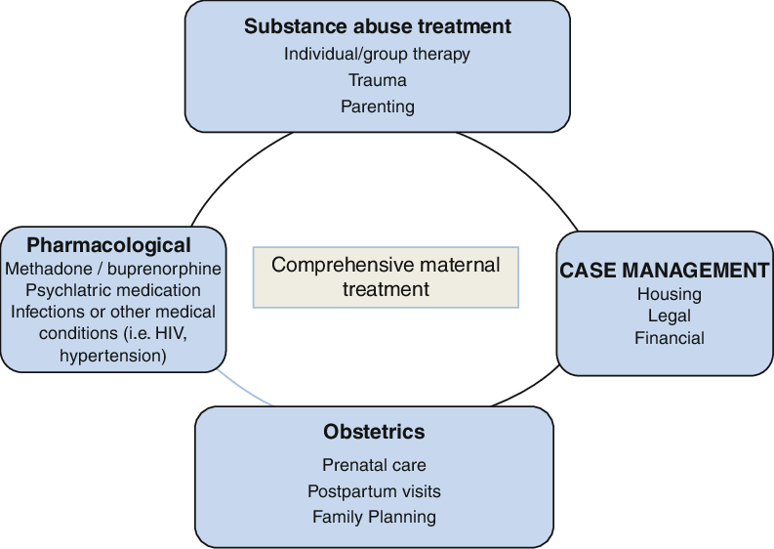
WHY INTEGRATE

Slide 5
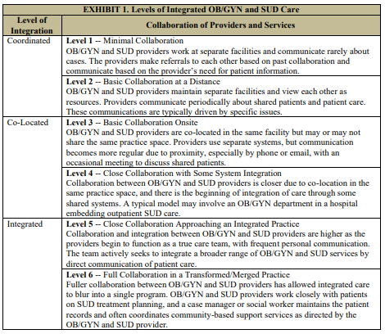
US DHHS 2022 REPORT

Slide 7
Role of a PEER | motivator and cheerleader ally and confidant truth-teller role model and mentor problem solver resource broker advocate community organizer lifestyle consultant a friend
NOT a PEER'S role | Medical care provider Case Manager Therapist Sponsor Priest/Clergy

Slide 8
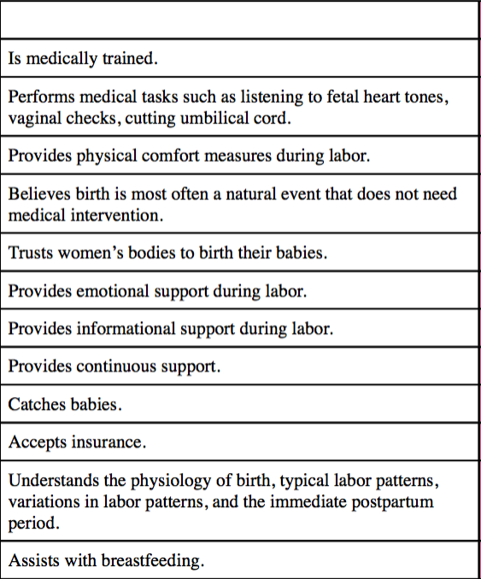
ROLE OF A DOULA

Slide 9
Combined models of care

Slide 10
Combined models of care

Slide 11
WHAT is CM
OPERANT CONDITIONING
Something is added to
increase the likelihood of
a behavior
BOGO, Loyalty cards
Something is removed to
increase the likelihood of
a behavior
Mail-in-voting
Flossing after having a
cavity filled
Positive
Reinforcement
Negative
Reinforcement
Positive
Punishment
Negative
Punishment
Something is added to
decrease the likelihood of
a behavior
Fines/fees
Something is removed to
decrease the likelihood of
a behavior
Loss of driver's license,
Jail/Prison

Slide 12
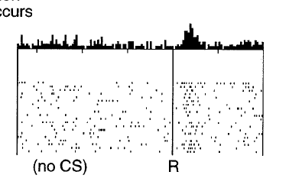
Operant Conditioning in Substance Use Disorder
Something is added to
increase the likelihood of
a behavior
Intoxication, Concurrent use,
Reward prediction error
Treatment: CM, Exercise
MOUD agonist, therapy
Positive
Reinforcement

Slide 13
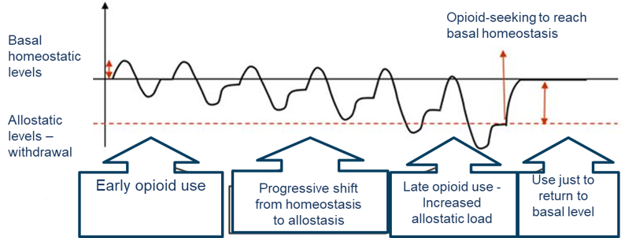
Operant Conditioning in Substance Use Disorder
Something is removed to
increase the likelihood of
a behavior
Withdrawal, Cravings
Treatment: MAT
Negative
Reinforcement

Slide 14
Operant Conditioning in Substance Use Disorder
Positive
Punishment
Something is added to
decrease the likelihood of
a behavior
Treatment: DUI classes,
Probation, Drug Court
Negative
Punishment
Something is removed to
decrease the likelihood of
a behavior
Treatment : mandated
Residential treatment,
Jail/Prison, Loss of
license

Slide 15
WHY CM
Using positive reinforcement to reward a behavior, hoping to replace a related negative behavior
Using the same pathway in the brain that initially started the substance use process
Evidence supported outcomes
Lack of other treatment options

Slide 16
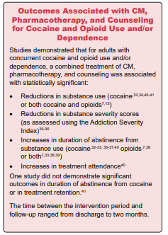
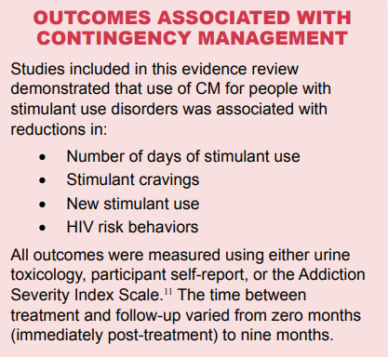
OUTCOMES

Slide 17
OUTCOMES
Long-term efficacy of contingency management treatment based on objective indicators of abstinence from illicit substance use up to 1 year following treatment: A meta-analysis
Ginley, M. K., Pfund, R. A., Rash, C. J., & Zajac, K. (2021).
Results: The overall likelihood of abstinence at the long-term follow-up among participants who received CM versus a comparison treatment (nearly half of which were community-based comprehensive therapies or protocol-based specific therapies) was OR = 1.22, 95% confidence interval [1.01, 1.44], with low to moderate heterogeneity (I² = 36.68). Among 18 moderators, longer length of active treatment was found to significantly improve long-term abstinence.

Slide 18
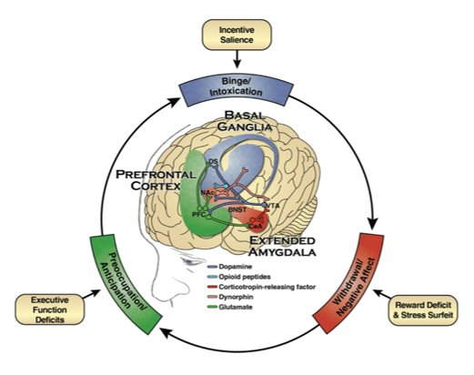
CM, a crucial adjunct treatment to buy time
Comparison of Treatment Course
 | Opioids | Stimulants
Accessing treatment | MOUD available and offered to address withdrawal and cravings | No FDA approved MOUD to encourage treatment, therapy and recovery support mainstay of treatment
Stabilizing in treatment | MOUD increased to effect of no further substance use, therapy can be introduced | Must endure withdrawal and cravings while trying to engage with treatment
Remaining in treatment | 60% or more retention at 1 year with MOUD | Without CM retention rates are less than 50% at a year

Slide 19
If you have seen one CM program, you have seen one CM program
Step 1: Choose the model that fits for your clinic
BUILDING YOUR CM PROGRAM
Voucher-Based Reinforcement Therapy | Fishbowl Method
Reward every behavior every time Continued behavior changes is incentivized by growing rewards, resulting in greater cost Preferred by patients Potential to delay reward for a larger reward | Every behavior has the potential to be rewarded Continued behavior changes is incentivized by growing rewards, cost is controlled by odds Often preferred by payers Requires immediate reward
Step 2: Choose your rewards
Cash/Debit Card
Gift cards
Goods/Food/Services
Reward closet vs Scheduled receipt with escalating value
Hybrid of multiple above

