Slide 1
ICWB Continuum of Care DIAGNOSIS AND THEN WHERE?
Kaylin Klie, MD
Ryan Jackman, MD

Slide 2
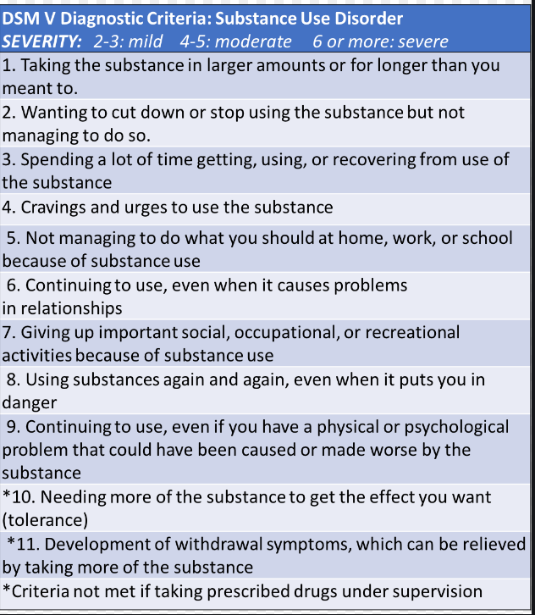
How to Diagnose a Substance Use Disorder
The Takeaway: 5 Cs
Craving
Compulsive Use
Continued Use Despite Harm
Impaired Control
Chronicity
Notably Absent from Criteria:
Urine toxicology result
Legal Consequences

Slide 3
Navigating the Diagnosis
Universal Screening
Not toxicology
Evidenced-based tool
Prevention and anticipatory guidance!
SBIRT
Please visit www.sbirtcolorado.org
Calendar of trainings, as well as opportunity to request specific trainings at your clinical site
Links to validated screening tools for adult, adolescent, and/or pregnant people

Slide 4
Screening: Ask validated questions to identify alcohol or other substance use.
Brief Intervention: A short conversation to provide feedback and enhance motivation to change.
Referral to Treatment: Further assessment and initiate services for substance use disorder and related needs.

Slide 5
Brief Negotiated Interview
Raise the subject
Provide feedback
Enhance motivation
Negotiate next steps

Slide 6
Step 1: Raise the Subject
“We ask all patients questions about alcohol and other substance use. Would it be ok to discuss your screening results?”
Ask permission to have the conversation
Notes:
In step 1 you simply engage the patient in the conversation by asking permission to discuss their screening result or to discuss how alcohol or drug use could be affecting their health.
This is consistent with the spirit of motivational interviewing because it respects autonomy .

Slide 7
Step 2: Provide Feedback
Review reported alcohol or other substance use.
Ask what they know about substance use and their health.
Discuss any questions or concerns about their use.
Advise to reduce use and consider cessation.
Don’t give too much information.
Always ask the patient what they think about the information.
Notes:
In step 2 you provide feedback.
Feedback should express concern, be personalized, nonjudgmental and tied to the primary concerns of the patient.
The best way to do this is to explore with the patient how alcohol could interfere with their health, their goals and their values.
Some ways to provide feedback include:
Review the screening results and explore reasons for their current level of drinking or drug use.
Describe lower risk drinking limits for adult women or men and express concern that exceeding the limits could lead to future problems or exacerbate existing problems.
Connect alcohol to the chief complaint or current health problems.
Here are two important points about providing feedback:
First, don’t give too much information! Health professionals often give a lot of information hoping that it will convince a person to change ...but really it may overwhelm a person and does not enhance readiness to change.
Second, always ask the patient what they think about the information by asking, “What do you think about this information?” This helps promote a real conversation. The patient may not agree with the information, or they may see the situation differently. You need to know this in order to provide effective care.

Slide 8
Step 3: Enhance Motivation
Assess Importance
“On a scale of 0 -10, how important is it to change your relationship with X substance, where 0 is not at all and 10 is very important?”
Then ask:
“What made you choose X and not a lower number?”
How important is this change for you?
Notes:
Step three of the brief intervention is focused on enhancing motivation to change.
One of the most useful techniques is to ask about importance of the change. Here’s how:
The number they choose gives an indication of how ready they are to change but the primary reason this technique is useful is because it encourages “change talk”. In other words, it gives the patient the opportunity to speak in favor of change rather than against change. When the health professional asks why not a lower number it often prompts the person to give reasons why change might be a good idea even if they are not ready to change yet. When we allow patients to hear their own voice speaking in favor of change, it helps them move closer to actually being ready to change.
If a person chooses ‘0’ for importance or readiness which happens rarely, first acknowledge it, and then reinforce their autonomy - for example by saying, “It is totally up to you whether or not to change.” Or, “You will know best if it’s a good idea to make a change.” GOAL: Continue the conversation.

Slide 9
Step 3: Enhance Motivation
Assess Confidence
“On a scale of 0 -10, how confident are you
that you will be able to change your substance use if you decide to?”
Then Ask:
“What made you choose X?”
“What could help you feel more confident?”
Not Confident
Confident
How Confident Are You?
Notes:
Assessing confidence about making a change can also enhance motivation. Many people are reluctant to change because they are afraid to fail. Bringing their concerns out into the open helps normalize that ambivalence is common and change is difficult. It also helps you identify specific challenges and barriers to change; and explore strengths and practical, effective strategies will be effective.

Slide 10
Step 3: Enhance Motivation
“Why might you want to make a change in your substance use?” Why now?”
“What would you need in order to be successful?”
“What are some of the best reasons to work on this change?”
“How does your substance use fit with what matters most to you at this time in your life?”
Notes:
A few more examples of open-ended questions that can help a patient explore and resolve ambivalence and enhance motivation to change.

Slide 11
Step 4: Negotiate Next Steps
Affirm Autonomy
2. Explore the patients’ ideas first: “What next steps make sense for you?”
Negotiate a goal/tangible next step with patient.
3. Discuss this identified next step. Then ask:
“What will be challenging?”
“How could you handle these challenges?”
“Who can support you in making this change?”
4. Summarize and arrange next steps and follow-up→ could be Referral to Treatment
5. Suggestion: develop a comfortable, genuine way to express gratitude for patient’s vulnerability in having this discussion. Mutual positive reinforcement. ☺

Slide 12
I have a diagnosis – Now where do I send my client/patient The ASAM Placement Criteria
What?
A framework that can significantly impact practice depending on your state (not all states use ASAM criteria)
Who?
CO BHA/CO Medicaid use ASAM criteria, as do most private insurers
Policy makers
Treatment centers, clinicians
Patients/Families?

Slide 13
Levels of Care per ASAM Criteria

Slide 14
Summary of the Service Standards for Outpatient Levels of Care
 | Remission Monitoring (1.0) | Outpatient Therapy (1.5) | Medically-Managed Outpatient (1.7) | Intensive Outpatient Treatment (2.1) | High-Intensity Outpatient Treatment (2.5) | Medically-Managed High-Inensity (2.7)
MD | Variable | Not typical | Yes | Not typical | Yes | Yes
RN | Not typical | Not typical | Variable | Not typical | Variable | Yes
Program Director | Variable | Yes | Variable | Yes | Yes | Yes
Physical Exam | Annually | Within 1 month of intake | At initial assessment | Within 14 days of admission | Within 7 days of admission | Within 24-48 hours of admission
Clinical Hours | Quarterly visit (minimum) | < 9 hours/week | < 9 hours/week | 9-19 hours/week | ≥ 20 hours/week | ≥ 20 hours/week
Clinical Services | Recovery and remission management services | Direct psychosocial services | Direct withdrawal management services; Management of common psychiatric conditions; Psychosocial services | Direct psychosocial services; Therapeutic milieu | Direct psychosocial services; Therapeutic milieu | Direct withdrawal management services with nurse monitoring; Management of common psychiatric conditions; Psychosocial services

Slide 15
Summary of the Service Standards for Inpatient Levels of Care
 | Clinically Managed Low-intensity Residential (3.1) | Clinically Managed High-intensity Residential (3.5) | Medically Managed Residential (3.7) | Medically Managed Inpatient Treatment (4.0)
Supervision | Client may leave independently | 24 hour supervision | 24 hour supervision | 24 hour supervision
MD | Not typical | Available to review admission decisions | Available onsite or for 24/7 telemedicine | Available onsite 24/7
RN | Not typical | Variable | Available 24/7 | Available 24/7
Program Director | Yes | Yes | Yes | Variable
Physical Exam | Within 14 days of admission | Within 72 hours of admission | Within 24 hours of admission | Within 24 hours of admission
Clinical Hours | 9-19 hours/week | > 20 hours/week | >20 hours/week | Variable
Clinical Services | Direct psychosocial services; Therapeutic milieu | Direct psychosocial services; High-intensity Therapeutic milieu | Direct withdrawal management services and biomedical services; Management of common psychiatric disorders; Psychosocial services | Direct withdrawal management services and biomedical services (ICU available); Psychiatric services; Psychosocial services

Slide 16
ASAM Criteria Dimensions of Care

Slide 17
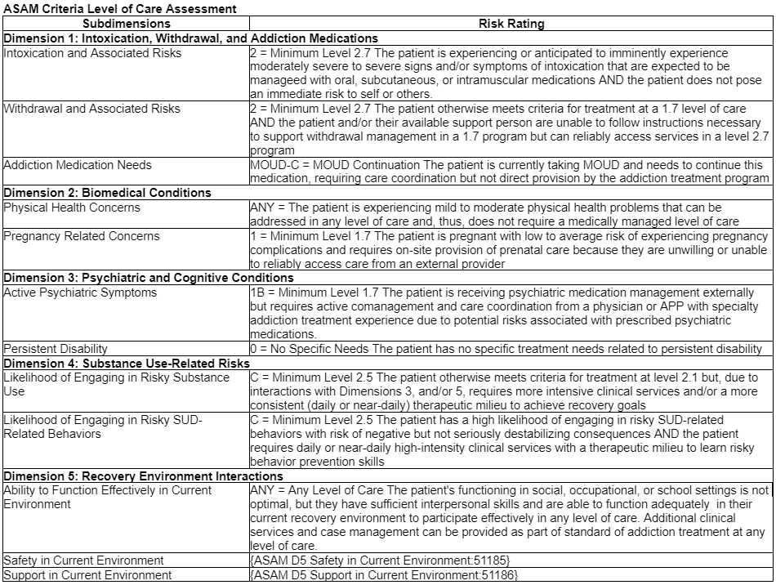
What an ASAM Criteria Dimension Guided Assessment Can Look Like

Slide 18
Questions

