Slide 1
The Six Building Blocks: A Team Based Approach to Improving Opioid Management in Primary Care
Shared Learning Call
Cohort II Kickoff
September 23, 2021

Slide 2
Agenda
Welcome – Kyle Knierim
Introductions – Kathy Cebuhar
What are Shared Learning Calls? - Kathy
Highlights from our Subject Matter Experts – Amy Wachholtz & Rachael Rzasa
Feedback from Cohort 1 – Taylor Miranda Thompson
Logistics & Measurements – Andrew Bienstock

Slide 3
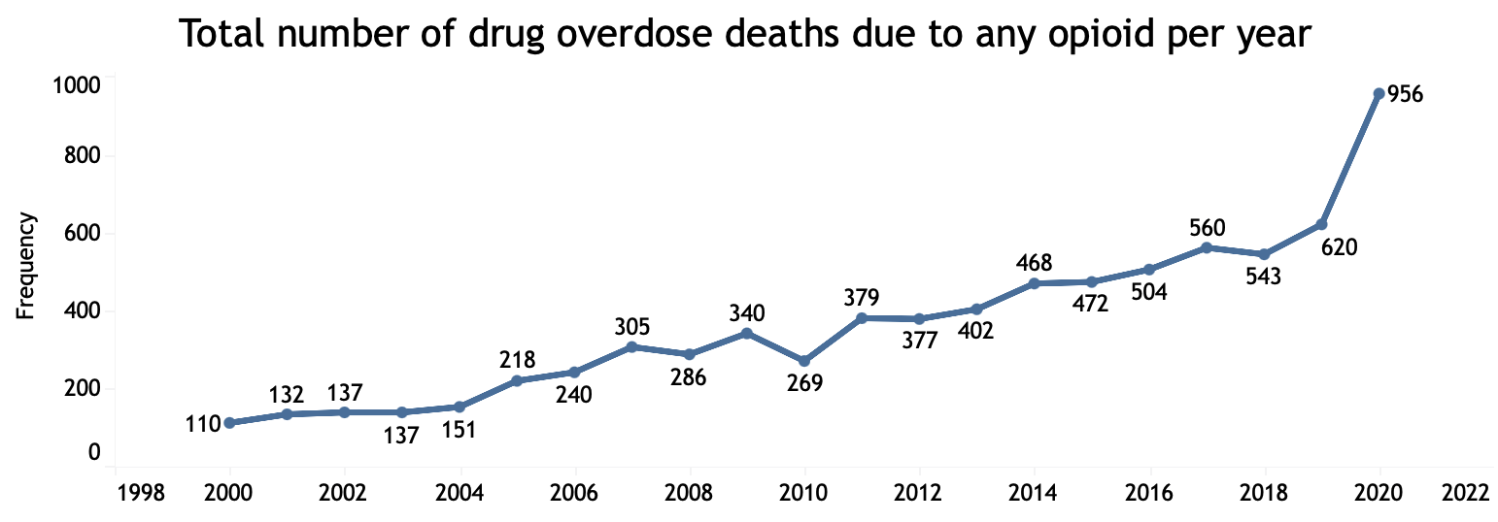
Why Are We Here?
Source: Link to CDPHE Drug Overdose Dashboard
Notes:
Why are we here. Overdose death rates of any opioid – prescribed or otherwise is up 9 fold in the last 2 decades. Covid has accelarated the trend.
Funding from CDPHE and the CDC’s Overdose Data to Action program. Started 2019, running for 3 years. we are one strategy they are funding to engage health care system

Slide 4
Goals
Reduce risky opioid prescribing by 5%
Risky = morphine equivalent dose (MED) of 90 or higher, co-prescribed benzodiazepines
Offer all patients on COT integrated BH services
I.e. screening and brief interventions for risky substance use or co-morbid psychological issues, brief interventions for pain management, warm handoffs, etc.
Increase patients on COT in longitudinal integrated BH services by 5%
Longitudinal defined as 3+ interactions

Slide 5
6 Building Blocks
Leadership and Consensus
Policies, patient agreements, workflows
Tracking and monitoring patient care
Planned, patient centered visits
Caring for complex patients
Measuring success

Slide 6
Why use the 6BB model?
Clinics who have gone through this program have shown:
Reduction in risky opioid prescribing¹
Increased confidence and comfort in care provided to patients with long-term opioid therapy²
Increased collaboration among clinicians and staff²
Improved ability to respond to external administrative requests²
Improved relationships with patients using long-term opioid therapy²
An overall decrease in stress²
1. Annals of FM. VOL. 17, NO. 4, JULY/AUGUST 2019.
2. JABFM. Sep 2019, 32 (5) 715-723; DOI:10.3122/jabfm.2019.05.190027
More on the 6BB program and their results can be found through this link.

Slide 7
Introductions
Tell us your name
Organization
Show us the mug or cup you're using this morning. Does it have special meaning?

Slide 8
Shared Learning Calls
Benefits
Expectations
Opportunity for bi-directional communication with project team
Access to subject matter experts
Peer-to-peer connection
Access to resources and best practices for your clinics
Opportunity to troubleshoot issues
Regular attendance
Report out from all attendees on progress from the previous month
Cameras on to facilitate meaningful engagement
Open and trusted communication

Slide 9
Introducing Pain Psychology
Amy Wachholtz, PhD, MDIv, MS
Director Clinical Health Psychology
University of Colorado Denver
Amy.Wachholtz@ucDenver.edu

Slide 10
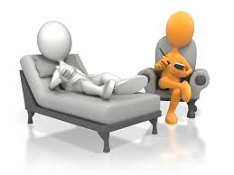
Language Matters
Don’t use “pain coping”
Socratic approach/Motivational Interviewing to getting buy-in
How much has pain taken from you?
Are you happy with your life right now?
What would you do if pain/medications controlled less of your life?
BH Pain Treatment can help you get back your life
Strongly supported by research

Slide 11
Anticipate Concerns
“My provider thinks I’m lying about my pain”
“Does my provider this its all in my head?”
“Does this mean I’m crazy?”
“What are they going to do? Talk me out of my pain?”

Slide 12
Making the Connection
If you have someone of similar age/culture/language who can share how much it helped them live or in brochure
Warm handoffs if possible, even in tele-health

Slide 13
In the pain psychology segments…
We will discuss what pain psychology is and why it is fundamental to pain treatment
Why pain psychology is more than just “coping with pain”
Introducing pain psychology to your patient to increase follow through
How to address resistant patients
How to assess mental health issues pain patients (HINT: Its NOT the PHQ-9!)
Methods of measuring if treatment is working
Brief objective monitoring approaches for patients on opioids
Some of the pain psychology treatment approaches a patient may experience
Assessing for addiction and diversion

Slide 14
Approach to Chronic Low Back Pain
Rachael Rzasa Lynn, MD
Associate Professor, Department of Anesthesiology
University of Colorado School of Medicine

Slide 15
Diagnosis
Age-specific prevalence estimates of degenerative spine imaging findings in asymptomatic patientsª
Identify the pain generator
May not always be possible
May be multiple
History and Exam are critical
Use imaging to confirm or precisely localize
Imaging abnormalities are common and not always relevant
Imaging Finding | Age (yr)
 | 20 | 30 | 40 | 50 | 60 | 70 | 80
Disk degeneration | 37% | 52% | 68% | 80% | 88% | 93% | 96%
Disk signal loss | 17% | 33% | 54% | 73% | 86% | 94% | 97%
Disk height loss | 24% | 34% | 45% | 56% | 67% | 76% | 84%
Disk bulge | 30% | 40% | 50% | 60% | 69% | 77% | 84%
Disk protrusion | 29% | 31% | 33% | 36% | 38% | 40% | 43%
Annular fissure | 19% | 20% | 22% | 23% | 25% | 27% | 29%
Facet degeneration | 4% | 9% | 18% | 32% | 50% | 69% | 83%
Spondylolisthesis | 3% | 5% | 8% | 14% | 23% | 35% | 50%
AJNR Am J Neuroradiol. 2015 Apr; 36(4): 811–816.

Slide 16
Sources of Low Back Pain
Muscles
Joints
Facets
Sacroiliac
Discs
Nerves

Slide 17
Muscular Pain
Localized but not precise
May be migratory
Worse with activity, better with rest
May see muscle spasm, asymmetry
TTP with palpable bands or points

Slide 18
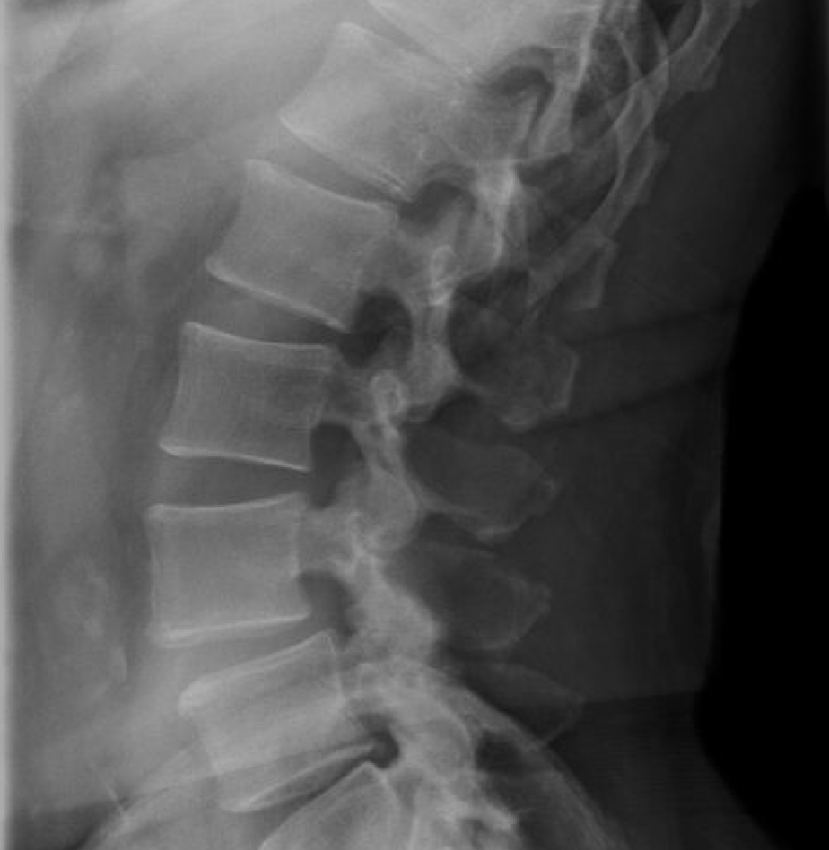
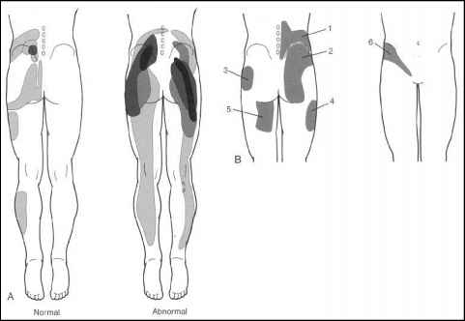
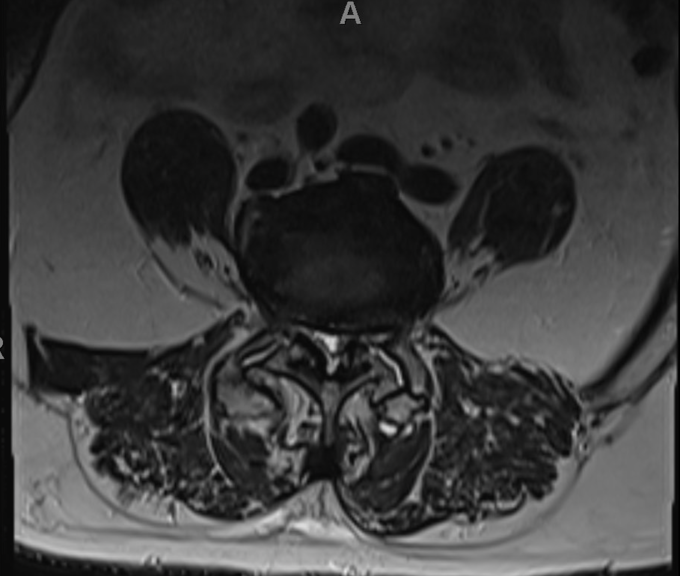
Joints: Facets
Paraspinal, may refer laterally or into gluteal regions
Pain worse with motion
Stiffness
May improve with NSAIDs, steroid
TTP over paraspinals
Worse with extension
Notes:
Focal muscle spasms

Slide 19
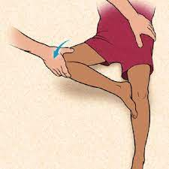
Joints: Sacroiliac
Usually well localized but may refer into sacral, gluteal, upper thigh regions
Fortin’s finger
Pain with transition from sit to stand
May respond to NSAID, steroids
Maneuvers to stress
FABER/Patrick’s, Gaenslen, thigh thrust, compression, distraction

Slide 20
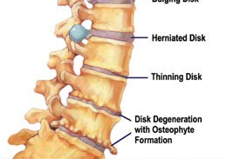
Discs
Discogenic pain
Axial, non-radicular
Aggravated by:
Axial load (sitting/standing)
Forward flexion
Cough
Alleviated by:
Supine position
Maybe extension

Slide 21
Nerves
Pain is shooting, maybe paresthesia
Radiculopathy
Look for dermatomal pattern vs referred
Positive SLR or slump or femoral stretch
Claudication
Claudication (pain improves with sitting/rest)
Flexion may help, extension worsens
Cauda Equina

Slide 22
Outcomes & Takeaways from Cohort 1
Clinical Quality Measures
PDMP Reports*
6BB Change Package Assessment Data
Keynote Interviews with practice staff
Notes:
In terms of eval, we have 4 key sources of data -
CQMs using a platform that was built by the University and has been used for many projects. 5 CQMs – in a typical program would ask practices to report on a rolling quarterly basis, for cohort 1 we've asked practices to report twice.
PDMP Reports – All of our practices have provided rosters with DEA number. Allows the state to pull detailed PDMP reports for practice – number of COT patients, number of patients on high dose opioids, benzodiazepenes, multiple providers, how many are prescribing at the practice, etc. Delay due to turnover at the state, BUT we feel in cohort 2 these reports will be extremely valuable. Intent – diving into a chart (5 patient example)
6BB Assessment – Change package developed by UW, assesses "score" of practices at each adminstration to monitor progress along the BBs
KEynote interviews- The University has completed interviews with each practice to learn about the key supports, challenges, and changes made from the practice perspective.

Slide 23
Clinical Quality Measures
In both practices, total number of Chronic Opioid Therapy (COT) patients* (non-cancer pain) went down
When looking at patients on high-dose opioids (>90 MME):
Practice A did not report any patients >90 MME
Practice B was unable to report at baseline, however, they were able to successfully report the measure by the end of the project
Collected 3 BH-related measures
Practice A was initially unable to report at baseline, and they were able to report all 3 measures by the end of the project.
Practice B was unable to report BH measures throughout the project. This was initially a practice without integrated BH, in a rural setting. By the end of the project, they had hired an integrated BHP.
Chronic Opioid Therapy PDMP definition:
Count of any patient who filled at least one script in calendar quarter AND filled prescriptions that cover 60+ days in the 90 days preceding the most recent fill date
Notes:
Made some adjustments to reporting to ease burden – only collected at 2 points. Practices started at very different places- Practice A began with 4 COT patients; Practice B began with 103 at baseline. At most recent reporting, Practice A reported 2 COT patients and Practice B reported 79.
High-dose opioids, measuring >90 MME
-Practice A did not report any patients >90 MME
-Practice B was unable to report at baseline, however, one of the areas they have been working on is to develop a registry with the capability to pull in data from prescriptions. At second reporting, they were able to report this measure with about 17% or 21% of their patients on COT that are on high-dose opioids. This is an opportunity to further use that registry to identify these patients, get them connected to BH or alternative services, provide some education about the risks, etc.
We are also tracking three BH-related measures. Now, these were much harder for our practices to report on – primarily due to not having this logic set up.
Practice A is a fully integrated practice, BHPs and case-managers on staff in an integrated model. At baseline, unable to report all 3 measures. In Q4 2020, reported that 100% of their patients on COT (N=2) were being offered BH services internally. None of the patients were engaged long-term, and none of them were referred externally.
Practice B has been unable to report, AND they have done a substantial amount of work on improving BH. This is a rural practice with little access to community BH support. In January, they hired an internal BH provider who is involved as a new member of their team andwill suport COT patients as well as their general pop.

Slide 24
Practice Interview Highlights
Active Practices
Key Facilitation Support Areas
Accountability, Focus, Structure, Resources
Key Practice Improvements
Structured & standardized policies, patient agreements, documentation, & workflows
PDMP/EHR integration
Improved population tracking and screening
Challenges
EHR and data limitations
Medical staff capacity limitations
Overall
BH providers report improved confidence in talking with patients about: chronic pain, long-term opioids, and BH-medical integration.
Medical providers report improved confidence in talking with patients about chronic pain and making medication adjustments.
Practices reported substantial benefit from peer sharing.
Conducted by Evaluator at
the CU Department of Family Medicine
Notes:
SL
TM add: Both practices have done quite a bit of work, one practice developed all new P&Ps AND rolled out MAT to their staff alongside the opioid prescribing work. They don’t have a lot of COT patients now, but they are adding a new site and they feel more prepared and equipped to address these concerns as they come up.
Practice 2 has been working on registries to better manage the list of patients they currently have, including risk, connection to BH, ensure they are using safe refill policies. They've also onboarded BHp.

Slide 25
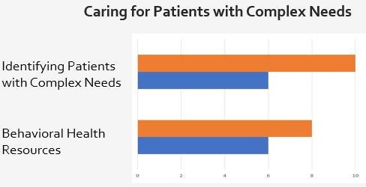
Practice Assessment Data
Practice A:
6BB Change Package
 | Practice A | Practice B
Baseline | 74 / 228 | 113 / 228
Final | 154 / 228 | 163 / 228
Practice B:

Slide 26
PDMP Measures
Number of Patients receiving Chronic Opioid Therapy
Number of Patients on high dose opioids
Number of patients with multiple types of opioids
Number of patients with opioid prescriptions from multiple prescribers
Number of patients co-prescribed benzodiazepines

Slide 27
PDMP Quarterly Data
practice_name1 | Reporting Period | clinic_provider | COT_patients | high_mme | mult_drugs | mult_providers | co_rx
Clinic A | Q2 2021 | 13 | 137 | 10 | 41 | 44 | 33
Clinic B | Q2 2021 | 2 | 6 | 0 | 1 | 3 | 3
Clinic C | Q2 2021 | 2 | 87 | 17 | 23 | 10 | 31

Slide 28
6BB Metrics

Slide 29
6BB Metrics

