Slide 1

Call Instructions:​​
Please ​​
Mute your phone, microphone, and speakers on your computer/device​​
Enter your name/preferred pronouns and organization in the chat box feature
We encourage active participation via Chat or audio​​
  Submit questions via the chat box feature​​
    Questions will be answered as submitted​​
  Unmute yourself to ask question and participate in discussions​​
Time to ask questions via audio will be offered for those on the phone​​
*6 - Toggle mute/un-mute​​
*9 - Toggle raise/lower hand
Notes:
Kathy

Slide 2


How are ISP practices (still) working on behavioral health integration and behavioral health services?
Interim Field Note Analysis
January 2022

Slide 3
What we reviewed
ISP Practice Facilitator field notes
All notes from March 2020 through December 2021

Slide 4
What we did
Summarized quantitative data
Read and summarized qualitative data
Described overall BH activity in ISP practices

Slide 5
Keep in mind
Just because we didn’t see it in a field note that doesn’t mean it’s didn’t happen
This is preliminary and results could change
Data are uneven across practices

Slide 6
What we saw in the data
BH-related activities included:
Initiate an integrated behavioral health program or a new BHP
Improve coordination of care with BHPs
Add or improve behavioral health-related screenings, workflows, quality measures, telehealth, and documentation
Identify additional community-based behavioral health resources including:
  Referrals or collaborative agreements
  Services to address SDOH or SUD
  Identifying resources with RHC
Address BHP turnover
Just over 50% of practices in ISP addressed BH in more than one month

Slide 7
What we saw in the data
  Data driven improvement
  Care coordination
  Access
  SUD
  Population management
  Social needs
  Team-based care
  Continuity of care
  Leadership
  Telehealth
  Value-based contracting
  Inclusion and health equity
  Empanelment
  Patient engagement
BH activities integrated into other building block work

Slide 8
Although the practice rated themselves as high for processes around screening and follow-up for depression, their eCQM for depression screening and follow up is around 32%. We identified this will be the first area for QI work. We will begin next month but during this time, they will start thinking about their current workflow, look at their documentation and try to identify some changes to test.
Had the baseline and June ISP CQM's available for review for the first time. Maternal depression screenings are at 30%, BMI screening at 56%, immunizations at 60% and Depression Screening at 48%. Team says they lost a lot of their screenings when a lot of telehealth was being done. Short-term goals set were 50% for maternal depression screening, 65% for BMI, 65% for immunizations and 65% for Depression Screening. Workflow in the EMR to get credit was reviewed. Dr. [name] was especially concerned about the maternal depression screening and is going to review the registry and have the team focus on making sure they get those.

Slide 9
What we saw in the data
In 37% of ISP practices, a BHP was present during at least one Practice Facilitator encounter
In 24% of ISP practices, a BHP was present during two or more encounters
7 practices have had consistent BHP participation in at least 50% of encounters
Participation by BHPs from 0% to 100% of encounters
We don’t know how many practices have an on-site BHP
Participation of BHP providers in ISP meetings was common, but uneven

Slide 10
What we saw in the data
Most attention focused on BHP roles in these building blocks:
  Social needs
  Substance use
  Care coordination
  Data-driven improvement
  Team-based care
  Telehealth
BHP participation and integration appeared across all ISP building bocks

Slide 11
We spent most of our 2 meetings this month discussing how we would like to include SUD into the AWV process, trained staff on how to recognize symptoms, developed process for integrating BH and the provider if the patient is showing symptoms.
Goal is formal plan to measure effectiveness of BH Interventions. Discussed status and new Team Agenda. Need to test new agenda for interdisciplinary team meeting.

Slide 12

Team Based Care in 2022
1

Slide 13
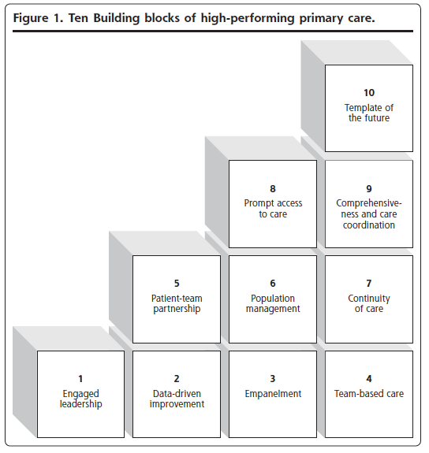
Bodenheimer, et al. Annals of Family Medicine. 2014
Notes:
Going into a bit of the how:
Spent a great deal of time with Kyle this morning discussing data and how that informs managing populations within your practice.
I’m going to spend some time discussing some tools in addition to effectively using data to better understand and manage populations of patients within your practice, including:
Empanelment
Team-based care
Poplulation management tools – risk stratification, registries

Slide 14

Team-based Care
The Institute for Healthcare Improvement defines a care team as, “the right mix of people coming together with the right tools to deliver the right care for a defined population of patients.”

Slide 15

Evidence for TBC
Many care and care-coordination activities are better provided by non-physician members of a care team (Coleman & Reid, 2010).
A 2006 evidence review of diabetes interventions found that providing team-based care was the single most effective intervention in improving intermediate diabetes outcomes (Shojania, et al., 2006).
Most physicians only deliver 55 percent of recommended care and 42 percent report not having enough time with their patients (Bodenheimer, 2008).
Providers spend 13 percent of their day on care coordination activities and only half of their time on activities using their medical knowledge (Loudin, et al., 2011).
Team-based care decreases costs and increases revenue (Coleman & Reid, 2010).

Slide 16

Attributes of Highly Functional Care Teams:
Clear expectations and available tools
Easy to understand and discuss processes of care
Information is available when needed
Everyone on the staff is valued; there’s a culture of respect and caring
Feedback of performance and opportunities to grow
Positive attitudes of co-workers

Slide 17
What we usually see:
Workflows that are provider centric
Providers doing many things that they don’t need to do
RN’s working below licensure
Front desk and MA roles are not maximized
Leadership has not analyzed workflow efficiency
Fear about delegating to “physician-extenders”

Slide 18

Tools to support TBC

Slide 19

What’s on
Your Mind?
Notes:
Kathy

Slide 20

Resources
Practice Innovation Program Colorado http://www.practiceinnovationco.org/
Events http://www.practiceinnovationco.org/events/
Innovation Support Project (ISP) https://www.practiceinnovationco.org/isp/
PIPCO: Coronavirus Resources https://www.practiceinnovationco.org/covid-19/
CMS Medicare Quality Payment Program (QPP) https://qpp.cms.gov/
Notes:
Kathy

Slide 21
University Practice Innovation Team Contact Information
Practice Transformation – Stephanie.Kirchner@cuanschutz.edu
Learning Community – Kathy.Cebuhar@cuanschutz.edu
CQMs – Andrew.Bienstock@cuanschutz.edu; Jennifer.Halfacre@cuanschutz.edu
e-Learning – Bonnie.Jortberg@cuanschutz.edu or Robyn.Wearner@cuanschutz.edu
ISP - Jennifer.Halfacre@cuanschutz.edu
ISP Project Manager - Kristin.Crispe@cuanschutz.edu
ISP Faculty – Pam Ballou-Nelson; Pam@healthcareconsultinginc.com
SPLIT – Help Desk
Notes:
Kathy

