Slide 1


TCPi
Preparing for Value Based Payment:
Reducing waste and demonstrating cost effective care
Notes:
Add Kathy’s system process
Patient education
Scripts
tools
Look for Kelly’s comments -
Opportunities for savings
Pause on the “waste” slide – from choosing wisely
Kathy can recommend videos for staff – how everyone in the practice need to contribute –

Slide 2
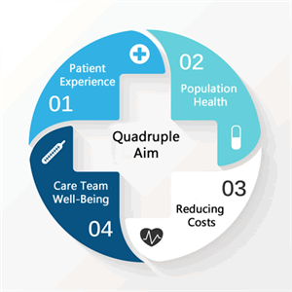
Quadruple aim Drives all of our work:
Improve health outcomes
Reduce per capita cost of care
Improve the experience of care for the patients
Restore the joy in work for the healthcare team: clinicians and staff
Notes:
Before we begin the specific content for today’s discussion, I want to put it in the context of the over arching goals of our healthcare reform efforts and TCPi in particular.
We are all striving for THE QUADRUPLE AIM – how many of heard of it? How about the Triple Aim?
Well the triple aim was a worthy goal – improved health at a reduced cost with a good experience for the patients; but relatively soon after the term was coined and started gaining traction, lots of people started recognizing that getting these results need to also include assuring that the care delivery teams enjoy their work. First of all we need the workforce to meet the growing demands for care as the “baby boomers age; but also happy and engaged healthcare teams will be more successful
Today we are only going to discuss one part of the quadruple aim – but please be aware, we know that a positive experience for the health care team and patients are key to achieving improved health outcomes and reduced costs.

Slide 3
Objectives for today:
Understand why reducing cost and utilization matters
  To the nation, to your practice, to your patients
Identify specific opportunities in your practice to implement tactics to reduce cost and utilization, eliminate waste
Learn tips and tools you can use with the team to eliminate waste
Notes:
Our focus l today is to have a discussion about reducing cost and utilization.
We will address
Why does it matter: To our country, to your practice and to your patients.
We will explore specific opportunities for your practices to reduce cost costs and utilization of unnecessary services
Discuss evidence based strategies you can test in your practice

Slide 4
We have a problem
19.3%
19.3%
17.4%
15.4%
13.4%
10.1%
7.2%
5.4%
Health Spending as a Share of GDP
United States, 1963 to 2023-selected years
1963 1973 1983 1993 2003 2013* 2023P
*2013 figure reflects a 3.1% increase in gross domestic product (GDP) and a 3.6% increase in national health spending over the prior year. See page 27 for a comparison of economic growth and health spending growth.
Notes: Health spending refers to national health expenditures. Projections shown as P.
Source: “National Health Expenditure Data,” Centers for Medicare & Medicaid Services (CMS), 2014 (historical) and 2015 (projections), www.cms.gov.
© 2015 CALIFORNIA HEALTHCARE FOUNDATION
Notes:
This dramatic rise in healthcare spending as a portion of our over all economy is what is driving the conversations to find a better solution. It’s this reality that has made healthcare reform so important.
As we spend more on healthcare, education, transportation, infrastructure and other needs are impacted.

Slide 5
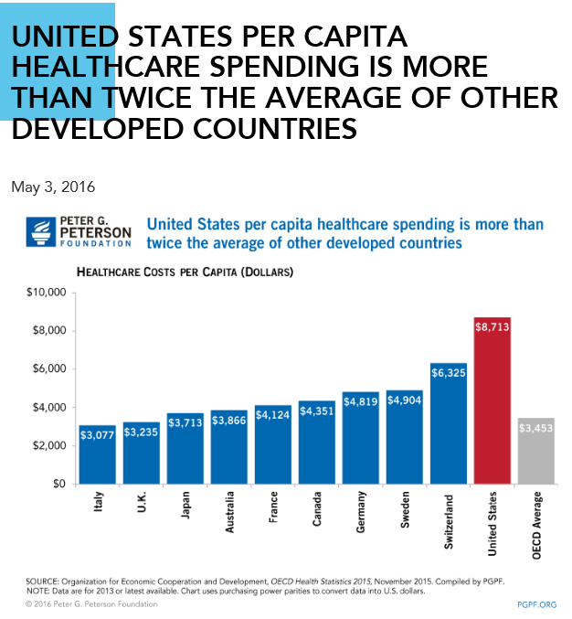
Why it matters to the Nation
Notes:
We know it’s possible to spend less, because other industrial nations like us spend a lot less. Our per capita spending is more than twice the average of other industrial nations…
And yet…

Slide 6
Why Does it matter to the nation:
Notes:
According to the Commonwealth Fund and the World Health Organization, our results are not as good in many areas – including “health lives,
There are lots of reasons why there is so much emphasis these days on improving quality of care while reducing the costs. One positive outcome of the messy partisan discussions leading up to and following the passage of Obama care – known as the Affordable care act, is that it drew attention to the undisputed fact regardless of your politics the cost of care in the US is really high and we need to do something about it.
It’s the urgency to improve quality while reducing cost is the basis for all the discussion about “healthcare reform” – which means changing how care is delivered and paid for.

Slide 7

Why Does Reducing Cost and Utilization Matter?
From a practice perspective:
Compensation is changing for your practice and for your referring providers
Patients are paying more out of pocket, and they care more about the cost of care
Notes:
Compensation is changing with a goal of getting greater value – which means we have to think and act differently if we hope to get a different result.
These compensation changes include providing cost effective care and this is true for your practice as well as practices that refer to you. Your referring network will be looking for high value specialists – those with good outcomes, timely access and competitive costs of care. Primary Care in particular are increasingly becoming accountable for the total cost of care – not just they care they provide, but anywhere in the healthcare system.

Slide 8
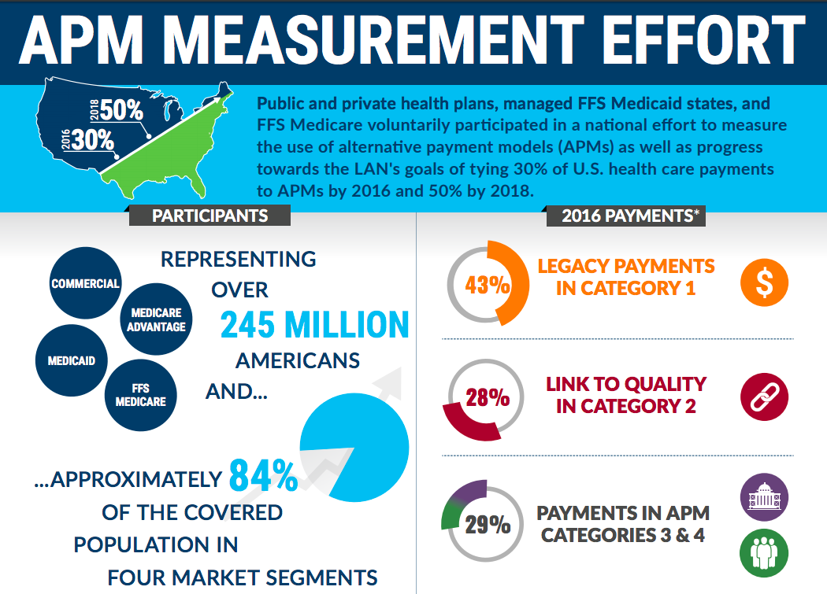
Notes:
And it’s not just MIPS. Most public and private payers, collectively representing 84% of the country are participating in ”Learning and Action Network’ LAN and have commited to changing how care is paid for with a goal of driving for greater value – improved care at a lower cost.
The goal across the partnership of payers is to have 50% of all healthcare payments based on value by 2018.
This means that it’s in your best interest to be able to demonstrate high quality care through your clinical quality measures, and cost effective care. We can help you explore opportunities to reduced costs for the patients you treat. Reducing unnecessary spending will help you in contracting with payers, in being a desirable referral option for primary care and others, and attractive for patients who are paying more and more out of pocket.

Slide 9
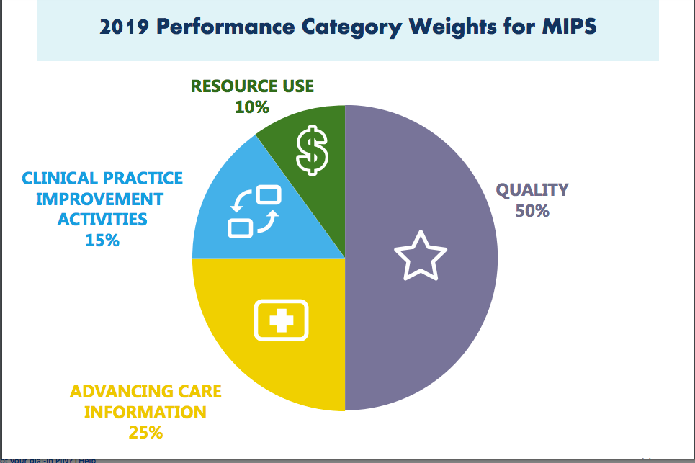
Why Does Reducing Cost and Utilization Matter?
From a practice perspective:
Compensation is changing:
PUBLIC PAYERS:
Medicare and CO Medicaid:
MIPS:
  2018 Performance year:
    10% of “score” is based on your contribution to cost of care
    Increases each year by 10% up to 30%
Alternative Payment Models (that include risk for cost)
  5% fee increase if you participate in a CMS APM
Notes:
This is the MIPS scoring algorithm. You can see that cost and Quality make up the largest portion. In 2019- Quality is 50%, Cost is 10, Advancing Care Information ( using HIT) is 25% and Improvement activities ,TCPi and activities within TCPi that you work on, are weighted at 15%. Clearly cost and quality are most important; in the future the cost portion is scheduled to increase each year as quality decreases .
Now is the time to take advantage of my help ( PF or CHITA) to identify areas of impact you can influence so your cost and quality measures position you well in value based payment.
There is a strong desire on the part of CMS to encourage Alternative Payment Models, which include some risk. When you have some risk at stake you want to be sure you are not overlooking opportunities to reduce costs. CMS incentizes APMs with a 5 % increase in Medicare fee schedule.

Slide 10

Why Does Reducing Cost and Utilization Matter?
From a practice perspective:
Primary Care will be looking for high value specialists
Commercial carriers:
Shared savings
ACOs
Premier Designations:
  Incentivizing patients to use high value providers
You can negotiate beneficial contracts when you have good data
Notes:
Another reason to work on reducing unnecessary utilization of resources is to be a highly desirable partner to primary care whose compensation is starting to be incentivized to be accountable for the total cost of care for their patients. It will matter to them which specialists can see their patients in a timely manner, get good results at a competitive price.
Many carriers are moving to ”Premier designations” that look at cost and quality and reduce patient’s co-pays or co-insurance if they choose the designated practices
Also, we have seen examples where practices have been able to go to carriers demonstrating their value and successfully negotiate higher fees.
The evolving world of healthcare is going to reward those with good outcomes and efficient use of resources. Best results at the lowest cost.

Slide 11
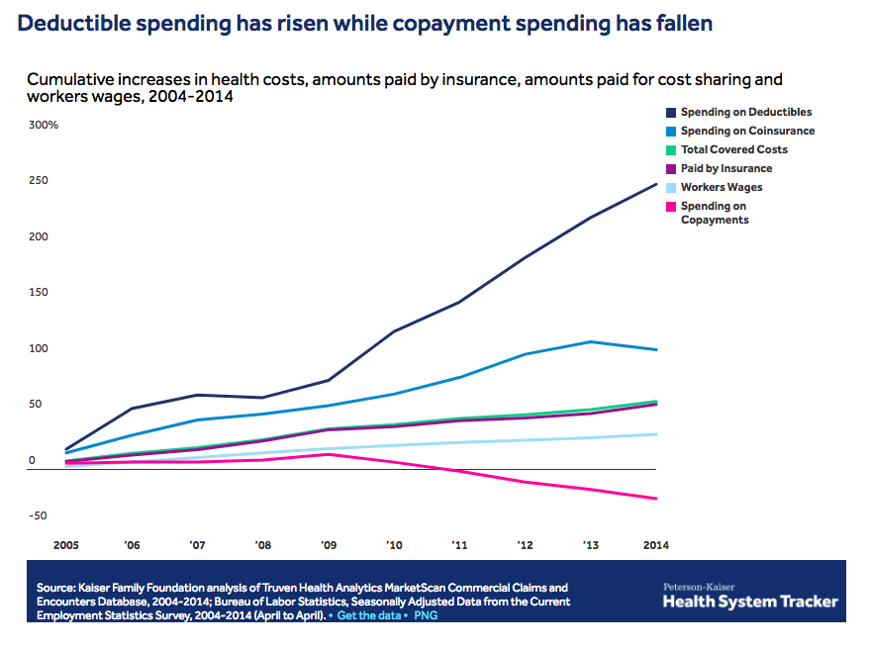
Why Does Reducing Cost and Utilization Matter?
From a patient perspective
Patients portion of healthcare costs are rising:
Health Savings Accounts
Higher Deductibles
Notes:
Patients are starting to care about cost, too. In the past, they didn’t know or care – someone else paid. But we are seeing the trends that their portion of healthcare costs is rising rapidly.
Websites like Physician compare are getting more and more attention as the cost of care is coming from the patients

Slide 12
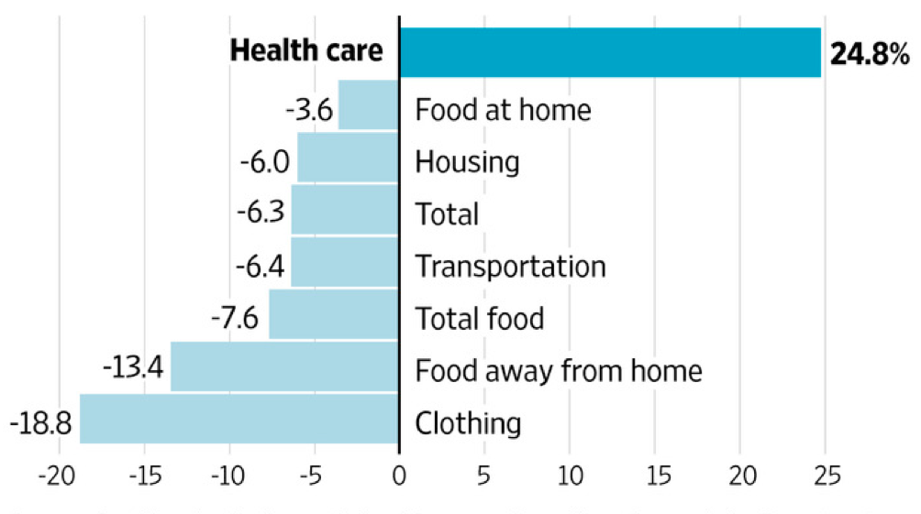
Percent change in middle-income households’ spending on basic needs (2007-2014)
Source: Brookings Institution, Wall Street Journal
Notes:
This chart is a dramatic view of what has happened to household spending. From 2006-2016, the average families premium contribution increased 77%, while for the same period, median income increased less than 19%, leaving them less for the other necessities – food, housing etc
if spending continues at the current rate, by 2020 US families will be spending 50% of their income on healthcare – this is not sustainable - and if they have choices of good outcomes at a lower cost they are driven to find it.

Slide 13
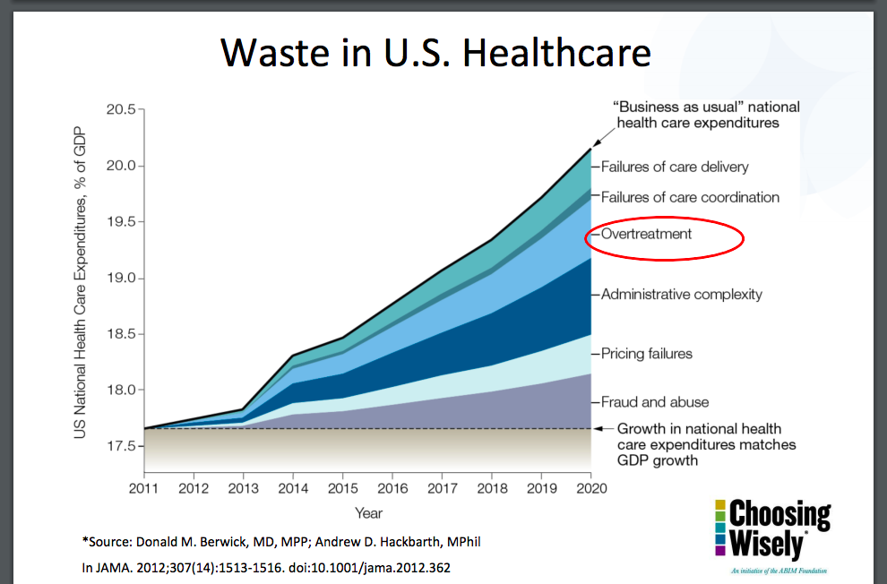
What can we do about it?
Eliminate Waste
Waste: activity which could be eliminated without harming consumers or reducing the quality of care that people receive
Researchers estimate 20% - 50% of healthcare spending is “waste”
Notes:
So what can we do about it? Look for the opportunity to eliminate unnecessary care and provide the best care in the best setting – except for trauma and serious conditions, it’s not the ED.
Unfortunately, the chart shows that we are trending in the wrong direction – more waste, not less -
We have to curb healthcare spending, the easy target is to eliminate activity could be eliminated without harming consumers or reducing the quality of care that people receive. We need to provide appropriate care in the appropriate setting.
“Appropriate” in this context, means health care that is: • Supported by evidence; • Truly necessary; • Not duplicative of other tests or procedures already received; and • As free from harm as possible.
Some estimates indicate that overuse could account for as much as one-third of total health care spending in the United States.

Slide 14
Potential savings opportunities:
Avoidable use of ED
Avoidable hospital readmissions
Tests that do not inform treatment options but may be a part of a standing order
Preoperative baseline laboratory studies prior to low-risk surgery
Duplicate tests
Brand name pharmaceuticals when generic provide same result
Preoperative EKG, chest x-ray and pulmonary function testing prior to low risk surgery
Using a high cost facility when lower cost is an option
  i.e., Operating Room vs ambulatory surgical center
Notes:
“PFs – I would tailor this slide to your audience -
This slide is meant to help you “explore” options with the practice – get them to think about where they might consider beginning.
I would list all of them – for instance if a practice doesn’t do surgery – don’t suggest they look for lower cost surgery centers.
But you can suggest they look for lower cost imaging centers…
Overuse in health care – also called overtreatment, low-value health care or waste is everywhere . Generally, if you look, you can find opportunities for savings, and don’t think you are only looking for “high cost” options – Studies show that low cost, but high volume can actually result in greater savings – for instance routine tests for low risk procedures – examine standing orders for information that will inform care -
Over use refers to medical tests and procedures that have been shown to provide little benefit in particular clinical scenarios
Some examples include:
Avoidable use of ED
Avoidable hospital admissions
Preoperative baseline laboratory studies prior to low-risk surgery
Unnecessary imaging for eye disease, low back pain within 6 week, uncomplicated headache
Annual EKGs or cardiac screening in low risk, asymptomatic individuals
Prescribing antibiotics for acute upper respiratory and ear infections
Preoperative EKG, chest x-ray and pulmonary function testing prior to low risk surgery
Cardiac stress testing

Slide 15

Discussion:
What are your thoughts about healthcare
costs your practice might impact?
Notes:
Depending on the specialty you might probe differently:
For Proceduralists –
Pre –op tesing – labs or Imaging or EKG
ED utilization – consider a variety of access options –
Same day apts; access to clinician via phone for advice
Below are some phrases that have been shown to be open-ended and invite exploration
What are your thoughts about health care costs in your practice?
Are you worried at all about duplication or waste in your work?
Are you concerned that patients think more care is always better care?
What ideas do you have about cost and utilization programs such as Choosing Wisely?
Do patients have concerns about the cost of x?
What difference will it make for your practice or your patients if you eliminated certain tests?

Slide 16
If we decide to change, how can we implement that?
We can help train staff to understand how the change will increase the value of care.
  Sometimes changes improve patient safety as well!
Adjust roles and workflows so that all staff support the change. Examples include:
  Scripting
  Embedded decision support
  Shared decision making with patients
Engage patients with decision aids, access to price and quality information.
Notes:
We will help you. We will work with your providers and staff to understand how change will increase the value of care; often providing only appropriate care can improve patient safety as well.
Doing things differently may entail revision of roles and workflow – we will help with that by helping to devlop
Scripting
Perhaps identifying embedded decision support with the EHR – for appropriate imaging or tests for example
An excellent opportunity is to engage patients in shared decision making – empowering them to be partners in managing their health –
There are excellent tools and resource we can provide to engage your patients – once we determine what you want to focus on, we can look for tools to support your practice.

Slide 17
Engaging patients in shared decision making
Encourage patients to consider the “Five Questions”
Do I really need this test or procedure?
What are the risks?
Are there simpler, safer options?
What happens if I don’t do anything
How much does it cost?
Notes:
Consumer Reports is aggressively engaged in helping patients make informed choices about their medical care. After a lot of research, focus groups and PDSAs they have settled on these five questions. Many practices have placed posters in prominent areas to let patients know that the practice recognizes that cost of care matters to the patient. There are posters and wallet cards available.
As you well know a fully engaged informed patient is much more likely to get a good outcome, which is clearly better for your practice.
Consumer reports has partnered with the American Board of Internal Medicine on the Choosing Wisely initiative. We can go into that in a lot more detail at another session to look at specific tools and resources. .
( NOTE TO PFs – depending on where there are opportunities for reducing, choosing wisely may have excellent tools specifically for the target the practice has identified – please contact the faculty – D FM and our faculty to help you find the myriad of resources that are available)
I

Slide 18

How can we measure it to make sure changes are having an impact
Options:
EHR data
Tests ordered last quarter vs next quarter
Look at Brand name prescribing by conditions
Last quarter vs. next quarter
Data capture on Spreadsheets
Avoidable ED visits
Number of Urgent appointments scheduled
Track most common condition for patients going to ED
Notes:
PFs NOTE: this is where you may need to get creative – if it’s not easy for you or the practice to identify how to measure what the practice is working on , please consult with the D FM team and we can connect your with the appropriate faculty member to explore options – either with you, or if appropriate they can meet with you and the practice together – your choice.
There are several ways to track your efforts to know if the changes you are making are having an impact;
If you are tracking reduced testing, you can look in your EHR – check on one common test, for one condition. Depending on the prevalence of the condition and test you may be able to look at a month’s worth of data, or you may need to look at a quarter. Look for the number of tests in the past measurement period, institute your changes, then remeasure for the same measurement period to see if your process had an impact.
If your effort involves generic prescribing, use the same principle – Look at number of brand name Rx’s for the measurement period, following your implementation of a new protocol , re measure, share with the team and discuss whether the results you see are what you expected.

Slide 19
Next Steps:
What will we address first?
What steps will we take to make one small change
How many ”events” will we measure
What data points can we measure ?
What is our ”baseline”
When will we measure?
Who will lead the change?
Notes:
The goal of this slide is to identify your first PDSA ,
You may need to change it a bit to fit the language to what the practice wants to address – a test, expanding access, patient self management support following a procedure… whatever .

