Slide 1
FAST PTO Touchbase
Wednesday September 22, 2021 9:00AM
Call Instructions:
Please
Mute your phone, microphone, and speakers on your computer/device
Enter your name/organization in the chat box feature for attendance
We encourage active participation via Chat or audio
Submit questions via the chat box feature
Questions will be answered as submitted
Unmute yourself to ask question and participate in discussions
Time to ask questions via audio will be offered for those on the phone
*6 - Toggle mute/un-mute
*9 - Toggle raise/lower hand
Notes:
Kathy

Slide 2
Agenda
Check In & Follow up
Education
Q&A
Reminders/Upcoming Events/Wrap Up
Notes:
Kathy-
Check in/follow up- next slide
Education- Jarid Rollins, LCSW from MidValley Family Medicine in Basalt, is going to share his experience with group visits for UAU. Carolyn will also provide a round own of some of the latest evidence for group visits for UAU.
Q&A-
Prompt or probe about FAST recruitment and engagement
-UAU articles and news, older adults and women (targeted outreach), testimonials

Slide 3
Education
Notes:
Kathy – Introduce and pass to Jarid

Slide 4
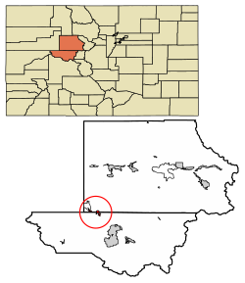
Midvalley family practice
Unhealthy alcohol use screening, treatment and recovery
Notes:
Jarid

Slide 5
The clinic as a secure base
MIDVALLEY FAMILY PRACTICE
HEALTHY ALL TOGETHER
Notes:
Jarid

Slide 6
TEAM BASED CARE
FRONT DESK
TWISTLE
HARD COPIES
MEDICAL
NURSES AND MAs
PROVIDERS
COUNSELORS
LCSW
ADDICTIONS COUNSELOR
INTERN
Notes:
Jarid

Slide 7
Why start an in house treatment program?
In one study clients referred from a VA emergency room to outpatient care showed 53% adherence on the first week. Subsequent weeks were associated with worse attendance.
Family medicine completes about 50% of referrals to all specialties.
This rate goes down for people at higher risk for adherence
Barriers exist in our community in accessing timely care.
Not all clients are comfortable with community based recovery programs i.e. AA/NA
The clinic is a safe place
Notes:
Jarid

Slide 8
Recruitment and retention
It’s a team effort!
When medical providers refer to group follow up is more likely.
Advertise within the clinic.
Let criminal justice organizations know about your work.
Make it interesting for members
Our addiction counselor designed a 6 week module based on his interest in literature and recovery.
Follow up when group members no show for a group.
Outreach should be completed by person running the group
Notes:
Jarid

Slide 9
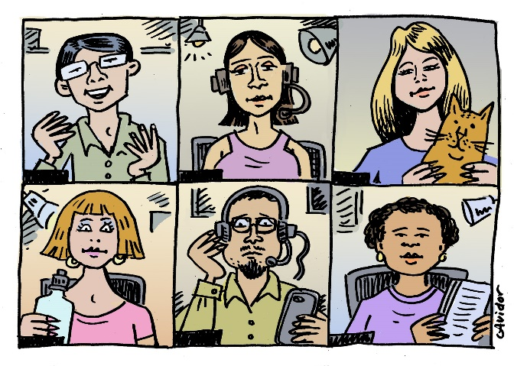
Group design
Due to COVID group is virtual
utilization of doxy.me group feature
MORE (My Ongoing Recovery Experience) group model based on Hazelden curriculum
Open group model
One provider completing the groups (ensuring safe space and continuity)
1-hour sessions after work hours
Notes:
Jarid

Slide 10
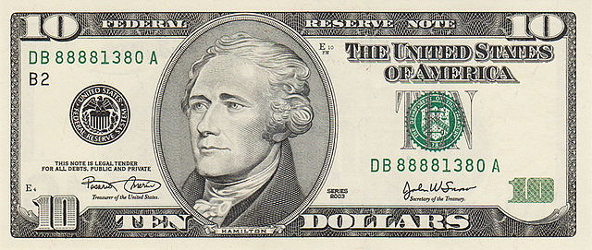
Billing
Groups where patients see provider and therapist
Use office visit codes with modifiers
We use these with Pain Relief Group and Suboxone Group
Therapist only groups
Group psychotherapy codes
Notes:
Jarid

Slide 11
Groups are hard to run in rural areas…but worth it.
“There is no human deed or thought that lies fully outside the experience of other people.”
Irvin Yalom “The Theory and Practice of Group Psychotherapy”
Notes:
Jarid

Slide 12
Questions & Answers
Notes:
Kathy to Facilitate & Jarid

Slide 13
Future Events
October 14th 12pm – 1pm – HCPF Medicaid APM 2.0 Discussion
October - SAMHSA SBIRT/telehealth report
Notes:
Kathy

Slide 14
Resources
Practice Innovation Program Colorado: http://www.practiceinnovationco.org/
Events: http://www.practiceinnovationco.org/events/
Facilitating Alcohol Referral & Treatment (FAST): https://www.practiceinnovationco.org/alcohol/
e-Learning: https://cuelearning.org/
AHRQ UAU Initiative: https://integrationacademy.ahrq.gov/about/opioids-substance-use/ahrq-alcohol-initiative

Slide 15
University Practice Innovation Team
Contact Information
Practice Transformation – Stephanie.Kirchner@cuanschutz.edu
Learning Community - Kathy.Cebuhar@cuanschutz.edu; Taryn.Bogdewiecz@cuanschutz.edu
CQMs – Andrew.Bienstock@cuanschutz.edu; Jennifer.Halfacre@cuanschutz.edu
e-Learning – Bonnie.Jortberg@cuanschutz.edu or Robyn.Wearner@cuanschutz.edu
FAST - Allyson.Gottsman@cuanschutz.edu
FAST Project Manager – Bonnie.Jortberg@cuanschutz.edu
FAST Faculty – cjswenson57@gmail.com
SPLIT – Help Desk

