Slide 1
APM2
A Bridge between Payer and provider
Notes:
May not not call it Value based payments yet but a bridge to that goal, a transition phase to VB models.

Slide 2
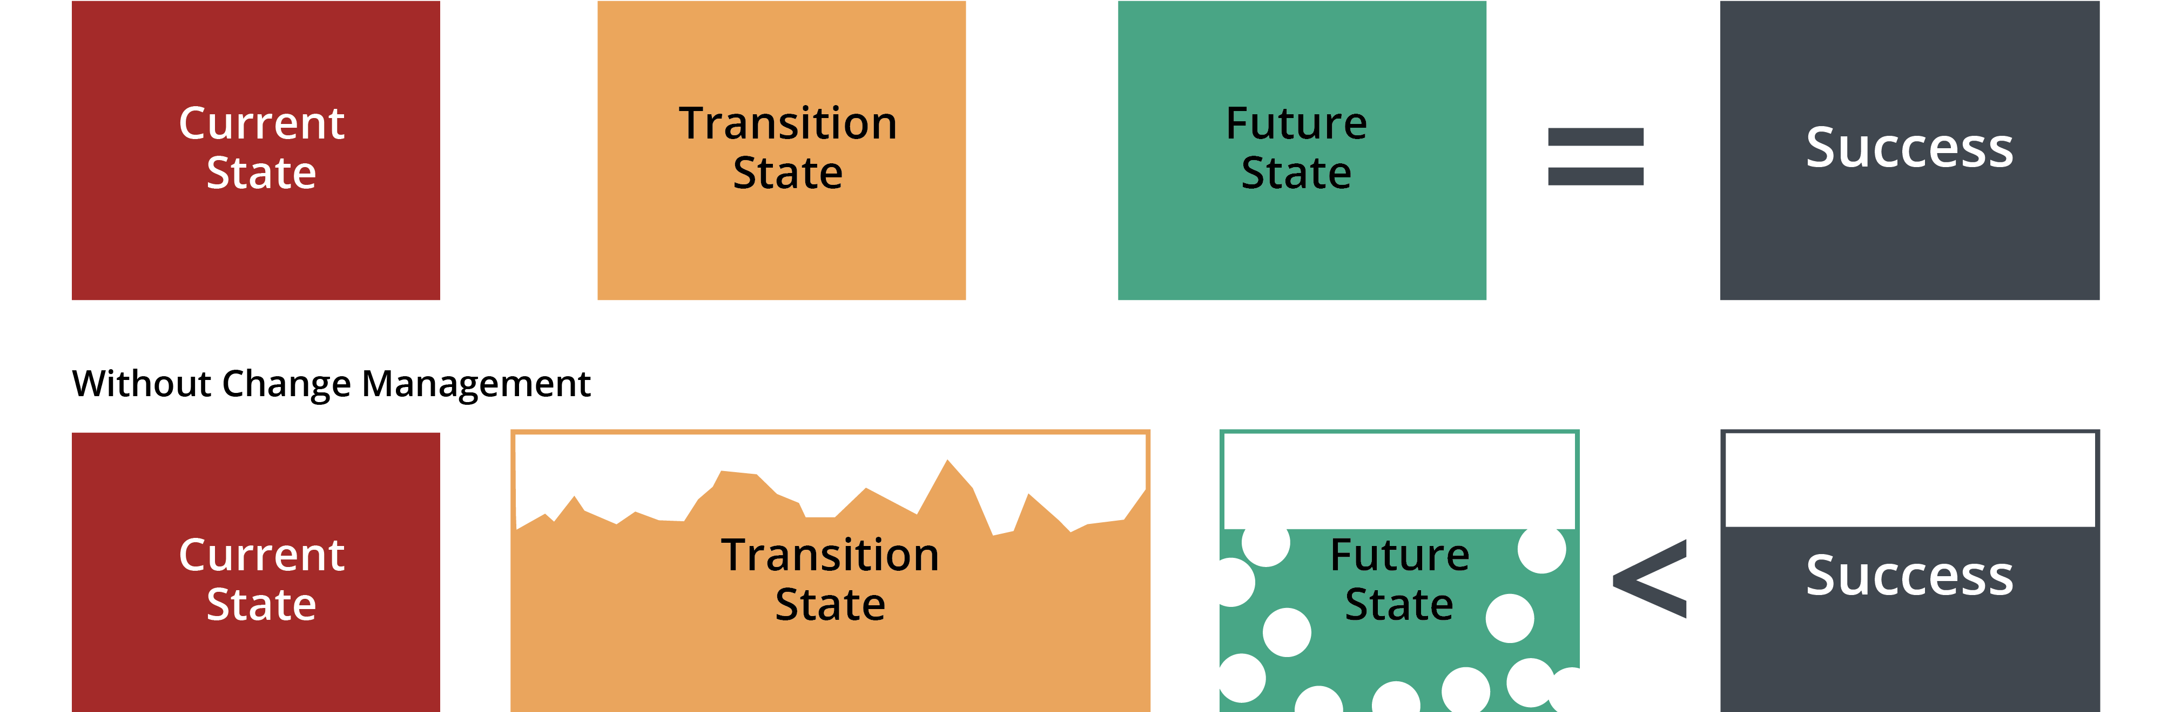
Transition State APM2
Notes:
Prosci is a change management theory and model to help us understand the dynamic required for change . We need to connect people to success.

Slide 3
Consequences of the “Swiss Cheese Future State”
Instead of
Lower ROI
History of Failed Changes
Unachieved Improvement
Not What We Expected/ Hoped For
Notes:
I see APM2 as that planned transition state to get all on board so we can realize the future state of true VB Payment models that reward for adjustable/variable outcomes

Slide 4
Practice Objectives for APM2
Understand APM2 model - a transition phase to VB models of payment.
Obtain the data Click here to submit a request to see how this model would work for your practice.
Know how to evaluate the data for your practice.
Understand the E&M codes used in PMPM.
Understand the chronic care episodes and codes used.
Discuss why partial or full cap? What are the benefits of partial or full cap?
Evaluate practice clinical quality guidelines currently in place.
Evaluate current clinical practices around patient stratification and quality outcomes.
Notes:
VB models of payment is the overarching goal but what are the objectives we need to meet to be successful? We have been stating for several years now that the revenue cycle the financial side of your business /practice is intrinsically linked to clinical outcomes, patient activation, and change management. This model will drive that home even deeper.

Slide 5
Practice Objectives for APM2
Recommend practice prepare a budget, if not already in place, evaluate current budget FFS to PMPM payment.
Know practice per-visit cost.
Ability to measure outcomes.
Access to data both financial and quality data. Process and Outcome data.
Notes:
Objectives are specific Actions things the practice is doing OR needs to do AND measure

Slide 6
How Can I Help
Work with you on specific objectives for the practice.
Work directly with the practice on specific objectives.
Review the meaning of the data and discuss why partial or full capitation.
I can be a thought partner with you.
I can assist you understand and deploy change management tools for breaking down barriers, or resistance.

