Slide 1
APM 2
Overview

Slide 2
APM 2 Pillars
Goal: increase equity, improve health outcomes, and lower cost by redistributing money to primary care
Provider Reimbursement
Partial Capitation
Fee-for-service
Upside-only incentive payments to share the savings achieved by improving patient outcomes and lowering costs for chronic conditions
Gainsharing
Balances partial capitation with an additional payment to reflect visit volumes
Stabilizes revenue and allows investments in outreach, care coordination, etc. that aren’t tied to a specific visit

Slide 3
Partial Capitation & FFS
Details:
Modified APM Code Set
Baseline year of 2018-2019
Ability to choose revenue breakdown
Benefits: flexible, consistent payment, which allows and rewards innovative care delivery

Slide 4
Mechanics of Gainsharing
Upside-Only
50/50 Shared Savings Split
Annual Reconciliation Process
PCMP-Specific Thresholds

Slide 5
Chronic Condition Episodes
Asthma
Hypertension
Coronary Artery Disease
Crohn’s Disease
Trauma/
Stressors Disorders
Ulcerative Colitis
Diabetes
Osteoarthritis
Low Back Pain
Heart failure
COPD
Arrythmia/Heart Block
GERD
Note: Size of the boxes does not communicate significance

Slide 6
Modeling:
Partial Capitation

Slide 7
Provider-Specific Data
Through review of the data and conversations with providers, we found material variation in aggregate per member per months due to differences in penetration rate, leakage rate, and member mix.
As a result, the decision was made to go with an easier model design that’s based on a practices’ historical experience.
Excel Walkthrough
Notes:
Optumas

Slide 8
Reconciliation
One-way reconciliation
A PCMP’s practice pattern is assumed to be inherently reflected within their partial capitation, since their own experience is used as the basis of projection
A PCMP will be made whole if they improve upon their penetration and/or leakage metrics, which would result in higher than projected PMPM cost
A PCMP will only be subjected to downward reconciliation if their actual experience exceeds the established guardrails
Guardrails have been established to monitor the need for reconciliation. Reconciliation will only occur if a PCMP’s actual experience falls outside the guardrails.
Notes:
Optumas

Slide 9
Modeling:
Gainsharing

Slide 10
Gainsharing Spending SFY-19
Separate Program
Chronic Conditions best matches the criteria!
Chronic Condition Episodes
Total Cost of Care*
Reducing Inpatient
Pharmacy
Total Spending
$3.96 Billion
$4.23 Billion
$699 Million
$957 Million
APM 2 Eligible Members
$1.64 Billion
$1.88 Billion
$222 Million
$463 Million
*Need to ensure alignment between methods of calculation and terminology (ex: LTSS and HCBS are excluded)
Please Note: There is overlap in spending between the gainsharing methods
10
Notes:
Trevor
Ton of money available
Clinical tool to support provider success (deployable in its current state)
This team spoke about multiple chronic conditions being actionable and the modeling confirms that
Will make a real difference in sick people’s lives
Total cost of care is harder to support you with our current data—a little bit of boiling the ocean—so chronic conditions SEEMS like the best fit (and chronic conditions a measurable way for us to measure quality)—and a smaller subset of measures but they are driving measurable spend.
Let’s get your feedback on HOW we’re planning to do it.

Slide 11
Gainsharing Final Details
We are focused on (13) chronic conditions with consideration given to comorbidities including behavioral health and SUD conditions.
HCPF/Optumas will aggregate the thresholds for the 13 chronic conditions for each PCMP.
Each PCMP would have their own threshold predicated on their specific member panel: distribution of chronic conditions and provider-specific morbidity adjustment (risk adjustment)
Upside-only gainsharing with savings shared 50/50
Notes:
Optumas

Slide 12
Risk Adjustment
The average cost of specific episodes will vary based on specific risk factors identified through variance analyses. Each PCMP’s aggregate threshold will be risk-adjusted using the following factors:
Population type – Optumas has developed a COA relativity factor to reflect this observed variance
Gender - Optumas has developed a gender factor to be used to project each member’s expected episode cost
Co-morbidity – Optumas has developed co-morbidity factors to reflect the fact that members with more chronic conditions tend to have higher cost episodes
Notes:
Optumas

Slide 13
Episode Attribution
A practice’s threshold will be informed by members that are attributed to the practice and have an existing chronic condition prior to the contract period.
This is based upon policy that was informed by stakeholder input. It addresses the concern that it takes a provider time to develop a relationship and treatment plan for new chronic members and or members with new chronic conditions.
Notes:
Optumas

Slide 14
Incentive (Shared Savings) Payments
Acceptable Threshold
If average cost between acceptable and commendable (MSR), no change in payment
Average Cost Per Episode
Commendable Threshold
If average cost below commendable and quality metrics met, shared savings at 50%
Notes:
Trevor

Slide 15
Current Chronic Conditions
Cardiac
Orthopedic
Pulmonology
Behavioral Health/ SUD
Gastroenterology
Endocrinology
Arrhythmia/heart block/ conduction disorders
Coronary artery disease
Heart failure
Hypertension
Low back pain
Osteoarthritis
Asthma
Chronic obstructive pulmonary disease
Bipolar disorder
Depression and anxiety
Schizophrenia
Substance use disorder
Trauma & stressors disorders
Crohn's
Gastro-esophageal reflux disease (GERD)
Ulcerative colitis
Diabetes

Slide 16
Chronic Condition Episode of Care Example
An episode looks at all clinically related services provided to a patient for a discrete condition/procedure within a specific period of time across the entire continuum of care. Services could be related to management, ancillary, lab, pharmacy for a given time frame (one-year, start of symptoms to finish)
Begin
Never Ends
30 Day Look Back
Confirming Trigger Claim
Look Forward From The Trigger Claim
Trigger Claim
Annualize – most recent one-year claims for analysis / one-year from start of plan year for implementation purposes
Inpatient Professional
Claims with Actionable Adverse Events (AAEs)
Inpatient Stays
Are AAEs
ER Visits
Claims for typical care and services
Hospitalizations

Slide 17
Levers of Clinical Success
Clinical levers of success help providers win in an episodes of care program and are meant to identify variation in cost and/or outcomes.
Episode Management:
Med Reconciliation
Scheduled PCP visit
Co Provider Selection referral for Comorbid patients
Manage Complications:
Actionable Adverse Events
Hospitalizations
ED visits
Episode Trigger: Historical dx
Episode Duration: 1 Year
Episode Target List:
Super Utilizers
High Risk Patients (Multiple Comorbidities)
Manage Utilization of Services:
Potentially Avoidable Service
High Value Services
Pharmacy Utilization
Manage SDOH:
Referrals related to BH/SUD care
HHA
Engage community resources

Slide 18
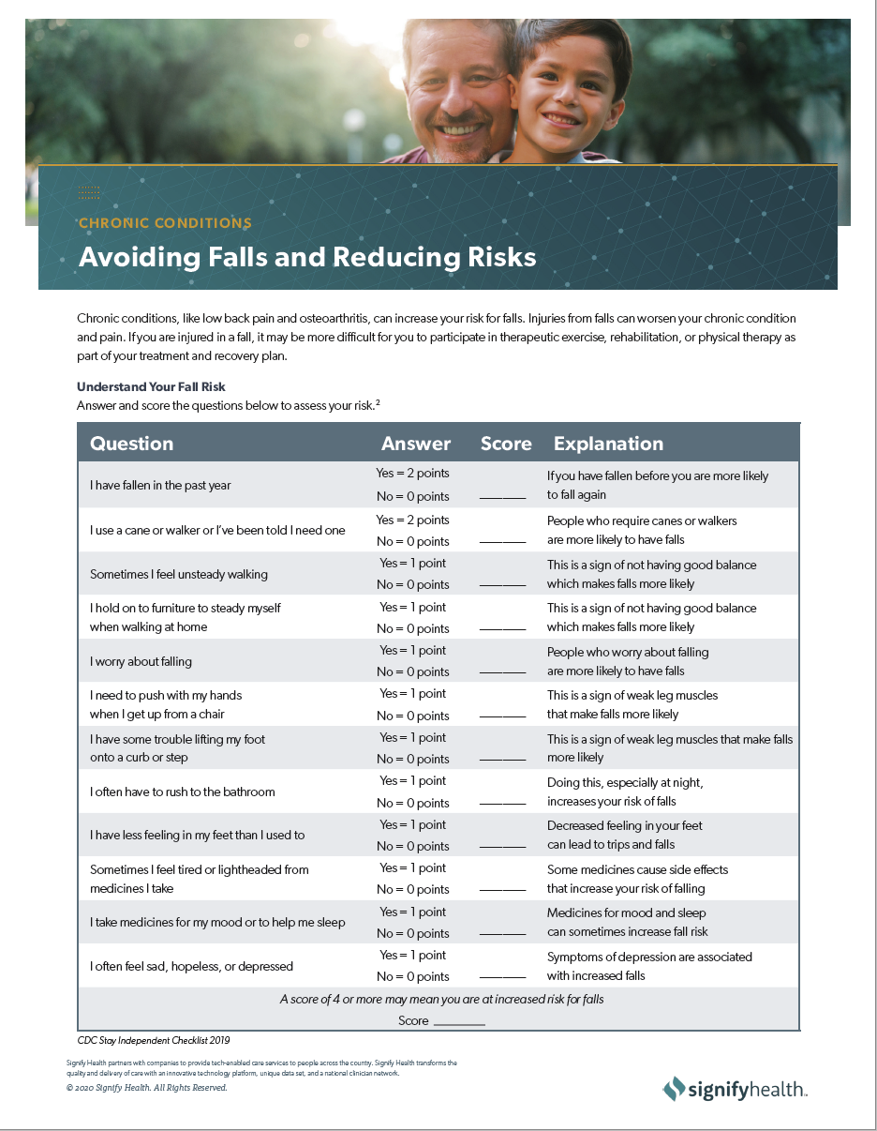
AAE Lever Drill-Downs Will Drive Focus
Lever Performance Reporting allows providers to hone in one or two lever focus areas that drive the biggest impact to cost & clinical outcomes.
Falls
Diabetes &Endocrine Problems
Pressure Sores, Cellulitis, and Skin Infection
Fluid and Electrolyte Disturbances
Sepsis and Urinary Tract Infection

Slide 19
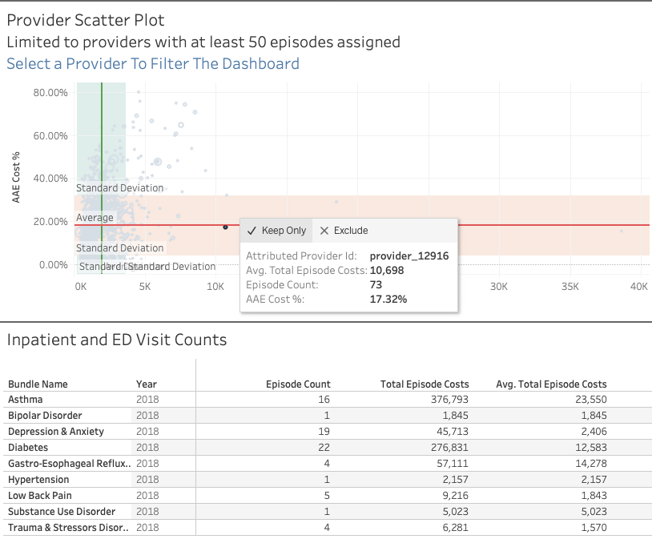
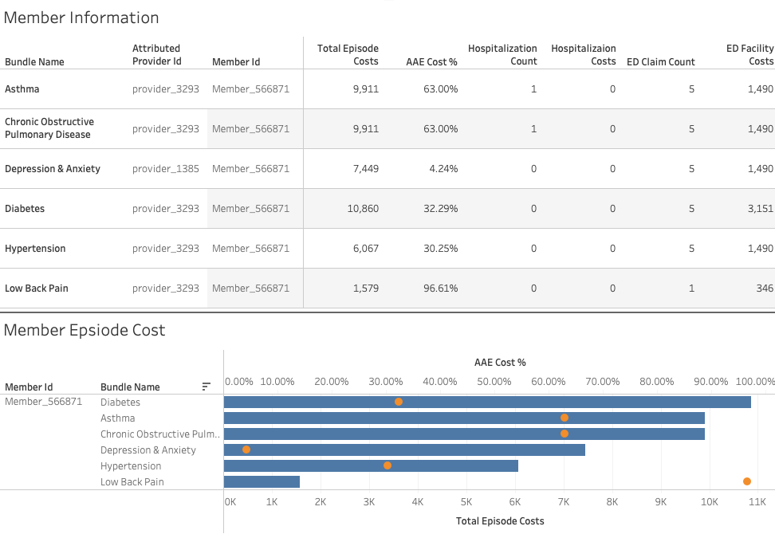
Drill Down to Provider and Member Level Information
Chronic condition episodes by provider – distribution of episodes seen by one provider
Drill down to the member level – multiple chronic conditions

Slide 20
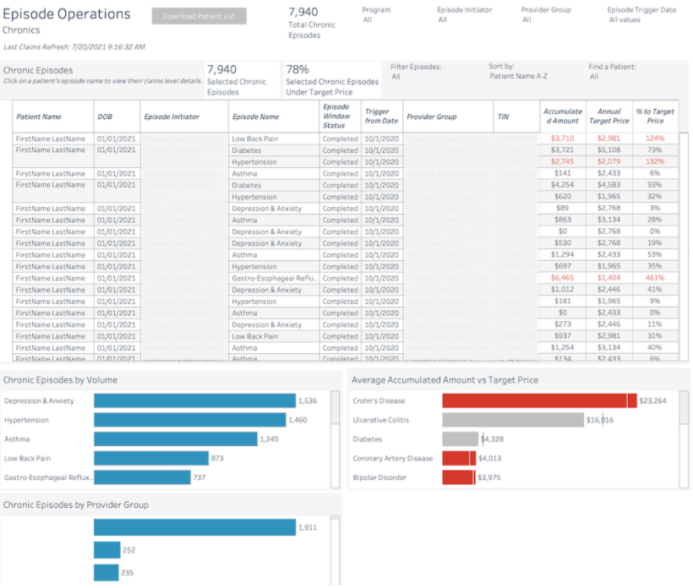
Dashboard: Episode Operations - Chronics
Provider View
Key Metrics
Volume of Chronic episodes
% of Episodes under target price
Allowed Amounts vs Target Price
Volume of chronic episodes by episode name and provider group
Average of Allowed Amounts vs Target Price by episode

Slide 21
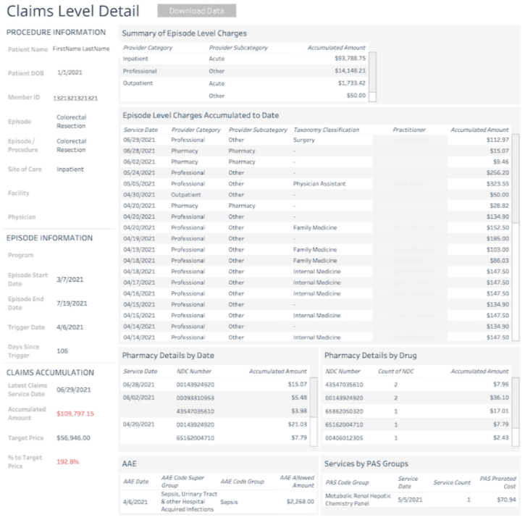
Claims Level Details - Drill-through from Episode Operations - Chronics
Provider View
Key Features
Insights into patient care at every step
Service date level claims for an episode
Relevant Episode AAEs and PAS

Slide 22
QUESTIONS?
Please email zoe.marchand@state.co.us and chloe.wilson@state.co.us with additional questions

Slide 23
THANK YOU!

