Slide 1
What have we accomplished?
11/10/2021
FAST and ISP Touchbase
Notes:
Kathy

Slide 2
Call instructions:
Please ​​
Mute your phone, microphone, and speakers on your computer/device​​
Enter your name/preferred pronouns and organization in the chat box feature
We encourage active participation via Chat or audio​​
Submit questions via the chat box feature​​
Questions will be answered as submitted​​
Unmute yourself to ask question and participate in discussions​​
Time to ask questions via audio will be offered for those on the phone​​
*6 - Toggle mute/un-mute​​
*9 - Toggle raise/lower hand
Notes:
Kathy

Slide 3
Taryn

Slide 4
Notes:
Jen

Slide 5
Facilitating Alcohol Screening and Treatment
(FAST)
Started with practices 6/1/2020
Currently recruiting until Spring 2022
Notes:
Jen – Andrew/Steph add in

Slide 6
3, 6, and 9 months = p=.005
Notes:
Jen – Andrew/Steph add in

Slide 7
3, 6, and 9 months = p=.02
Notes:
Jen – Andrew/Steph add in

Slide 8
3, 6, 9 month = p=.0014
Notes:
Jen – Andrew/Steph add in

Slide 9
Notes:
Jen – Andrew/Steph add in

Slide 10
SBIRT Implementation Checklist
 | Not Started | Planning | Active | Full
Practice has implemented process for screening
Baseline | 2 | 8 | 6 | 3
Follow-Up | 0 | 0 | 4 | 15
Practice has implemented process for reviewing and interpreting ETOH screening results
Baseline | 4 | 5 | 8 | 2
Follow-Up | 0 | 0 | 5 | 14
If patient screens + for UAU, practice has implemented process to assess for AUD
Baseline | 5 | 5 | 8 | 1
Follow-Up | 0 | 0 | 5 | 14
Practice has implemented process for routinely providing feedback on screen results and provides BI
Baseline | 5 | 4 | 7 | 3
Follow-up | 0 | 0 | 6 | 13
Practice has implemented system for initiating Pt. with care after UAU diagnosis
Baseline | 4 | 5 | 9 | 1
Follow-Up | 0 | 0 | 8 | 11
Notes:
Analysis of Total Score of the 5 Items – p<.0001
Jen – Andrew/Steph add in

Slide 11
FAST Telehealth Count of clinics using telehealth technology/software
Notes:
Jen – Andrew/Steph add in

Slide 12
Innovation Support Project (ISP)
Wave 1 – March 2020
Wave 2 – April-November 2020
Wave 3 – March-May 2021
Wave 4 – July-September 2021
Notes:
Jen – Andrew/Steph add in

Slide 13
Questions for Pam Ballou-Nelson
Notes:
Kathy

Slide 14
ISP MAC Leadership
Notes:
Jen – Andrew/Steph add in

Slide 15
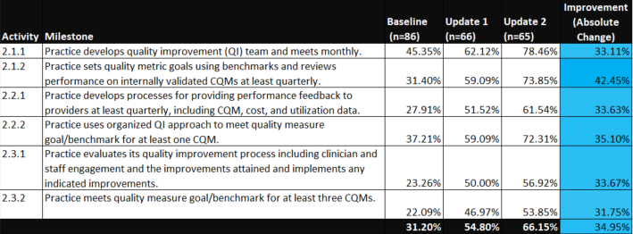
ISP MAC Data Drive QI
Notes:
Jen – Andrew/Steph add in
Work on this every month
Started under 50% and now over

Slide 16
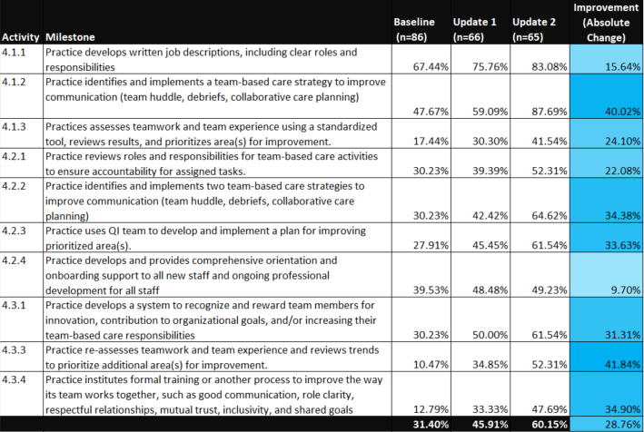
ISP MAC Team Based Care
Notes:
Jen – Andrew/Steph add in

Slide 17
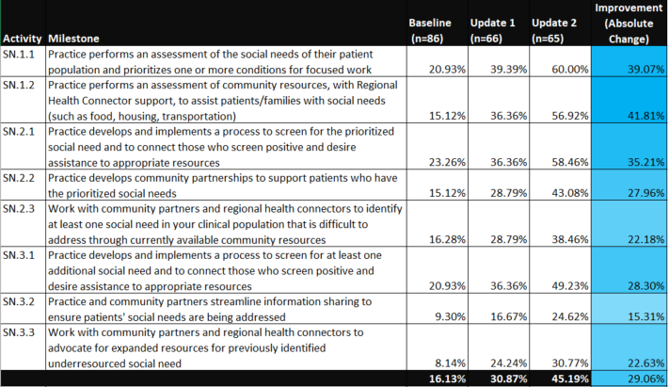
ISP MAC Optional Focus Addressing Social Needs of Patients
Notes:
Jen – Andrew/Steph add in

Slide 18
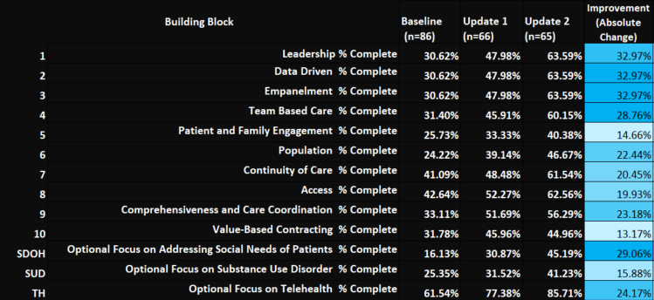
ISP MAC Summary
Notes:
Jen – Andrew/Steph add in

Slide 19
New ISP Focus – Diversity, Equity and Inclusion
Wave 4 practices were the first to complete baseline data for new DEI milestones.
MAC due 11/30/2021 for wave 1, 2 and 3 will have baseline for DEI.
More training and discussion to come in 2022.
Notes:
Jen – Andrew/Steph add in

Slide 20
Performance data on inclusion and equity?
Are there practices who are working on collecting and using performance data on inclusion and equity?
Notes:
Jen – Andrew/Steph add in

Slide 21
Success from the field
Notes:
Jen – Andrew/Steph add in

Slide 22
Excelling Practices
82 Field Notes that had excelling practices
44 Pediatric and School based clinics
34 Primary Care and Family Med
4 Internal Medicine and Women’s Health
Notes:
Jen – Andrew/Steph add in

Slide 23
CHPG Primary Care Southmoor
Practice is working on care management enrollment/documentation for high-risk patients.
Using data feedback reports of high-risk patients for outreach and implementing into clinic flow.
Notes:
Jen – Andrew/Steph add in

Slide 24
Thompson River Pediatrics
Case and care management work. They have found many gaps that have been caused by covid.
Working with their RHC for resources that can support enrollment including North County Health Alliance and the Health District.
Notes:
Jen – Andrew/Steph add in

Slide 25
Children’s Medical Center
March 2021 – Beginning to work on addressing and screening for SDOH
November 2021 - Starting screening for food insecurity
Notes:
Jen – Andrew/Steph add in

Slide 26
Women’s Health – Boulder
70% of all jobs at BVWHC have been evaluated and have new job descriptions that clearly outline responsibilities and roles.
Clinical care team has established weekly huddles to improve communication and debriefs.
Including adding random subjective data checks on huddles to determine effectiveness
Employee Engagement Committee has focused on communication, recognition and teamwork.
Meet on a bi-weekly basis
Developed various activities to improve team experience
Surveys on how individuals want to be recognized
Developing a standardized policy on overall recognition
Notes:
Jen – Andrew/Steph add in

Slide 27
Pediatric Partners of the Southwest
Team Based Care
Practice culture, gaps and developing their team-based care culture.
Practice engaged in a cultural awareness
Aligning values with behaviors to develop a common language throughout the practice around the purpose of their work
Screening for SDOH
Medical Home for Spanish speaking families
Notes:
Jen – Andrew/Steph add in

Slide 28
High Plains Community HC
Team continues to do very well on their CQM’s.
A1c's down to an amazing 14% (17% in July & 16% in August)
Alcohol & drug screening 92% (94% in July & 92% in August)
BMI screening 97% (94% in July & 96% in August)
Depression screening 92% (89% in July & 91% in August).
Secret is the staff member who meticulously reviews the registries and works with patients to get needed screens done.
Notes:
Jen – Andrew/Steph add in

Slide 29
Clinix
Implemented screening and program for social determinants of health
Worked on care gaps as well as diabetic eye exams including purchasing equipment for retinal exams
Notes:
Jen – Andrew/Steph add in

Slide 30
Kids First Health Care
Began their own Behavioral Health Program.
Including a vision for the program
Job description
Job posting
Budgeting
Candidate attributes that they wanted in the practice
Integration into the clinic
Notes:
Jen – Andrew/Steph add in

Slide 31
Rocky Ford Family Care
Diabetic patient management
Integrated behavioral health
Training staff in chronic disease self-management
Notes:
Jen – Andrew/Steph add in

Slide 32
What’s on Your Mind?
Notes:
Kathy

Slide 33
Resources
Practice Innovation Program Colorado http://www.practiceinnovationco.org/
Events http://www.practiceinnovationco.org/events/
Innovation Support Project (ISP) https://www.practiceinnovationco.org/isp/
PIPCO: Coronavirus Resources https://www.practiceinnovationco.org/covid-19/
CMS Medicare Quality Payment Program (QPP) https://qpp.cms.gov/
Notes:
Kathy

Slide 34
University Practice Innovation Team Contact Information
Practice Transformation – Stephanie.Kirchner@cuanschutz.edu
Learning Community – Kathy.Cebuhar@cuanschutz.edu; Taryn.Bogdewiecz@cuanschutz.edu​
CQMs – Andrew.Bienstock@cuanschutz.edu; Jennifer.Halfacre@cuanschutz.edu
e-Learning – Bonnie.Jortberg@cuanschutz.edu or Robyn.Wearner@cuanschutz.edu
ISP - Jennifer.Halfacre@cuanschutz.edu
ISP Project Manager - Kristin.Crispe@cuanschutz.edu
ISP Faculty – Pam Ballou-Nelson; Pam@healthcareconsultinginc.com
FAST - Allyson.Gottsman@cuanschutz.edu​
FAST Project Manager – Bonnie.Jortberg@cuanschutz.edu ​
FAST Faculty – cjswenson57@gmail.com ​
SPLIT – Help Desk
​
Notes:
Kathy

