Slide 1

ISP Touchbase: Catching the ISP Wave #4
07.14.2021
This Photo by Unknown author is licensed under CC BY-SA.
Notes:
Kathy

Slide 2

Call Instructions:​​
Please ​​
Mute your phone, microphone, and speakers on your computer/device​​
Enter your name/preferred pronouns and organization in the chat box feature
We encourage active participation via Chat or audio​​
  Submit questions via the chat box feature​​
    Questions will be answered as submitted​​
  Unmute yourself to ask question and participate in discussions​​
Time to ask questions via audio will be offered for those on the phone​​
*6 - Toggle mute/un-mute​​
*9 - Toggle raise/lower hand
Notes:
Kathy

Slide 3

ISP Implementation Guide
Notes:
Steph – will share screen

Slide 4
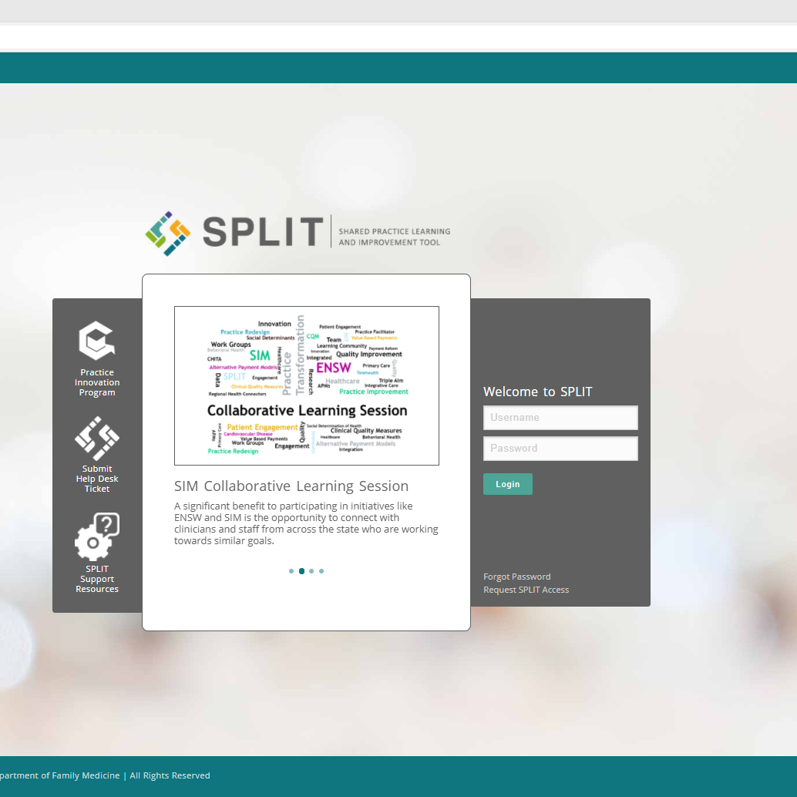
Any SPLIT Issues?
Notes:
Andrew?

Slide 5
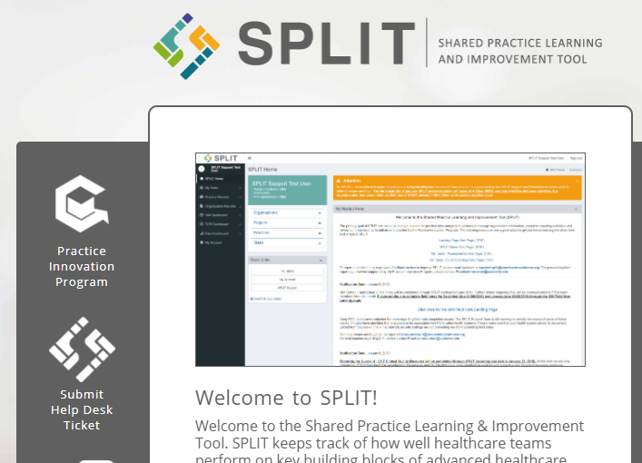
ISP Issues
Please submit a help desk ticket if you are still having issues
Using the help desk helps us see any trends and more quickly resolve errors.
URL https://split.practiceinnovationco.org/
SPLIT questions incorporated into monthly Touchbase calls
Notes:
Andrew?

Slide 6


Future Events
7/21 - SOR – Denver Health MAT Learning Collaborative; 12:15-1:15 pm
8/11 - ISP PTO Touchbase; 9:00-10:00 am
8/18 - SOR – Denver Health MAT Learning Collaborative; 12:15-1:15 pm
8/25 – FAST PTO Touchbase; 9:00-10:00 am
Notes:
Kathy?

Slide 7

What’s on
Your Mind?
Notes:
Kathy

Slide 8
Resources
Practice Innovation Program Colorado http://www.practiceinnovationco.org/
Events http://www.practiceinnovationco.org/events/
Innovation Support Project (ISP) https://www.practiceinnovationco.org/isp/
PIPCO: Coronavirus Resources https://www.practiceinnovationco.org/covid-19/
CMS Medicare Quality Payment Program (QPP) https://qpp.cms.gov/
Notes:
Kathy

Slide 9
University Practice Innovation Team Contact Information
Practice Transformation – Stephanie.Kirchner@cuanschutz.edu
Learning Community – Kathy.Cebuhar@cuanschutz.edu
CQMs – Andrew.Bienstock@cuanschutz.edu; Jennifer.Halfacre@cuanschutz.edu
e-Learning – Bonnie.Jortberg@cuanschutz.edu or Robyn.Wearner@cuanschutz.edu
ISP - Jennifer.Halfacre@cuanschutz.edu
ISP Project Manager - Kristin.Crispe@cuanschutz.edu
ISP Faculty – Pam Ballou-Nelson; Pam@healthcareconsultinginc.com
SPLIT – Help Desk
Notes:
Kathy

