Slide 1
SPLIT 1302 Training Shared Practice Learning & Improvement Tool
Practice Innovation Program Colorado
at CU Department of Family Medicine

Slide 2
Objective & Agenda
Objective: To provide an overview of SPLIT functionality.
Agenda:
SPLIT Overview – Major sections and organization of SPLIT
How to find information in SPLIT
Practices
PTOs
Q & A
Assements and surveys

Slide 3
Split Overview
SPLIT Landing Page
Help Desk Ticket
SPLIT Support Resources
Request SPLIT Access
Forgot Password
Home Page
Project Dashboard

Slide 4
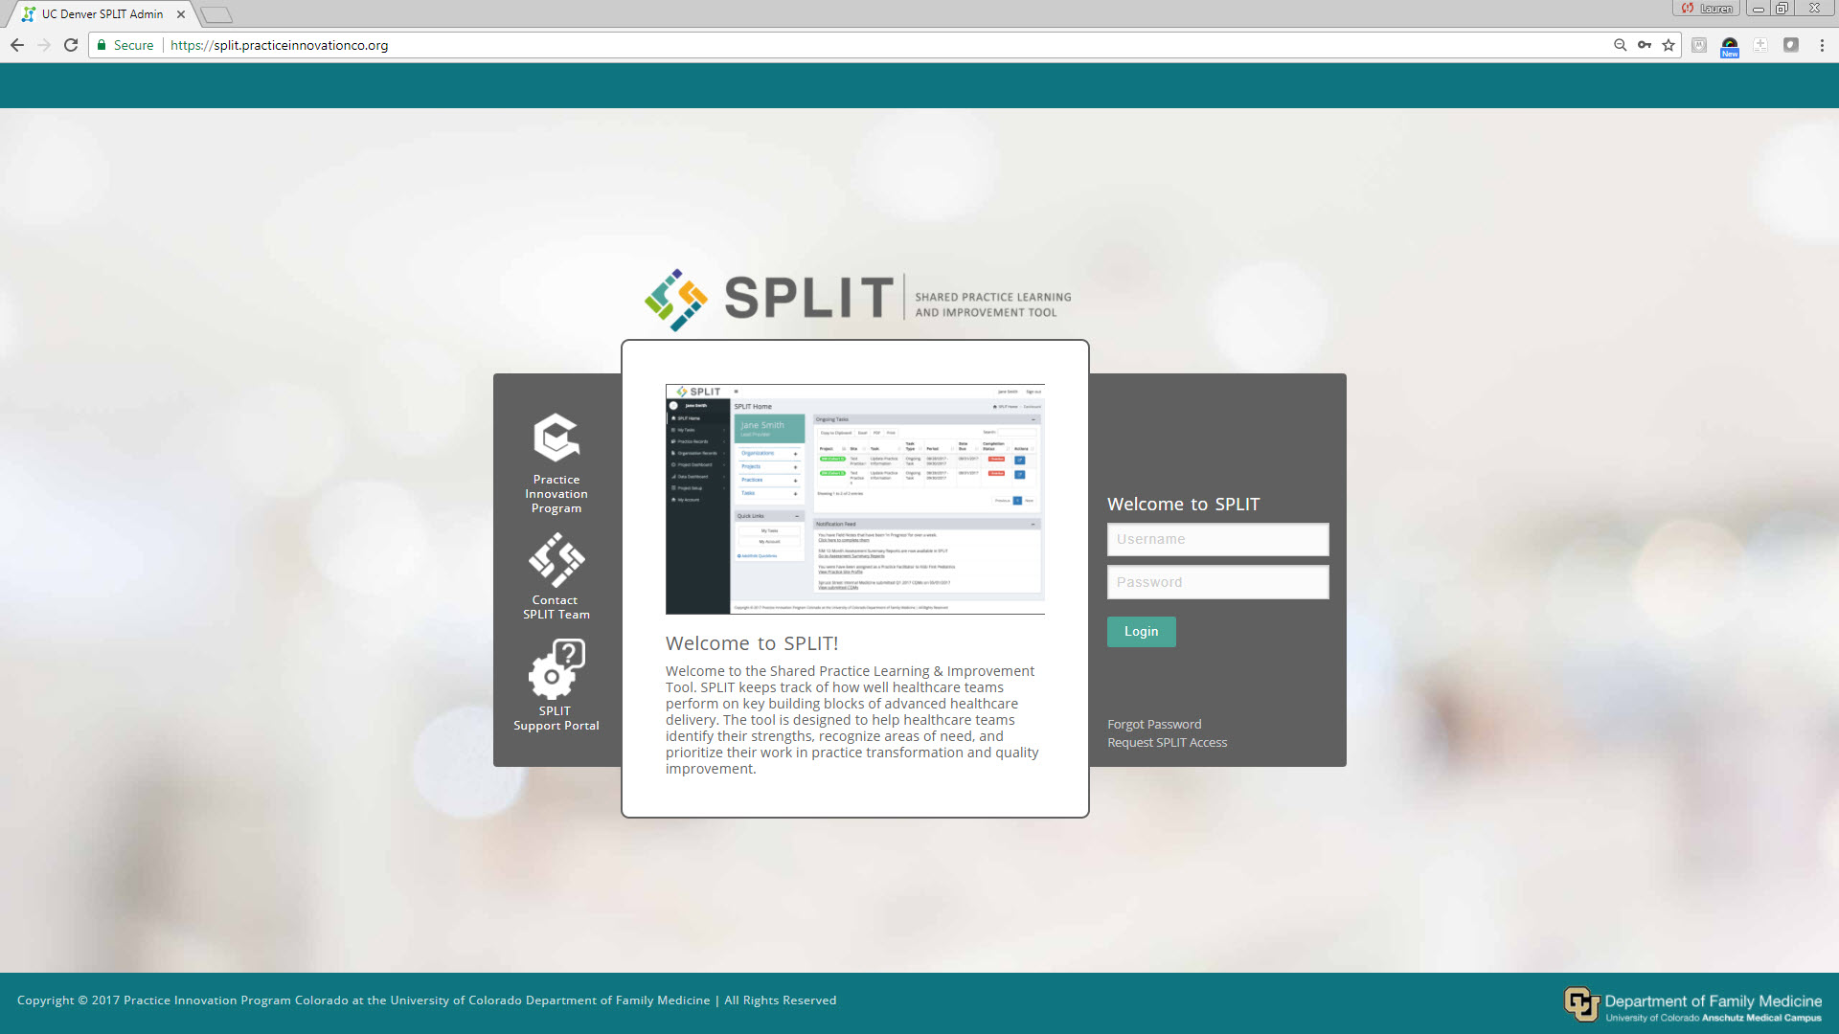
https://split.practiceinnovationco.org

Slide 5
Logging into split for the first time
1. On the home page click on "forgot password"
2. Use your work email to set up your account
3. An email will be sent to you to create password
4. Be sure to check your junk folder if you don’t see it

Slide 6
Assigning facilitators
To assign facilitators:
PTO lead will the email support desk with name, practice name, and the coaches emails.

Slide 7
How to reach out to the support desk
Click on "Submit Help Desk Ticket" on the SPLIT landing page or email support@practiceinnovationco.org

Slide 8
Office hours
Please feel free to reach out to Andrew and Lauren anytime.
November 30th at 11:00am

Slide 9
Assessments
Building Block Assessment: Looks at where practice stands in comparison to the Behavioral Health Framework (Baseline)
Baseline Goal Collection: Practice Facilitator works with practice to document the main goals the practice will work on over the course of the project. (These will feed into the Field Note and the Quarterly Snapshot survey tools) This should tie into or be the same as the goals that the practice documents on HCPF's Work Plan Template. (Baseline)
Monthly Field Note: Opportunity for Practice Facilitator to briefly describe the work they did with the practice around the practices goals that month. (Monthly)
Quarterly Snapshot: In depth documentation of the work Practice Facilitator is doing with the practice around practice goals. Opportunity to document the progress, successes, struggles, and sustainability of the practices goals. (Quarterly)
Notes:
Andrew

Slide 10
Behavioral Health Integration 1302 YEar 1 PTO Assessment Schedule
Activity | Completion Expectation | Final Due Date
November 2023 Field Note |  | 12/8/2023
December 2023 Field Note |  | 1/8/2024
Baseline Goal Collection Tool | To be completed by the end of the month following the month of the start of facilitation (ex. Due November 30 for practices beginning facilitation in October) | 1/31/2024
Baseline Building Blocks of Behavioral Health Integration: Care Delivery Assessment | To be completed by the end of the month following the month of the start of facilitation (ex. Due November 30 for practices beginning facilitation in October) | 1/31/2024
Quarterly PTO Snapshot- Q4 2023 |  | 1/31/2024
January 2024 Field Note |  | 2/8/2024
February 2024 Field Note |  | 3/8/2024
March 2024 Field Note |  | 4/8/2024
Quarterly PTO Snapshot- Q1 2024 |  | 4/30/2024
Building Blocks of Behavioral Health Integration: Care Delivery Assessment |  | 5/15/2024
April 2024 Field Note |  | 5/8/2024
May 2024 Field Note |  | 6/8/2024
June 2024 Field Note |  | 6/30/2024
Quarterly PTO Snapshot- Q2 2024 |  | 6/30/2024

Slide 11
QUESTIONS?

Slide 12
Thank you!

