Slide 1




1302 COLLABORATIVE LEARNING SESSION
Jenn Leiferman, PhD
Sarah Gelinas, MPH
April 21, 2025

Slide 2
Accreditation & Credit Designation Statements and Disclosure Information
Joint Accreditation Statement
In support of improving patient care, this activity has been planned and implemented by the University of Colorado and the American Society of Addiction Medicine. The American Society of Addiction Medicine is jointly accredited by the Accreditation Council for Continuing Medical Education (ACCME), the Accreditation Council for Pharmacy Education (ACPE), and the American Nurses Credentialing Center (ANCC), to provide continuing education for the healthcare team.
Physicians
The American Society of Addiction Medicine designates this live activity for a maximum of 5 AMA PRA Category 1 Credits™. Physicians should claim only the credit commensurate with the extent of their participation in the activity.
Nurses
This activity awards 5 Nursing contact hours.
Social Workers
As a Jointly Accredited Organization, ASAM is approved to offer social work continuing education by the Association of Social Work Boards (ASWB) Approved Continuing Education (ACE) program. Organizations, not individual courses, are approved under this program. Regulatory boards are the final authority on courses accepted for continuing education credit. Social workers completing this course receive 5 general continuing education credits.
Disclosure Information
In accordance with disclosure policies of ASAM and Joint Accreditation, the effort is made to ensure balance, independence, objectivity, and scientific rigor in all CME/CE activities. These policies include mitigating all relevant financial relationships with ineligible companies for the Planning Committees and Presenters. All activity Planning Committee members and Presenters have disclosed all financial relationship information. The ASAM CE Committee has reviewed these disclosures and determined that the relationships are not inappropriate in the context of their respective presentations and are not inconsistent with the educational goals and integrity of the activity. The planners, faculty and have no relevant financial relationships.
Notes:
Then lastly, Module 3 – Action to Impact: Investigating STANCE through Evaluation and Sustainability discusses what evaluation is and how this can be done, we provide what we did but really make sure to emphasis that any form of evaluation, big or small can be helpful. With sustainability – we took time to discuss some of the major factors that impacted the sustainability to STANCE in the SLV and the lessons we learned from that and also provide a “STANCE best practice Menu” that we used in the SLV to guide the ECE centers on how to choose the parts they wanted to sustain and make a plan to do that.

Slide 3


Agenda
STANCE Background, Overview and Goals
STANCE Study Methods​
STANCE Study Results
STANCE Toolkit and Dissemination Plan

Slide 4

Thank You to Our Team
  San Luis Valley (SLV) Early Childhood Council Team
  SLV Early Childhood Centers
  SLV Interagency Oversight Group
  SLV Community Advisory Board
  Jenn Leiferman (MPI)​
  Jini Puma (MPI) ​
  Marlayna Martinez​
  Mara Hsu​
  Veronica Cisneros​
  Angela Haynie​
  Dave LaRocca​
  Jamie Powers​
  Sarah Gelinas
  Sharon Scarbro​
  Jenny Lawlor​
  Betsy Risendal​
  Danielle Varda​
  Glen Mays​
  Beth McManus​
  Sarah Schmiege​
  Heather Smyth

Slide 5
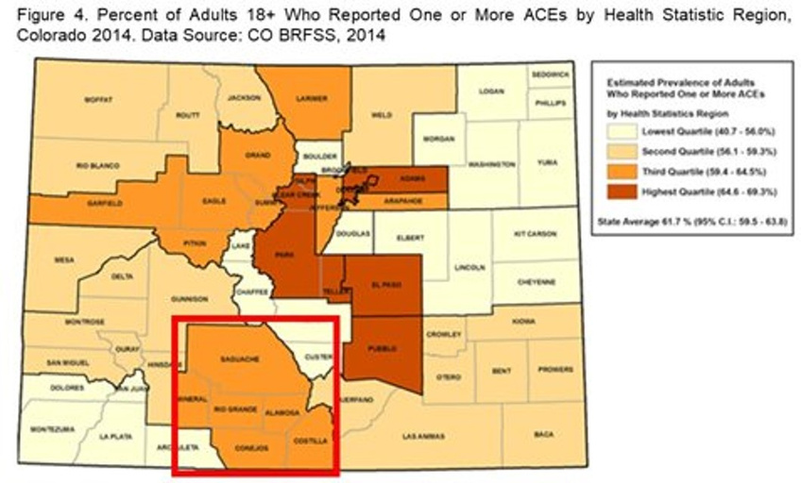
STANCE Background: Our Community Partner
San Luis Valley (SLV), CO
The RMPRC has cultivated a 25-year long academic-community partnership with the SLV to conduct community-engaged research.
  The SLV is a large rural region of over 8,000 square miles consisting of 6 counties
  Half of the residents are of Hispanic origin
  A quarter have a household income below the poverty level
  Faces significant health disparities and has been identified as:
    A Health Professional Shortage Area
    A Medically Underserved Area
Source: Colorado Department of Public Health and the Environment, 2017​

Slide 6
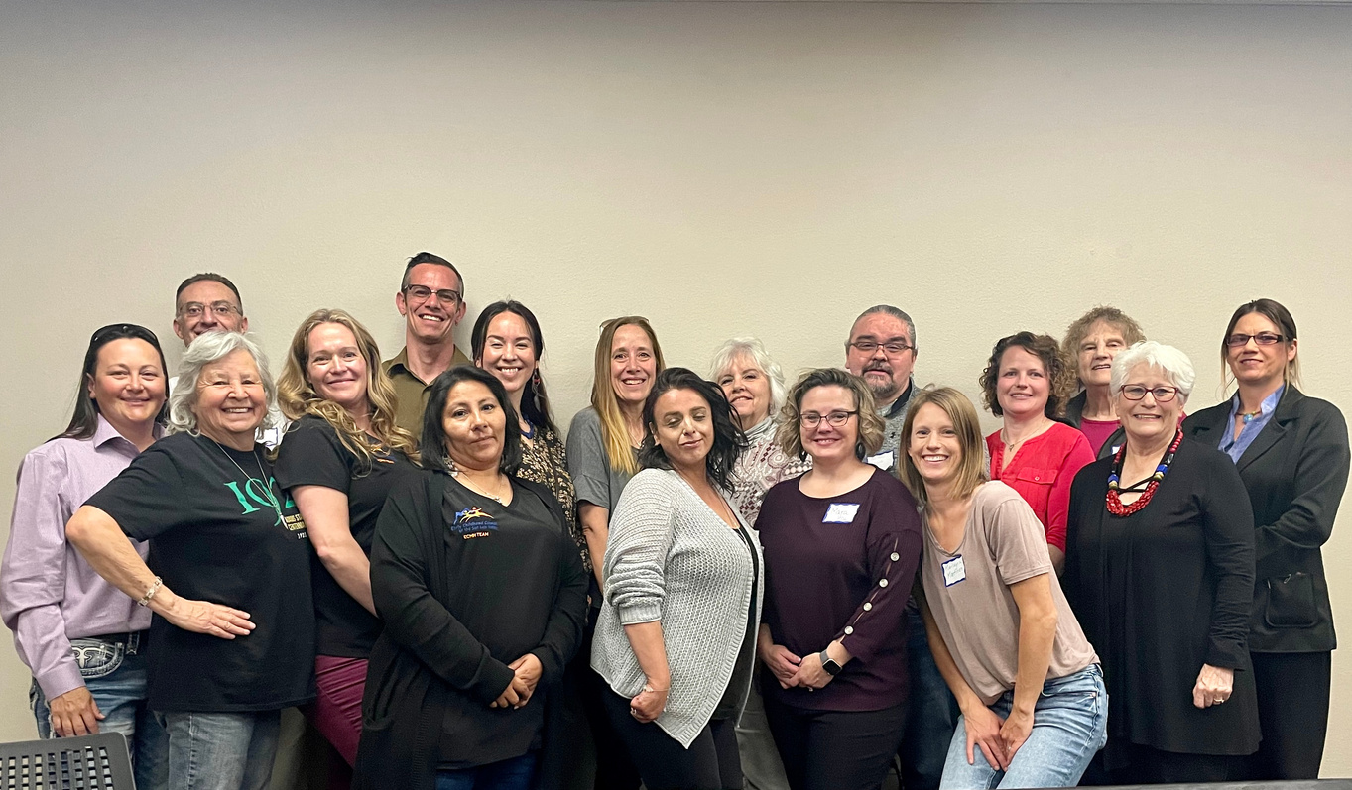
STANCE Background
“Year of Learning” with the SLV Community Advisory Board (CAB)
  Conducted interviews with community leaders
  Based on these interviews, the CAB selected topics they wanted to learn more about during the 2017 “Year of Learning” process and invited speakers to join their meetings to present on these topics
  The CAB chose “Adverse Childhood Experiences (ACEs) in early childhood as the topic to address in the Core Research Project
  The CAB worked with the RMPRC academic team and the Early Childhood Council of the SLV to develop STANCE, leveraging the work already in place and well-known by community members
SLV CAB

Slide 7





Types of ACEs
What are ACEs?
Adverse Childhood Experiences (ACEs) were first defined in the CDC Kaiser ACE study in 1998 as potentially traumatic or intense events in childhood (0-17 years).
  Can have big impacts on a child’s developing brain and body
  Can have lasting impacts on a person’s health throughout the lifespan impacting outcomes of disease, mental health, quality of life, care utilization and mortality
Abuse
Neglect
  Emotional
  Physical
  Sexual
  Emotional
  Physical
Household Dysfunction*
Other Adversities
  Substance misuse
  Mental Illness
  Suicidal thoughts or behavior
  Divorce or separation
  Incarceration
  Intimate partner violence or domestic abuse
  Bullying
  Community violence
  Natural disasters
  Refugee or wartime experiences
  Witnessing or experiencing acts of terrorism
*The child lives with a parent, caregiver, or other adult who experiences one or more of these challenges.
CDC, 2024

Slide 8

What are BCEs?
Types of BCEs
  Having at least one caregiver you feel safe with
  Having at least one good friend
  Having beliefs that give you comfort
  Liking school
  Having at least one teacher who cares about you
  Having good neighbors
  Having an adult (outside of a parent/caregiver) who could provide support or advice
  Having opportunities to have a good time
  Liking yourself or feeling comfortable with yourself
  Having a predictable home routine
Benevolent Childhood Experiences (BCEs) are protective factors that act in opposition to ACEs. They refer to a range of positive early life experiences and influences that can buffer against the negative impacts of ACEs.
  Experiences that reflect love, predictability and support, promote resiliency and positivity
  Categories include healthy attachment bonds, effective parenting behaviors, access to community resources and support, and social connections
Narayan, A. J., Rivera, L. M., Bernstein, R. E., Harris, W. W., & Lieberman, A. F. (2018). Positive childhood experiences predict less psychopathology and stress in pregnant women with childhood adversity: A pilot study of the benevolent childhood experiences (BCEs) scale. Child Abuse and Neglect, 78, 19-30. doi: 10.1016/j.chiabu.2017.09.022

Slide 9
STANCE Overview and Goals
STANCE is a multi-level, multi-generational, community-based intervention within a systems framework that aims to decrease the intergenerational transmission of ACEs and promote protective factors for young child and their families. Below are the specific goals of STANCE.
Build community awareness of ACEs | Increase the identification of children experiencing ACEs | Increase the use of evidence-based intervention strategies in ECE settings | Improve the linkage of affected children and their families to appropriate support services

Slide 10
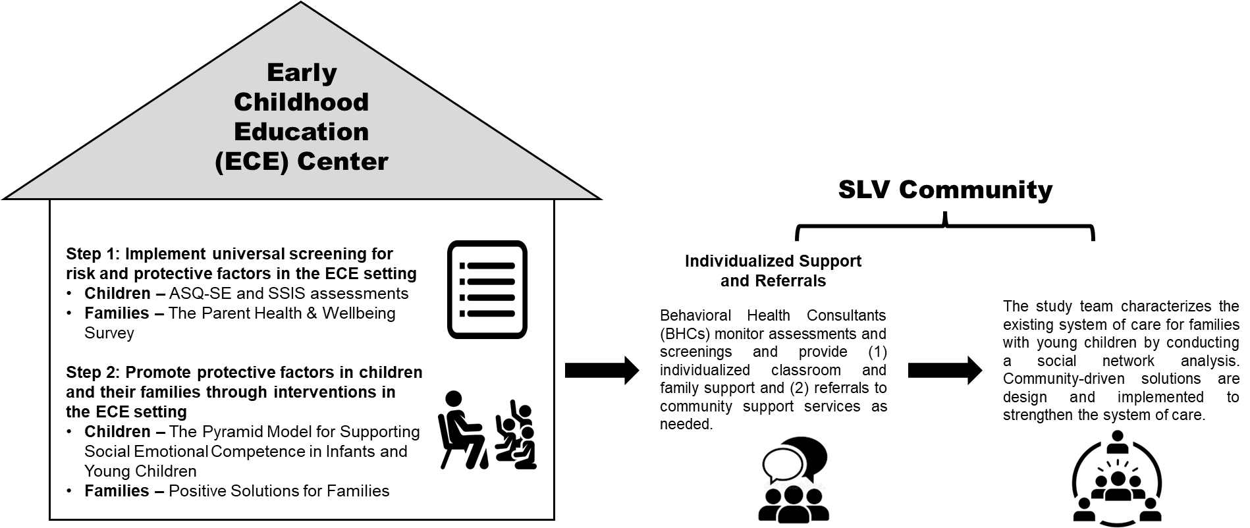
STANCE Overview and Goals

Slide 11
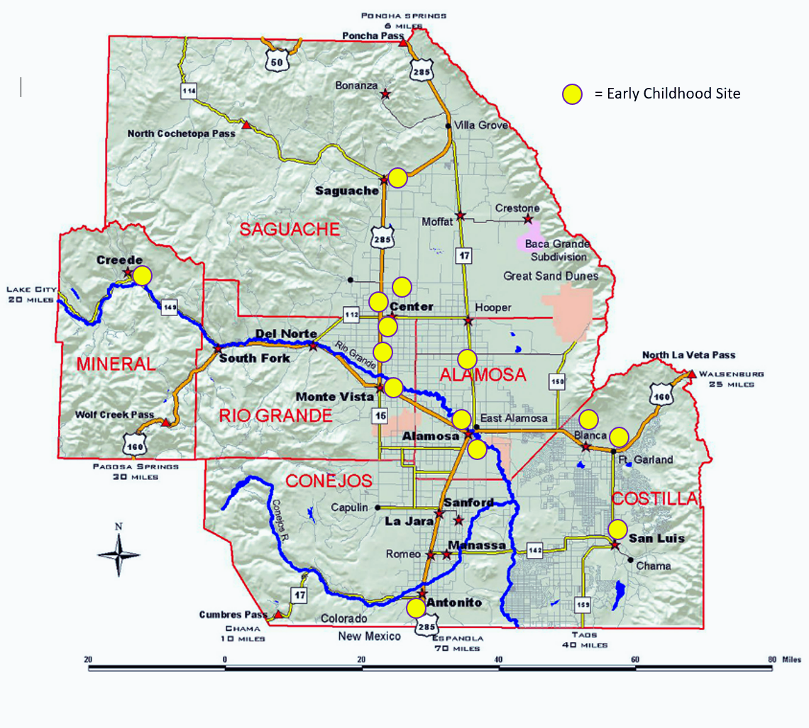
STANCE Study Methods
We partnered with 15 out of the 21 Early Childhood Education Centers in the SLV.
There were 3 cohort groups:
  Cohort 1: Centennial, Wee Care, Marsh, Haskin, Tiny Hands
  Cohort 2: Creede, Center EHS, Center HS, Sargent, Sierra Grande
  Cohort 3: Children’s Garden, Gingerbread, South Conejos, Mountain Valley, Sangre

Slide 12
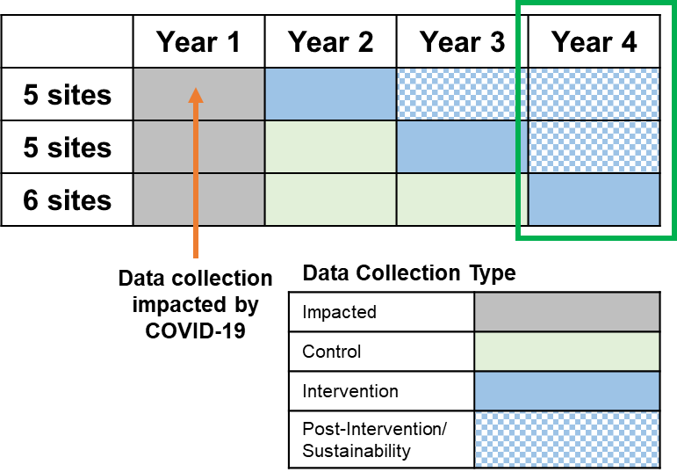
STANCE Study Design
  ECEs randomly assigned to one of 3 cohorts
  Cohort 1 started the STANCE program in Y2 and Cohorts 2 & 3 served as controls
  Cohort 2 started the STANCE program in Y3 and Cohort 3 served as a control
  Cohort 3 started the STANCE program in Year 4
  After the intervention year, ECE sites went into a “sustainability” phase

Slide 13
STANCE Assessment Tools and Timeline
 | Effectiveness Study Outcomes | Measurement Methods | Project Timeline | Project Timeline | Project Timeline | Project Timeline | Project Timeline
 | Effectiveness Study Outcomes | Measurement Methods
 |  |  | X | X | X | X
 |  |  |  | X | X | X
 |  |  |  | X | X | X
 |  |  |  | X | X | X
 |  |  |  | X | X | X
 |  |  |  | X | X | X
 |  |  |  | X | X | X
 |  |  | X |  |  | X
 |  |  |  | X | X | X
Y1
Y2
Y3
Y4
Y5
Increased social-emotional development in children, including (1) improved social skills, (2) improved problem behaviors
Ages and Stages Questionnaire: Social-Emotional (ASQ:SE); Social Skills Improvement System (SSIS) assessment
Primary Outcomes
Increased percent of children and caregivers screened for ACEs, protective factors, and mental health conditions
ECE Screening and Referral Form
Increased percent of children and caregivers referred for additional support services, if needed
ECE Screening and Referral Form
Number of caregiver and child ACEs
Health and Wellbeing Survey
Decreased depressive symptoms for caregivers
Patient Health Questionnaire (PHQ-8) [part of the Health and Wellbeing Survey]
Decreased anxiety symptoms for caregivers
Generalized Anxiety Disorder scale (GAD-7) [part of the Health and Wellbeing Survey]
Secondary Outcomes
Increased attitudes and behaviors related to social-emotional development in children for caregivers
STANCE Positive Solutions for Families Parent Survey
Improved systems-level network, including (1) increased strength of ties, (2) increased agreement amongst network partners, (3) increased trust
PARTNER Tool
Improved personal-level network, including (1) increased types of supports, (2) increased levels of supports
PARTNERme

Slide 14
Step 1: Implement Universal Screening for Risk and Protective Factors
REACH | RESULTS | LESSONS LEARNED
115 caregivers completed a Health and Well-being screener 21% of families screened were connected to additional supports |  | Screening can start a conversation and raise awareness about a health concern Including BCEs, other protective factors, and an assets-oriented approach is critical Screening with appropriate follow up is essential
 | ACEs | BCEs
Children | 30% had at least 1 7% had 4 or more | 99% had at least 1 86% had 8 or more
Parent/ Caregiver | 69% had at least 1 29% had 4 or more | 98% had at least 1 82% had 8 or more
Compared to a national study where 64% of adults reported at least 1 ACE and 17% reported 4 or more (Swedo et al., 2023), adults in the STANCE project reported much higher prevalence of ACEs.

Slide 15
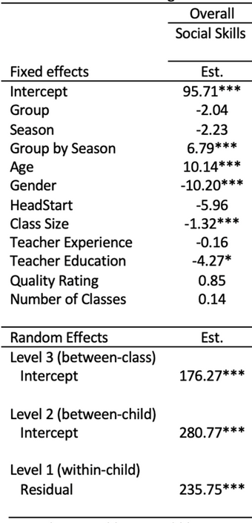
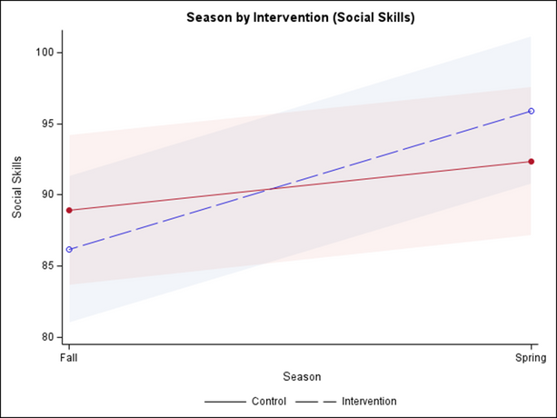
Step 2: Promote Protective Factors for Children and Families
Primary Research Question: Did STANCE improve children’s social-emotional development?
Social Emotional Assessment Data for Children (2.5-5 years old)
REACH | RESULTS
1,511 children assessed for social skills and challenging behaviors 862 children received intensive Pyramid Model strategies in the classroom | There was a statistically significant impact on children’s social skills with increases in cooperation, assertion, empathy, engagement, responsibility, communication and self-control
Note: * p <.05, ** p <.01, *** p <.001. Fixed effect p-values are two-tailed. Random effect p-values are one-tailed.
Reference categories coded 0: Group = Control, Season = Fall, Gender = Female, HeadStart = No.
Continuous predictors are centered at grand mean.

Slide 16

Step 2: Promote Protective Factors for Children and Families
Increases included:
Use of schedules and routines ​
Pyramid Model Training and Coaching for ECE Teachers
Use of transitions between activities being appropriate​
Teaching social and emotional competence​
REACH | RESULTS
140 teachers received Pyramid Model training and coaching 706 hours of training and coaching was provided | There were statistically significant increases in teachers use of evidence- based teaching strategies learned through the Pyramid Model
Teaching friendship skills​
Teaching children to express emotions​
Teaching problem solving​
Interventions for children with persistent challenges​
Supporting family use of Pyramid Model practices

Slide 17

Step 2: Promote Protective Factors for Children and Families
Parent/Caregiver Positive Solutions for Families Data
Increases included:
REACH | RESULTS
106 caregivers participated in PSFF 61% of caregivers attended 4 or more classes | There were significant increases in caregivers knowledge and use of skills
Positive reinforcement
Emotional literacy
Problem solving strategies
Overall knowledge of supporting social-emotional development
Overall confidence in promoting social emotional development

Slide 18
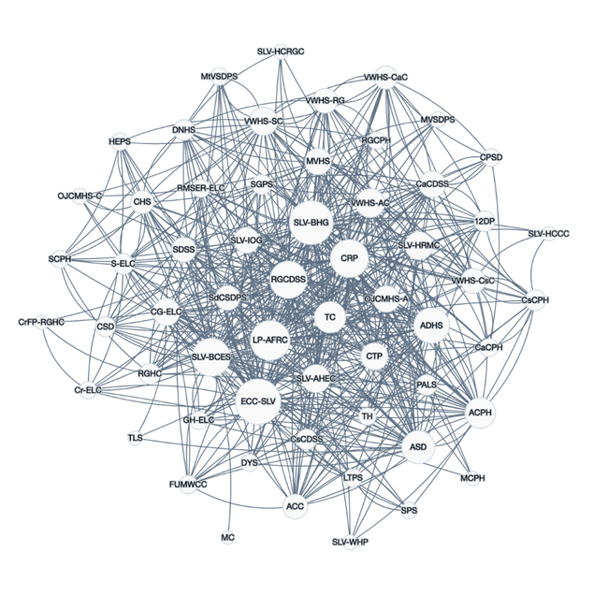
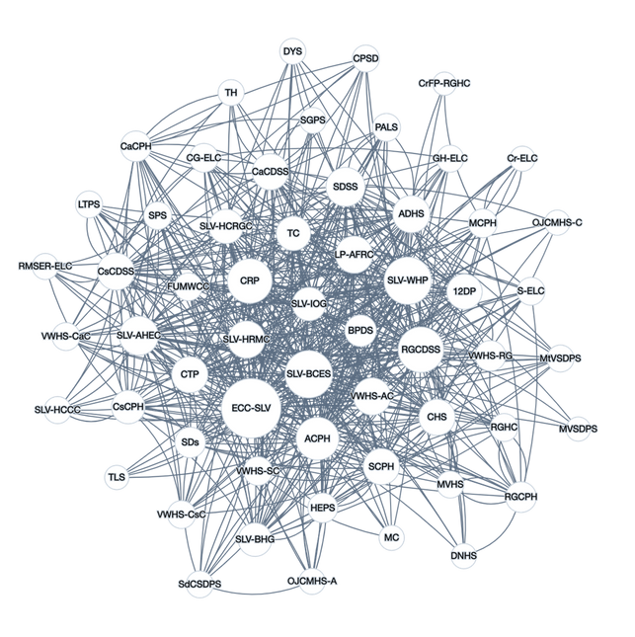
Step 3: Strengthen Community Service Network
Social Network Analysis
Time 1 - beginning of STANCE
We conducted a community-level social network analysis via the PARTNER (Program to Analyze, Record, and Track Networks to Enhance Relationships) tool to characterize existing ACEs services system of care and develop and implement community-driven solutions to strengthen the system of care.
PARTNER Tool Data
REACH | RESULTS
2020 - 59 organizations (75% response rate) 2023 - 58 Organizations (88% response rate) | The level of networking increased between time 1 and time 2 Key aspects of this enriched network included activities such as a significant increase in the sharing of information and data, an increase in client assessments, an increase in the sharing of tools and technologies
Time 2 - end of STANCE

Slide 19


The Development of the STANCE Toolkit
  It was an iterative and collaborative process
  Interviews with community implementors informed and directed key points to include in the STANCE toolkit
  We sought consistent feedback from the SLV CAB, Project Steering Committee, SLV community implementors, and our state and national partners
  We partnered with the Rocky Mountain Public Health Training Center to develop the online modules
Notes:
- Given that we found significant findings across levels of child, parent, teacher and network outcomes, we moved forward with the dissemination of STANCE through a variety of methods, one of those being the STANCE Toolkit.
- The development of STANCE toolkit was an iterative, collaborative, and thoughtful process, we consulted with an expert within Dissemination and Translation research to outline the modules and then worked as a team to write the toolkit content using knowledge gained from our interviews with community implementors including ECE directors, teachers, and parents, and CAB members. We spent a lot of time really thinking through each aspect of STANCE and what a community would need to implement this framework outside of the support we had due to it being a research project. The lessons we learned throughout the implementation really dictated the critical points we emphasized in the toolkit, along with continual feedback from the community.
-To develop the online modules, we partnered with the Rocky Mountain Public Health Training Center. They are a HRSA funded center that are experts within the field of public health training development and brought our vison to life.
- We found that the magic in STANCE was our community engaged foundation, our community partnerships, and the relationship and trust that they had already cultivated with our target population. They were viewed as well-known trusted messengers within the community which helped to generate buy in and motivation to implement STANCE.

Slide 20
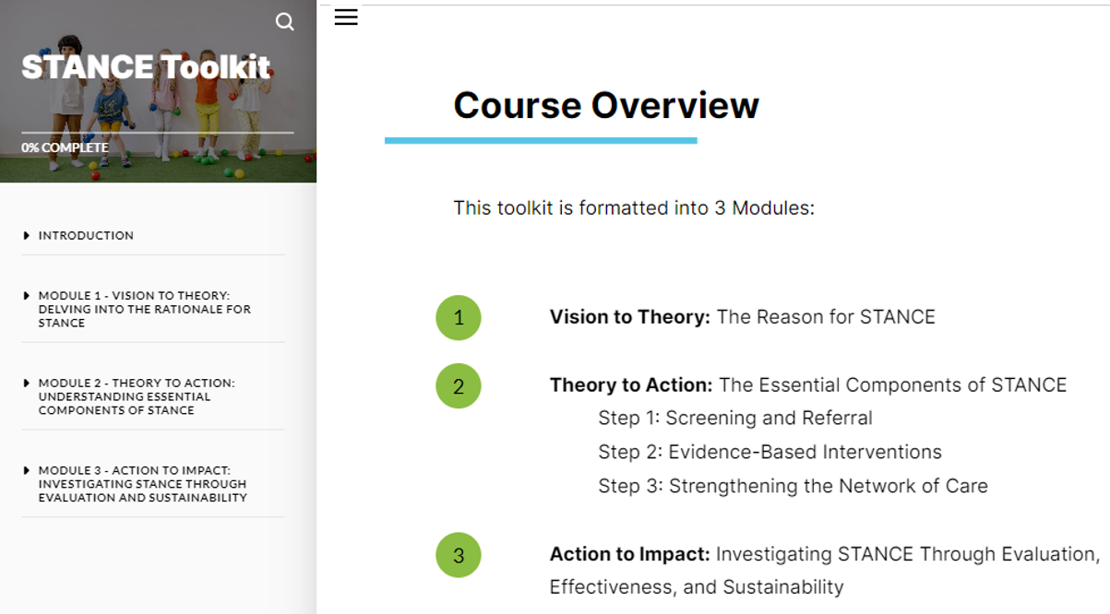
The STANCE Toolkit
Packages every component of STANCE into a free, online, self-paced toolkit that other communities can use as a guide to adopt, adapt, implement, evaluate and sustain STANCE
Notes:
This toolkit packages every component of STANCE into a free, online, self-paced toolkit that other communities can use as a guide to adopt, adapt, implement, evaluate and sustain STANCE. We ended put splitting the toolkit into three main modules, outlined here:
- Module 1: Vision to Theory: The Reason for STANCE
- Module 2: Theory to Action: The Essential Components of STANCE ,
and Module 3: Action to Impact: Investigating STANCE through Evaluation, and Sustainability
I will get into each of these modules in a second but wanted to mention that one of our main goals with the toolkit was to make the content interactive and engaging with a variety of different ways people can learn and apply the information. This includes interactive text and figures, videos, including case study videos from community members such as CAB members, teachers, directors and program implementors, knowledge check’s, reflection activities, worksheets and assessments

Slide 21
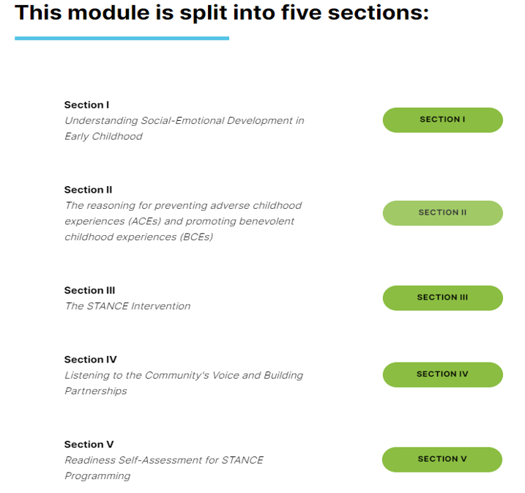
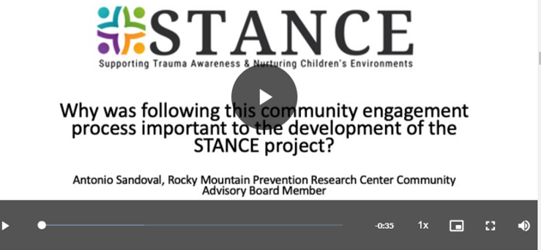
Module 1 - Vision to Theory: The Reason for STANCE
Notes:
Module 1 is designed to give communities a foundation for developing STANCE, answering the questions of ‘what do we need to know about STANCE before we decide to move forward with implementing it?” and the goal by the end of this module is that communities understand the impact of ACEs and BCEs, and they learn how to assess the resources they need to address them using the STANCE framework.

Slide 22
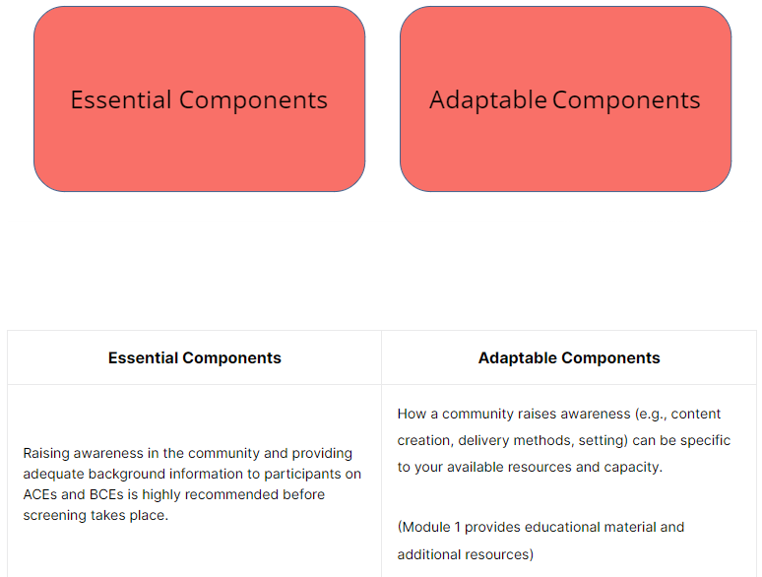
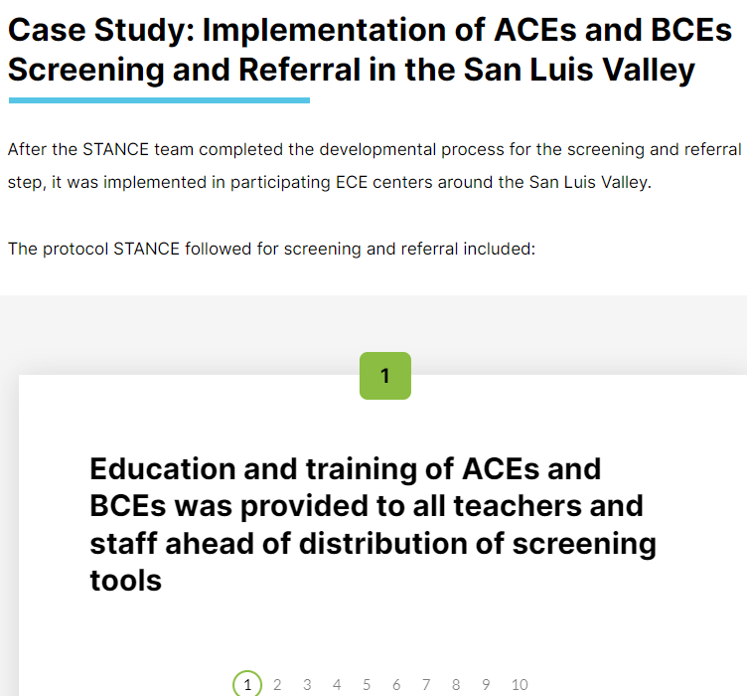
Module 2 - Theory to Action: The Essential Components of STANCE
Notes:
Module 2: theory to action: the essential components of STANCE, is the meat of the toolkit and really breaks down each of the three steps of STANCE. Each step follows the same outline where we provide learning objectives, delve into the evidence behind the step, so as an example for step 1 – Universal screening and referral we talk about what screening is, the benefits and challenges of it and important considerations when implementing screening especially for ACEs. We then talk about each component in detail, emphasizing the parts that are essential to keep and the parts that are adaptable, which is what this picture here on the left is giving you a sneak peak of. We lay out the exact steps we took when implementing it but also make sure to highlight that it is not meant to be implemented the exact same way we did, we share this as an example for how to apply the framework.

Slide 23
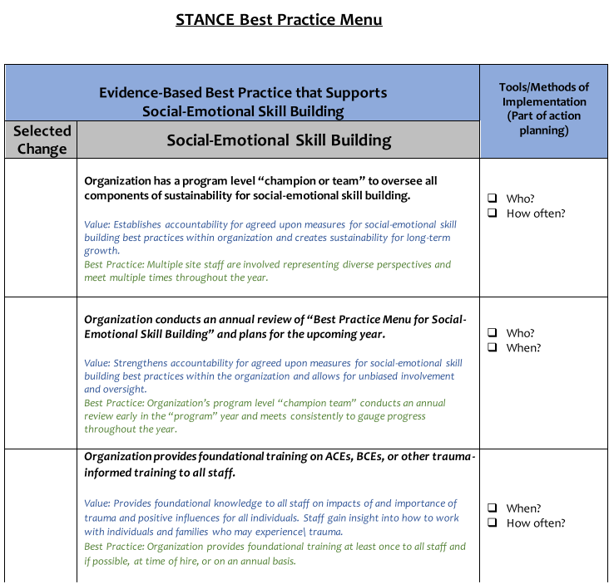
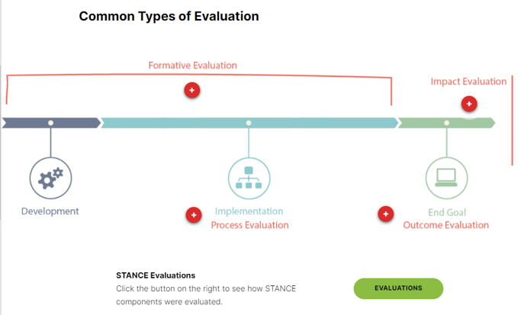
Module 3 - Action to Impact: Investigating STANCE Through Evaluation and Sustainability
Notes:
Then lastly, Module 3 – Action to Impact: Investigating STANCE through Evaluation and Sustainability discusses what evaluation is and how this can be done, we provide what we did but really make sure to emphasis that any form of evaluation, big or small can be helpful. With sustainability – we took time to discuss some of the major factors that impacted the sustainability to STANCE in the SLV and the lessons we learned from that and also provide a “STANCE best practice Menu” that we used in the SLV to guide the ECE centers on how to choose the parts they wanted to sustain and make a plan to do that.

Slide 24

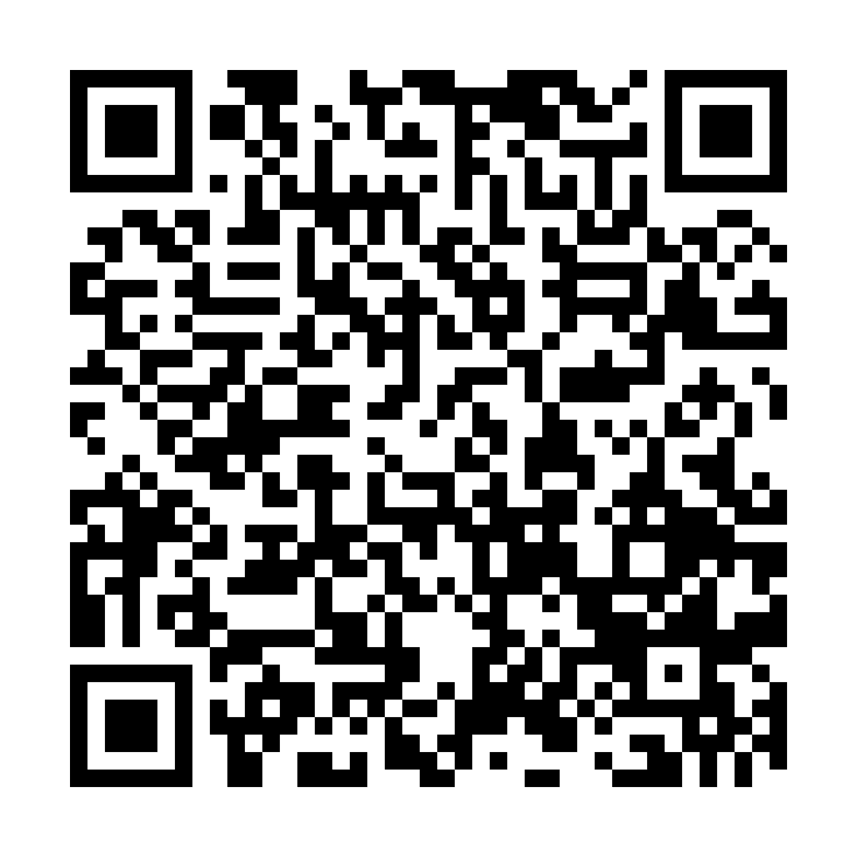
Dissemination Plan for the STANCE Toolkit
  Pilot Test the STANCE Toolkit
    Work with select urban and rural communities
  Provide technical assistance to communities utilizing the toolkit
    Webinars
    Frequently asked questions page and email support
    Evaluation Surveys
    Implementation support through site visits
  Toolkit is live and we are working on disseminating it to communities across Colorado
Scan me to complete a registration survey and receive a link to the STANCE toolkit:

Slide 25

STANCE in Clinical Settings
  Screening for ACEs and BCEs
    Build a trusted relationship
    Provide education
    Include protective factors
    Have appropriate referrals and resources in place
  Implement an evidence-based intervention for social emotional development
    For staff, case workers, parents/caregivers
  Strengthen network of care
    Build relationships with community organizations, healthcare providers, nurses, case workers, etc.

Slide 26



Thank you!
Questions or comments?
Contact Us:
Jenn Leiferman, PhD
RMPRC Director
jenn.leiferman@cuanschutz.edu
Sarah Gelinas, MPH
Professional Research Assistant
sarah.gelinas@cuanschutz.edu
RMPRC Website

