Slide 1

Welcome!
Please put your name, pronouns, practice name, and role in the chat.
You can ask questions via the chat we will monitor it as we go along. We will also pause for questions periodically.
These slides and the recording will be made available on the Practice Innovation Program website.
https://medschool.cuanschutz.edu/practice-innovation-program/current-initiatives/1302-behavioral-health-integration/for-practices
Notes:
Kathy

Slide 2

AGENDA
Upcoming Events – Kathy
The Role of Social Work and Care Management in Integrated Primary Care
Carolyn McCann Reynolds, LCSW
Ambulatory Social Worker
Family Medicine, Westminster
AMC Internal Medicine
UCHealth
Notes:
Open = 5 min, 2:00-2:05
e-Learning = 5 min, 2:05-2:10
SUD = 45 min, 2:10-2:55
Close = 5 min, 3:00

Slide 3
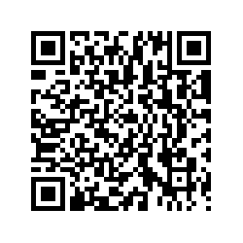
Scan to complete evaluation
https://practiceinnovationco.co1.qualtrics.com/jfe/form/SV_6YynHhJgFKtHWUm

Slide 4
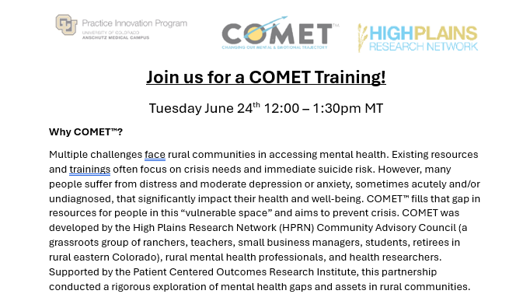

Events on the Horizon
May 21, 2025, How to Conduct a Waste Walk: Observations from a Pediatric Practice
  Pam Ballou-Nelson and Altitude Pediatrics
  June 11, 2025 – Business Operations Webinar, Reimbursement strategies from practices
Scan QR code to register

Slide 5
Social Work in Integrated Primary Care
Carolyn McCann, LCSW
Maggie Chaves, MSW Candidate
Notes:
Carolyn
Also talk about intern

Slide 6
Broader range of health, mental health, social and economic aspects of a persons' life has led to a greater need of social work and care management in integrated primary care settings.
Significant Changes in Healthcare
Notes:
Carolyn
In Social Work we look at the Whole Person – patient's lives are complex- we work, we live, we care and there so many factors affecting ones health

Slide 7
Social work and care management in the primary care settings makes sense today as many people address their mental health, social and economic needs for the first time in their Primary Care Provider office.
Front lines of Healthcare
Notes:
Carolyn AFTER reading the slide- For many of our patients- the first time they acknowledge factors affecting their health is in the PCP office. It is a place patients feel safe, validated and less isolated in what they may be going through.
AFTER reading the slide- For many of our patients- the first time they acknowledge factors affecting their health is in the PCP office. It is a place patients feel safe, validated and less isolated in what they may be going through.

Slide 8
Social Work/Care Management in Integrated Primary Care
Improve patient care and reduce the need for medical services by enhancing coordination of care, eliminate duplication and helping patients and caregivers more effectively manage health conditions.
Notes:
CarolynWe are the connectors our goal is to

Slide 9
Social Work/Behavioral Health in Integrated Primary Care
In response to a call for increased accountability, cost-effectiveness and application of evidence-based practices , the profession of social work is shifting to integrate behavioral health specialists (LCSW's and LSWs) in primary care.
Notes:
Carolyn There is a great need for Behavioral health today, we also recognize that many people at some point in their lives may need behavioral health supports. There also less stigma and more education around the value of behavioral health

Slide 10
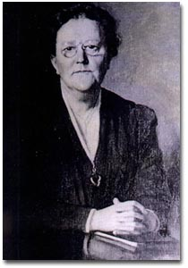
History of Social Work/Care Management Medical Setting
w
1906 - Ida Maude Cannon, founded the first hospital-based social work program at Mass General, hired on by Richard Cabot (leading physician). She worked as a nurse and social worker with a focus on outpatient clinics bridging the gap between "medical care and community and social needs"​.
1955- National Association of Social Workers (NASW) was established to enhance professional growth and development, create and maintain professional standards and advance social policies.
1990 - Case Management Society of America was founded to support and develop the profession of case management. ​
1995 - Standards of Practice for Case Management was created for healthcare workers to meet patient's health and human service needs. ​
​
​
​
Notes:
Maggie
As I mentioned in the earlier slide, in response to greater accountability and evidence based practices, Case Management Society was established. If anyone has watched "Call the Midwife- there is a focus on social factors affecting peoples lives.

Slide 11
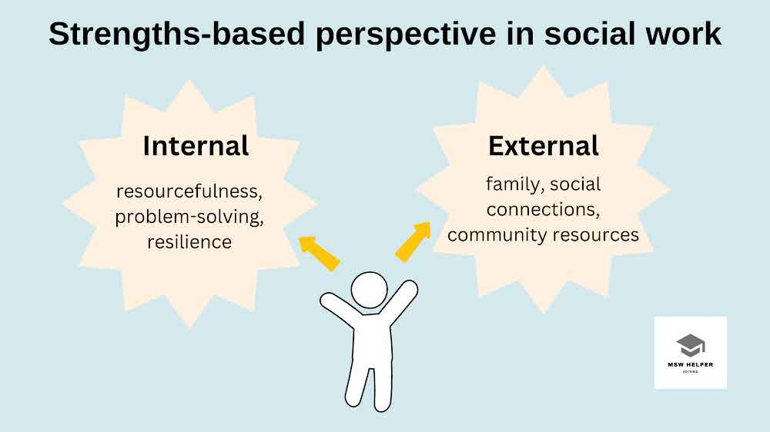
Role of Social Work/Care Management in Primary Care
Empower patients to manage their own self-care.​
​
Provide therapeutic interventions.​
Improve quality and control costs for patients with complex conditions.
Teach navigation of systems, problem solving and coping skills.
Notes:
Maggie
Our primary role is to:
Strengths based focuded on a persons abilities, potential for growth – ex: patient may come in with concerns with finding housing. Strengths-based looks at

Slide 12
Function of Social Work/Care Management in Primary Care
w
Assess social drivers of health (SDOH) and mental health needs, complementing the work of physicians.
Refer/link patients and families to community resources and services such as:
transportation, medical insurance, housing, food insecurity, and health literacy.
Advocate on behalf of patients, families, and communities when needed.
Provide emotional support and crisis counseling.
Provide education and training of healthcare providers.
Notes:
Carolyn

Slide 13
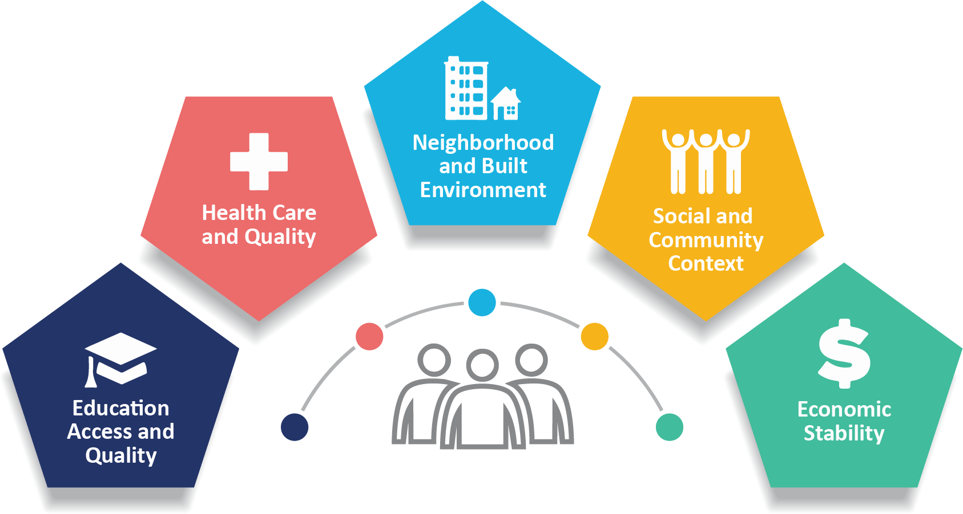
Social Drivers of Health
SDOH- Social Drivers of Health- (SDOH) are non-medical factors that affect health outcomes. They include the conditions in which people are born, grow, work, live, and age. SDOH also include the broader forces and systems that shape everyday life conditions.
Notes:
Carolyn To talk a little bit more about Social Drivers of Health: this is the foundation of the work we do;

Slide 14
Referrals to Social Work
​
​
​
​
​
​
​
Biopsychosocial Assessments
Brief Assessments & Intervention for:
Substance Use
Suicide Ideation/Safety Plan
Mental Health
Depression
Domestic Violence/IPV
Family Conflict
Elder Abuse/Child Abuse (mandated reporting)
Brief solution-focused counseling
Complex Patient needs (Longitudinal Case Management –Goal setting
Clinic Specific needs (ex: OB-Perinatal, Grief/Loss, Gender affirming supports,
Disease-specific needs :(Dialysis, Cancer, Diabetes)
Notes:
Maggie Provider, patients and families and health care providers all send referrals to us.

Slide 15



Additional Referrals to Social Work
Advanced Care Planning (MDPOA, Five Wishes)​
Long Term Care Planning
Palliative Care & Hospice Care​
Adjustment to Life Transitions
Resources for Community Regarding:​
Housing​
Food Insecurity/Food Banks​
Caregiver Burnout Support​
Home Care/Non-medical home care​
Substance Use/Sober living
Transportation
​
​
Notes:
Maggie

Slide 16

Referrals to RN Care Manager in Primary Care
Complex Chronic Care Management (Longitudinal Care Management)
Home Health Referrals/PT/OT/ST/SW
Medication Review
Transitions of Care
Hospice & Palliative Care
Notes:
Carolyn Just to differentiate, though we are in the same department-social work and RN care managers do have specific differences in responsibilities

Slide 17
Care Management Guiding Principles
Standard of Case Management (CM) Model: standardized, system-wide Ambulatory Care Management (ACM) model​
​
Standard Job Descriptions/Roles: operational standardized and defined job descriptions and roles​
​
Standard Processes and Operational Flows​
​
Standardized Tools and data analytics-for CM identification, documentation and outcomes for high-risk populations and performance management​
​
Learning and Innovation-CM learnings, trainings to meet market/regional needs and expectations​
(​
Notes:
Carolyn

Slide 18
Care Management Team Members
Social Worker, MSW, Licensed Clinical Social Workers
Social Worker, MSW, Clinical Social Worker
Social Work, Intern, MSW Candidate
Care Manager, BSRN, Registered Nurse
Care Coordinator, Licensed Practical Nurse
Notes:
Carolyn

Slide 19

Empower the patient to problem solve and explore options of care to achieve desired outcomes.
Encourage the use of heath care services, strive to improve quality of care and maintain cost effectiveness for each case.
Monitor progress
Evaluate patient goals/address and update changes.
Graduate/Disenrollment- Bring closure to the care management services and transition to highest level of function when the best possible outcome has been achieved.
Care Management Team Processes​
Notes:
CarolynIn working with patients,

Slide 20
Medical Literacy
Care Management Skills
Population Screening
Problem Solving
Working in Fast Paced setting
Skills needed in Care Management
Compassion in Action/Empathy
Advocacy
Sensitivity towards relationships Commitment to Social Justice Commitment to Ethical Practice
Resourcefulness
Notes:
Carolyn

Slide 21

Can You Think of Any Common Misconceptions of Social Workers/Care Managers?
Notes:
Maggie

Slide 22
Common Misconceptions:
1) Social Workers Take Children Away From Their Families
FALSE: Social Workers are dedicated to helping improving patients' lives. For SW's who choose to work in welfare (one of the many areas of SW) safety and wellbeing of children are the priority, with the goal of reunification.
2) Social Workers Only Work With People in Extreme Poverty
FALSE: While a portion of the service SW's provide are for individuals in poverty who need assistance with advocacy and finding resources – SW's work in an array of settings addressing a variety of mental health needs
3) Social Workers Have No Time for Personal Life, They are Sad and Miserable People
FALSE: While social work can be a demanding and often emotionally taxing job, it can also be very rewarding. This career allows a social worker to make a positive difference and witness change first-hand
Notes:
Maggie

Slide 23
Common Misconceptions:
4) Social work can get patients insurance.
FALSE: Social work and RN Care Manager provide education and linkages to resources for obtaining insurance-ie: Benefits in Action (BIA), County Human Services Offices, ColoradoPEAK.org (medicaid), medicare.org.
5) Social workers are social service employees.
FALSE: A Social worker is a trained professional who has a bachelor's, master's or doctoral degree in social work. All states license or regulate social work practice.
Notes:
Maggie

Slide 24
Case Study 1
  Elderly Patient with Predicted Early Onset Dementia
  Patient: 85 year old female, Lives alone in a two-story home
  Primary Language: English, Nationality/Ethnicity: Hispanic/Latino, Primary Insurance: Medicare A+B Son lives in state, out of home - provides transportation to appointments and errands.
  Assessment:
  Increased memory loss (MOCA score 18/30), missing medical appts, decreased physical activity, forgets to prepare meals, decreased attention to hygiene and housekeeping.
  Forgets making repeated phone calls to patient line, family members, and the dairy queen.
  Reports feeling lonely in the home.
  Care Plan:
  Consult with BH, PCP, and additional providers for dementia diagnosis and stages of progression
  Arrange for in home-care giver for daily visits – meal preparation, showering, and companionship)
  Provide resources for son as current caregiver for mother to help mitigate caregiver burnout
Any Suggestions?
Notes:
Carolyn

Slide 25
Case Study 2
Young Adult with Mental Health and Housing Needs
Patient: 25-year-old male Currently unhoused, Insurance: Medicaid lapsed, patient unsure why
Primary Language: English, Nationality/Ethnicity: White, Unemployed, Currently housed in Denver shelter
Assessment:
Recent admission to ED for alcohol-related substance use (SUD)
History of admissions to SUT facilities and psychiatric hospitals
Non-adherent to prescribed psych medication
Diagnosed with borderline personality disorder
Lacks social supports, estranged from family
Care Plan
Provide Benefits In Action referral for Medicaid re-application
Provide referral to NAMI for behavioral health supports
Provide referral to patient for SUD support groups/ sober living opportunities
Any Suggestions?
Notes:
Maggie

Slide 26
Notes:
Carolyn

Slide 27
The Role of Social Work in Integrated Health, SAMHSA-HRSA Center for Integrated Health Solutions, https://slideplayer.com/slide/11843968/
Social Drivers of Health and Health-Related Social Needs | CMS
The Evolution of Case Management and the Professional Case Manager | Springer Publishing
Standards of Case Management, UCHealth Ambulatory Care Management Playbook
Montreal Cognitive Assessment (MOCA) 26-30 or higher generally indicates normal cognitive function, 18-25 mild cognitive function, 10-17 moderate cognitive function, 0-10 severe cogntive function
References
Notes:
Carolyn

Slide 28

PIP Contacts
Stephanie Kirchner – Practice Transformation Program Manager
    Stephanie.Kirchner@cuanschutz.edu
    Kathy Cebuhar – Learning Community Lead
    Kathy.Cebuhar@cuanschutz.edu
Kristin Crispe – Practice Innovation Project Manager
    Kristin.Crispe@cuanschutz.edu
    Allyson Gottsman - Colorado Health Extension System Program Manager
    Allyson.Gottsman@cuanschutz.edu

Slide 29
THANK YOU!

