Slide 1
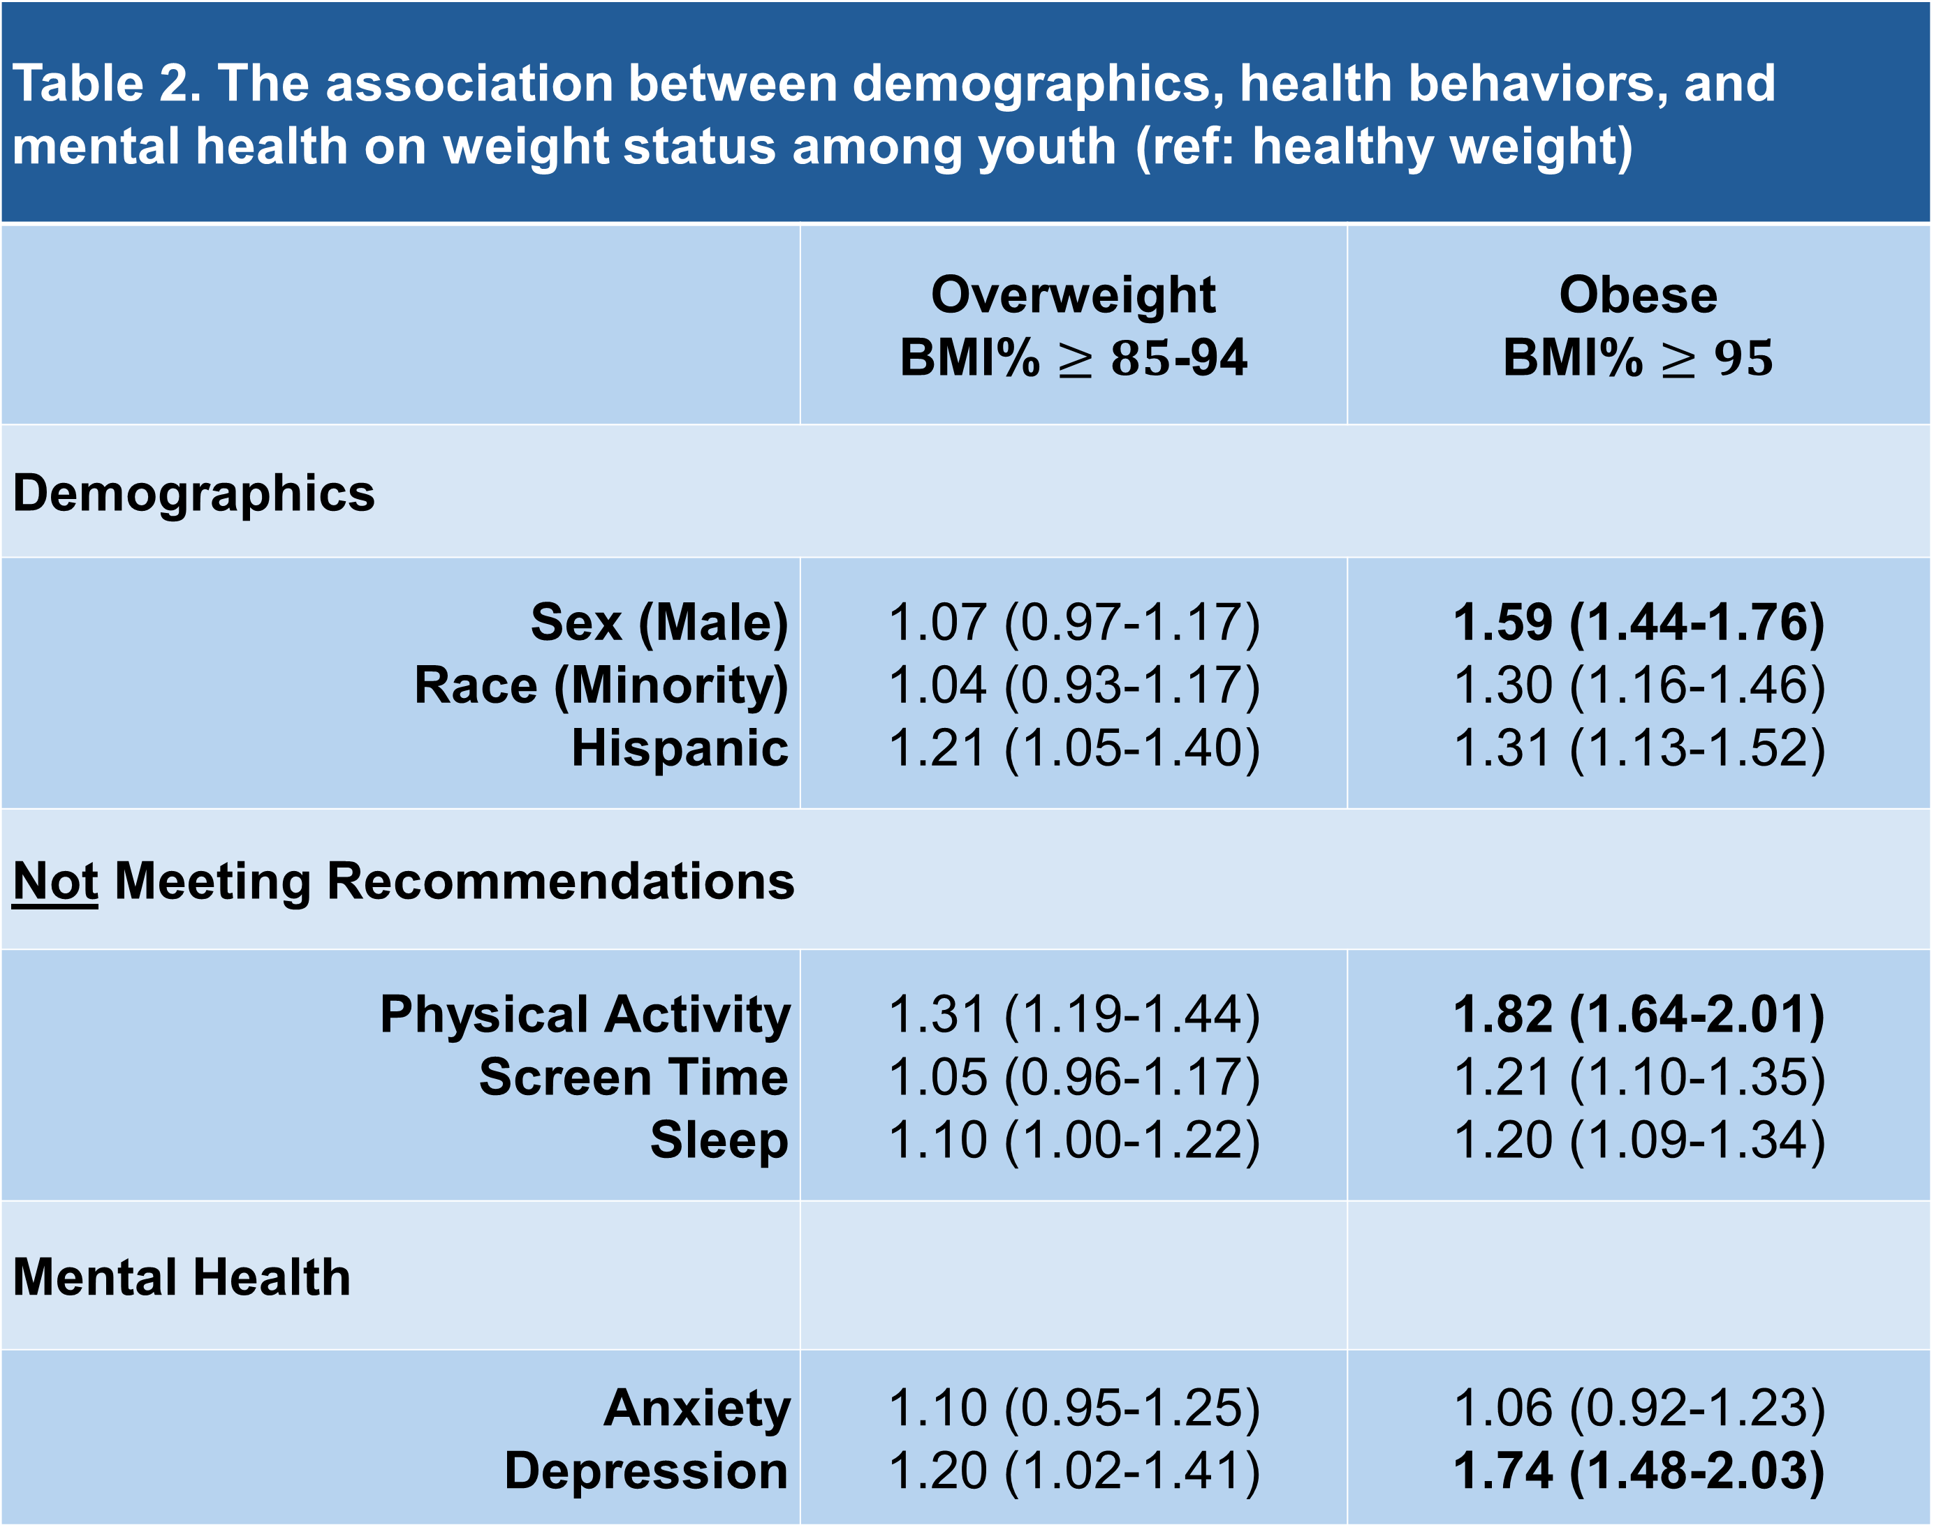
The Missing Link In Current Prevention Strategies Focused On Reducing CVD Risk Among Youth: Youth’s Mental Health
Jill L Kaar, PhD¹, Anne E Bowen, BS², Melissa Pangelinan, PhD³, Christina R Studts, PhD¹, Lauren B Shomaker, PhD^{1,2,4}, and Stacey L Simon, PhD¹
¹University of Colorado Anschutz Medical Campus, Aurora, CO | ²Children’s Hospital Colorado, Aurora, CO | ³Auburn University, Auburn, AL | ⁴Colorado State University, Fort Collins, CO
Background
Main Findings
Results
Physical activity (PA), sedentary behavior such as screen time, and sleep are well known health behaviors associated with CVD risk factors among youth.
CVD risk factors are prevalent among youth with mental health diagnosis, in particular, depression.
Low PA, high screen time, and insufficient sleep have been independently associated with increased risk of depression among youth.
How these health behaviors interact together and influence CVD risk among youth remains unclear.
Table 1. Characteristics of Cohort (N=15590)
 | Healthy | Overweight | Obese
Participants, n (%) | 11307 (73%) | 2248 (14%) | 2035 (13%)
Age (years) | 15.6 1.1 | 15.5 1.1 | 15.6 1.1
Sex (%) Male Female | 50% 50% | 51% 49% | 59% 41%
Ethnicity (%) Hispanic Non-Hispanic | 9% 91% | 11% 88% | 12% 88%
Race (%) White Minority | 81% 19% | 80% 20% | 77% 23%
The most significant predictors of obesity among youth are being male, not meeting physical activity recommendations, and being depressed.
Table 2. The association between demographics, health behaviors, and mental health on weight status among youth (ref: healthy weight)
 | Overweight BMI% $≥85$-94 | Obese BMI% $≥95$
Demographics
Sex (Male) Race (Minority) Hispanic | 1.07 (0.97-1.17) 1.04 (0.93-1.17) 1.21 (1.05-1.40) | 1.59 (1.44-1.76) 1.30 (1.16-1.46) 1.31 (1.13-1.52)
Not Meeting Recommendations
Physical Activity Screen Time Sleep | 1.31 (1.19-1.44) 1.05 (0.96-1.17) 1.10 (1.00-1.22) | 1.82 (1.64-2.01) 1.21 (1.10-1.35) 1.20 (1.09-1.34)
Mental Health
Anxiety Depression | 1.10 (0.95-1.25) 1.20 (1.02-1.41) | 1.06 (0.92-1.23) 1.74 (1.48-2.03)
Figure 1. Youth diagnosis of mental health outcome by weight status
Objective
To examine the interplay of health behaviors, mental health indicators, and other sociodemographic predictors of obesity risk among youth.
Methods
Youth (aged 13-18 years) from the 2018-2019 National Survey of Children’s Health data was utilized.
Obesity risk was defined as overweight (BMI% $≥8$5-94) or obese (BMI% $≥95$).
Demographics (age, sex, race, ethnicity), PA, screen time, hours of sleep per night on weeknights, and diagnosis of depression or anxiety from a health care provider were extracted.
Meeting recommendations defined as follows
Physical Activity: 60 minutes/day, 4-7 days/week
Screen time: $≤2$ hours/day
Sleep: $≥$8 hours/night
Statistical Analysis
Multivariable logistic regression analyses examined predictors of obesity risk.
Significance: Odds Ratio >1.50
,
Figure 2. Youth not meeting recommendations by weight status
Conclusion
In light of the increased mental health concerns among youth, the interplay of health behaviors, mental health, and CVD risk factors need to be examined further to elucidate possible mechanisms of causation. Further, CVD prevention programs should include a focus on mental health.

