Slide 4
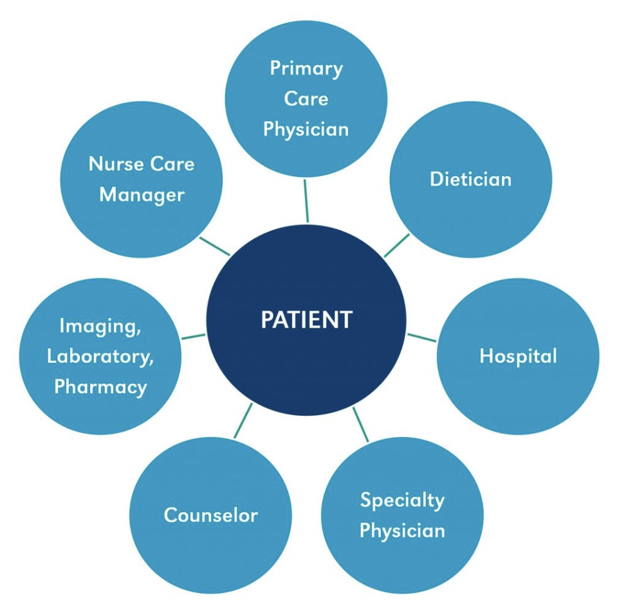
From Clinic To Community

Slide 5
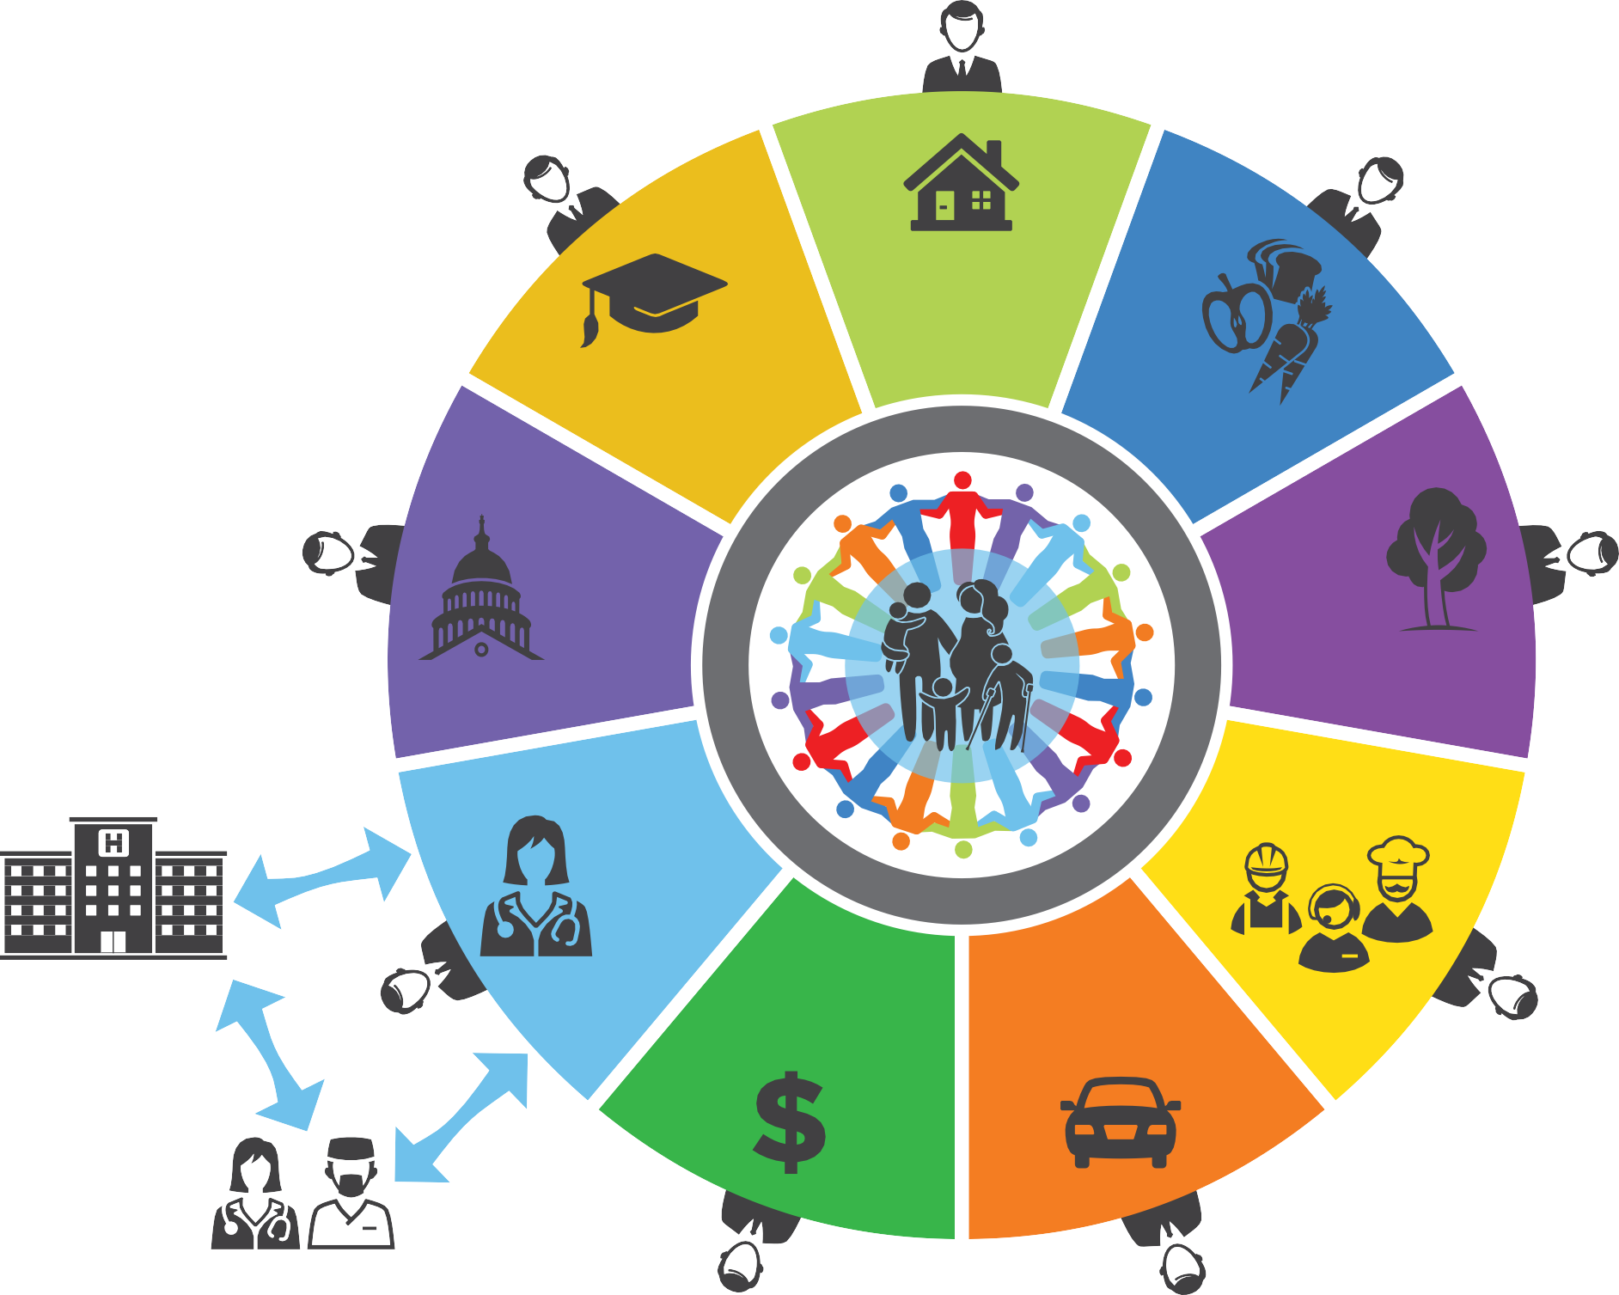
FUTURE WHOLE HEALTH SYSTEM
HOUSING
Emphasis on vitality, not illness response
EDUCATION
FOOD
Community as full partner
Person and family centered
Focus on friends, community; then team of providers and CBOs
"Companion”: coach, navigator
Holistic, wraparound support
Integrates delivery of social,
community, clinical supports
Medicine tightly integrated
O
N
T
E
I
C
T
H
R
M
A
N
O
O
L
F
O
N
G
I
Y
PUBLIC HEALTH
C
S
ENVIRONMENT
O
N
M
A
M
L
O
P
N
S
S
S
C
E
HEALTH: BEHAVIORAL, PRIMARY, ORAL
O
C
C
JOBS
M
U
P
S
A
N
N
G
I
I
O
N
S
N
A
G
:
M
A
HOSPITAL
INCOME
TRANSPORTATION
Minimize acute care and its costs
SPECIALISTS

Slide 6
