Slide 1
Shared Resilience:
A Partnership Approach to Care
Mary O’Hara, LCSW
CU Psychiatry Dept.
Mary.ohara@cuanschutz.edu
Notes:
You are the experts
We are talking about care in contect of our past relationships
Instead of pt and caregiver/team
Meidcal model to a partnerhip model where
Individula not reliant

Slide 2

Building Shared Resilience
What is something positive you have learned about your relationships in this experience?
Are there any ways that the challenges have led you to become closer, more connected or more appreciative?
What moments have you felt like a team in this experience?

Slide 3
Stress in the Partnership
Attachment
Stress on you individually and the relationship
Both Experience Grief, Guilt, Fear, Vulnerable, Overwhelm
Different Observations about symptoms, safety
Difficulty speaking openly

Slide 4
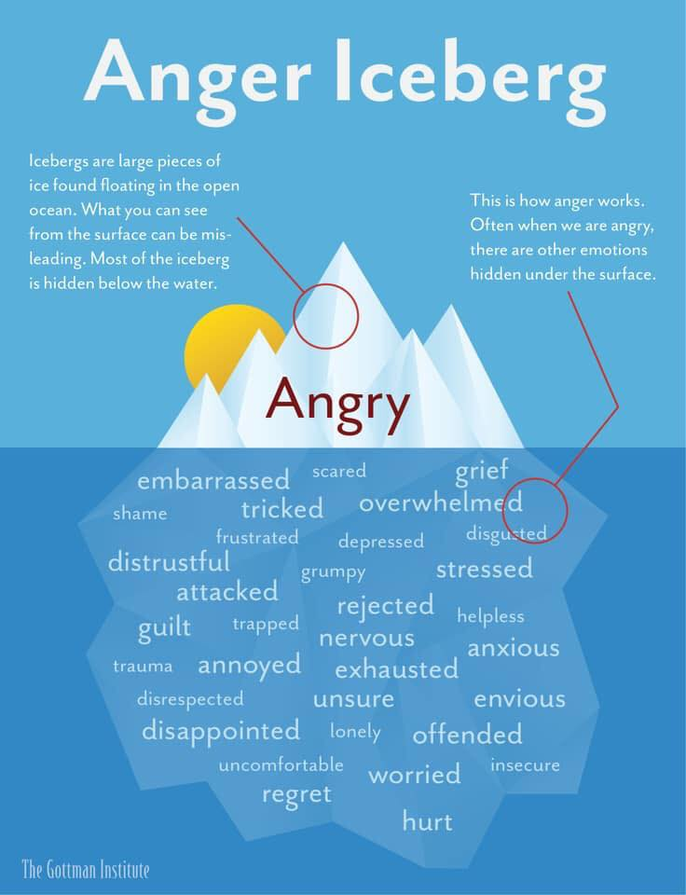

Slide 5
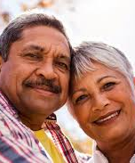
Invisible Team-Work
Redefining Roles
Letting Go
Acceptance
Adaptation
Dementia Grief
Ambiguous Loss

Slide 6
A Partnership Approach
Shared Values/Intentions/Hope
Remain focused on abilities, strengths and adaptation.
Do together- not for
Patience- Not always most efficient
Participation in hard conversations
Radical Acceptance of what is and can’t be changed

Slide 7
Couples Resilience in Early Dementia
Shared activities
Teamwork approach to problem solving
Humor and Positivity
Preserve independence
Self-Care
Face stressors as a unit

Slide 8
Supporting the Team Approach
Expect Mistakes, Repair and Reset
Seek guidance from Providers
MGI and Self Compassion
Share what you need and relationship needs
Adapt –Be Open to Accepting Help
Create Buffers, Celebrate Accomplishments

Slide 9
Dispelling A Burden Myth
Myth: Accepting their support/help will put a burden on others”
Reality: A burden is felt by family when one needs help and declines/refuses it.
Reality: A little help goes a long way to support independence.
Reality: In-order to stay at home, it’s necessary to allow other’s support.

Slide 10
Communication Log
How did the difficulty come about? | What did you want from the person/situation? What did you get? | What did the other person(s) want? What did they get? | How did you feel during and after this time?
We were running late to an apt. | I wanted to Leave on Time for this apt. I got stressed and upset | He wanted to find something. He got upset, felt criticized and got my anger too | Angry at the time. Then I felt Guilty, and Sad that I reacted that way.

Slide 11
Adapting Communication
Disconnection | Partnership
I already told you….. | I know this is important to you.
Don’t you remember? | DO NOT SAY THIS
You need to calm down | I’m here. Silence. A Hug
You can’t do that anymore | We can try it together.
You need….. | We/Us need

Slide 12
Reframing Thoughts/Perspectives
Stressful Event | Automatic Thoughts/ Judgement | Feelings | Reframe- Get Curious What is the most generous interpretation? What would I say to a friend in this situation? Just because…does not mean…. Am I taking this personally when maybe it’s not about me?
Partner refused to discuss a driving evaluation. | He’s so stubborn and ridged and won't consider safety of others or my concerns. | Anger, Fear, Frustration, hurt, rejection, resentment | He is doing the best he can. He is grieving and holding onto what he can control. By saying “no” he is communicating his fears and uncertainty. Maybe adapting my approach or inviting someone else to be a part of this will soften the charge of this topic. Just because he said no the first time I tried does not mean we can’t try again at a different time. It’s not about him not listening to me, it’s about how difficult it is to talk about.

Slide 13
Repair, Reset, Reconnect:
“Truce-Time Out- Ouch- Same team”
“We are both upset- This is really hard-We don’t want to hurt each other- Let’s not let this get between us- Let’s take 5”
“I’m sorry-That was not my intention” (do not follow this with a “But..”)
No Words: Welcome Home Hug
Name what went well, the wins, the accomplishments
Practice Gratitude. It turns what we have into enough.
Give credit to your relationship and to each other for everything you each are doing as a team in this difficult time.

Slide 14
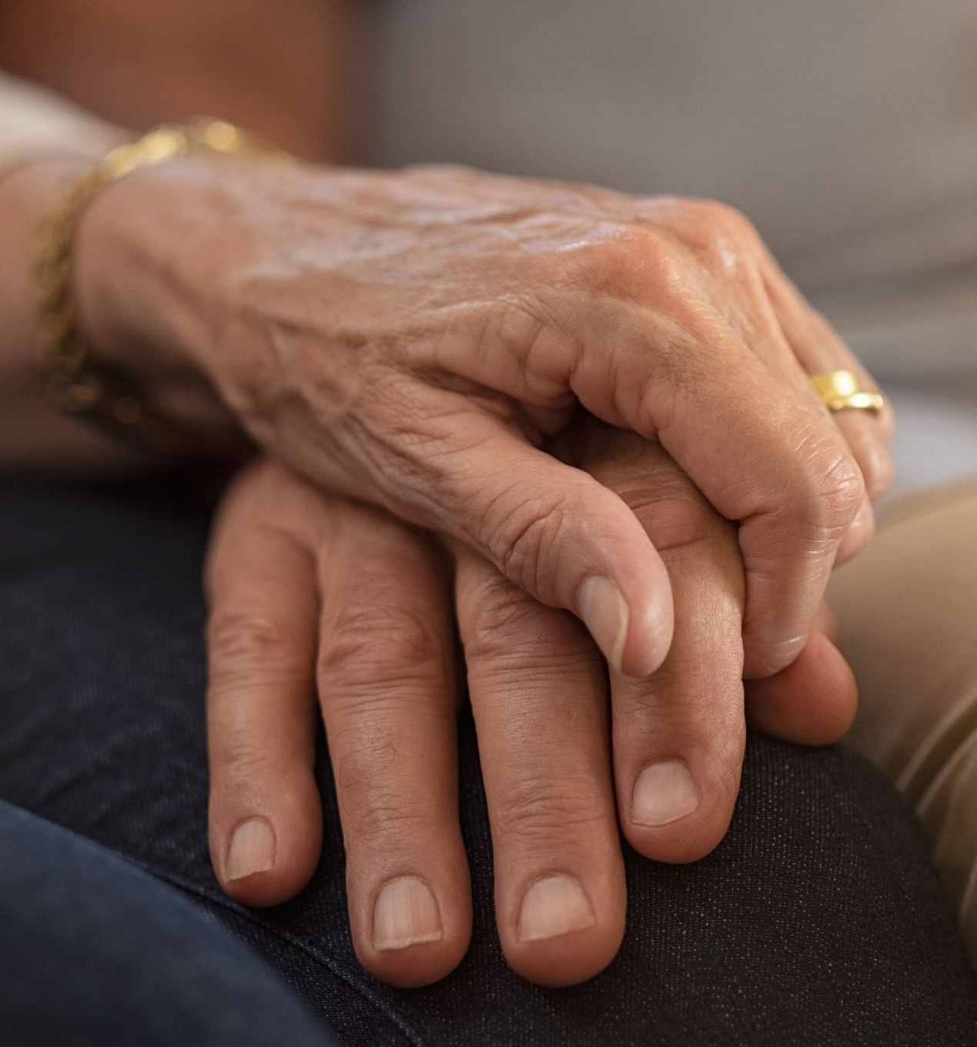
Take Care of Each Other
Seek Support
Accept help: No one can do this alone
Recognize what you ARE doing for yourself and your relationship.
Check in to identify and prioritize your own needs and needs of your relationship

Slide 15
Reading
Still Me: Accepting Dementia without Losing Yourself by Rebecca Chopp
Dementia, Reimagined by Tia Powell
Before and After Loss: A Neurologist’s Perspective on Loss, Grief and the Brain by Dr. Lisa Shulman
How to Be Sick: A Buddhist Inspired Guide for the Chronically Ill and their Caregivers by Tony Bernhard

Slide 16
Communication 101
Instead
  How does person want help?
  Offering Cuing / context
  Repeating answers as if it’s first time
  Don’t talk- Use touch, a smile
  Being thoughtful about tone, word choice, PWD sensitivity or insecurities
  “This is hard. You’re doing the best you can”
Avoid:
  Direct questions
  Don’t you remember?
  We already talked about that
  Quizzing person for details
  Reminding the person of what they can’t do
  Don’t meet anger with anger- never goes well.

