Slide 1
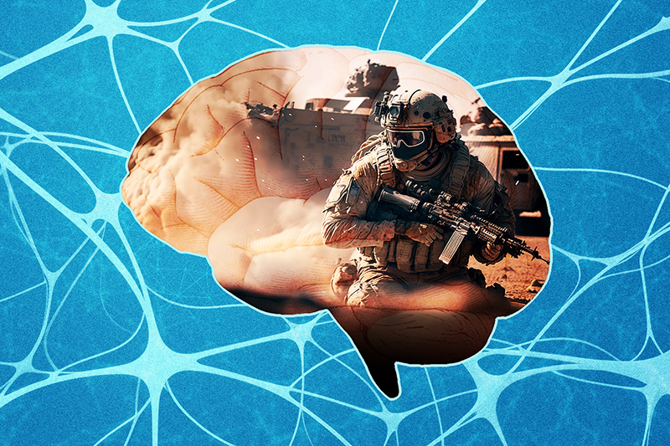
The Marcus Institute for Brain Health
TBI 101

Slide 2
A Basic Understanding of TBI
Basic medical terminology
Mechanisms of injury (cause) and how it can impact brain function
  Understanding blast exposures
Classifications of TBI
Factors that impact recovery

Slide 3
Types of Brain Injury – Medical Terminology
mild Traumatic Brain Injury (mTBI) and
Concussion are considered the same and used interchangeably
Traumatic Brain Injury (TBI) blow to head, blast
  Mechanism of injury is external
Acquired Brain Injury (ABI) stroke, brain tumor, infection
  Mechanism of injury is internal
Types of traumatic Brain Injury:
Closed Head (CHI)
  Injury has occurred inside the intact skull
Open Head Injury (OHI)
  Injury has occurred to the skull (fractured, penetrating injury such as shrapnel or bullet)

Slide 4

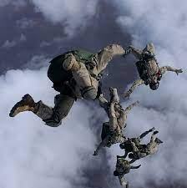
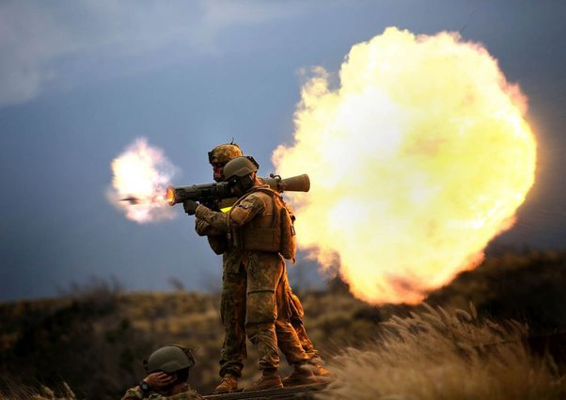
Mechanisms (cause) of Injury
  Impact / Blunt Force: Striking the head such as during combatives, falls, vehicle accidents, fast roping, parachute landings, assaults, contact sports
Blast Injury: IED, firing weapons, propane explosion, chronic low-level blast exposure

Slide 5
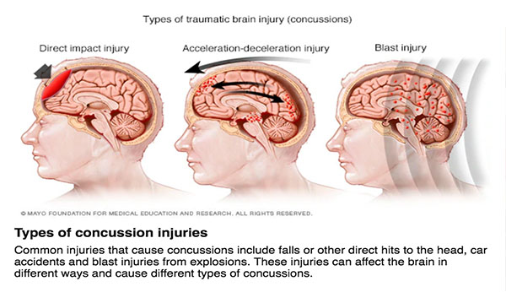
How the Mechanism of Injury (TBI)
Impacts the Brain
Blunt Force Trauma
Blast Injury
“Focal”
“Diffuse”

Slide 6
Lobes of the Brain – Primary Function
Behavior and emotional control center (personality, judgement, impulse control, motivation, concentration, social interactions)
Cognition (thinking, planning, organizing, problem-solving)
Sensory processing and integration (taste, auditory, sight, touch, and smell)
Visual processing
Memory, and language comprehension
Muscle control (posture, balance, equilibrium)
Regulate and coordinate vital bodily functions (breathing, body temp, digestion, sleep, swallow)

Slide 7

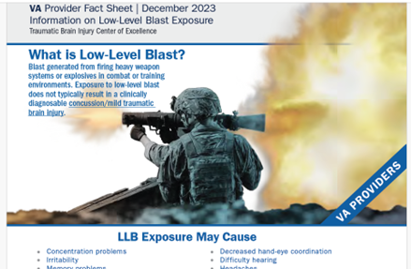
Blast Exposures
Blast Overpressure (BOP) The sharp rise in atmospheric pressure resulting from explosives or firing weapons is blast overpressure.
High Level Blast (HLB)
Low Level Blast (LLB)
Most commonly occurs from IEDs and other incoming explosives
LLB exposure most commonly occurs from outgoing, user-directed firing within operational and training environments. 2-5 psi is considered LLB exposure.
Blast Overpressure (BOP) Exposure Mitigation, Brain Health, and Performance Readiness, ODASD (Health Readiness Policy and Oversight)< November 2024

Slide 8
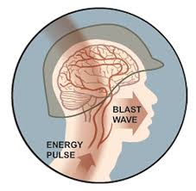
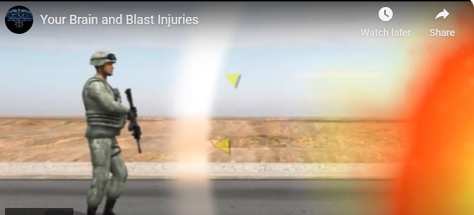
Blast Injuries
Potential impacts to the brain:
  Diffuse Axonal Injury (shearing of connecting fibers in the brain)
  Neuroinflammation (impacting the lining of blood vessels making them more fragile)
  Damage to Blood Vessels (brain is a highly vascularized organ)
Common Symptoms: memory problems, concentration difficulties, changes in mood / behavior, headaches, tinnitus, dizziness
Single HLB and repetitive LLB exposures can lead to diffuse changes in brain function.
Blast-induced TBI results from exposure to blast overpressure (BOP), which generates shock wave energy that transmits force throughout the skull and can impact brain tissue.

Slide 9
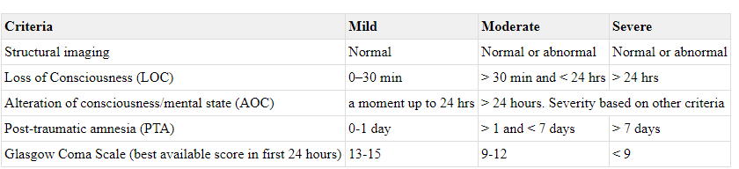
Classifications of Traumatic Brain Injury
TBI Classification is not based on how bad your symptoms are currently; it is based on criteria immediately following the injury
  Definitions:
  Structural Imaging – CT Scan or MRI
  Loss of Consciousness (LOC) – Knocked out, unconscious and/or
  Alteration of Consciousness (AOC) – “Bell rung” (confusion, disoriented, slowed thinking)
  Post Traumatic Amnesia (PTA) – Full loss of memory immediately after injury

Slide 10
Factors that impact TBI Recovery
Single lifetime event (mod – severe)
Multiple cumulative TBI events over the lifespan
Multiple TBI / exposure events within a specific
timespan (within approx. 2-3 months)
Multiple injuries in one event
    Primary, secondary, tertiary
Habits (sleep, alcohol, nicotine, nutrition)
Age
Preexisting Physical and Health Conditions

Slide 11

Overlapping and Intertwined Symptoms
Psychological Health
TBI
Major Depression
Mood Swings
Flashbacks
Avoidance
Hypervigilance
Nightmares
Headache
Light / Sound Sensitivity
Nausea / Vomiting
Vision Changes
Dizziness / Vestibular
Mood Changes
Irritability
Cognitive Changes (memory, concentration)
Sleep Difficulties
Fatigue
Impulsivity
Additional Factors
Medication
Pain
Alcohol & other substances
Stress

Slide 12
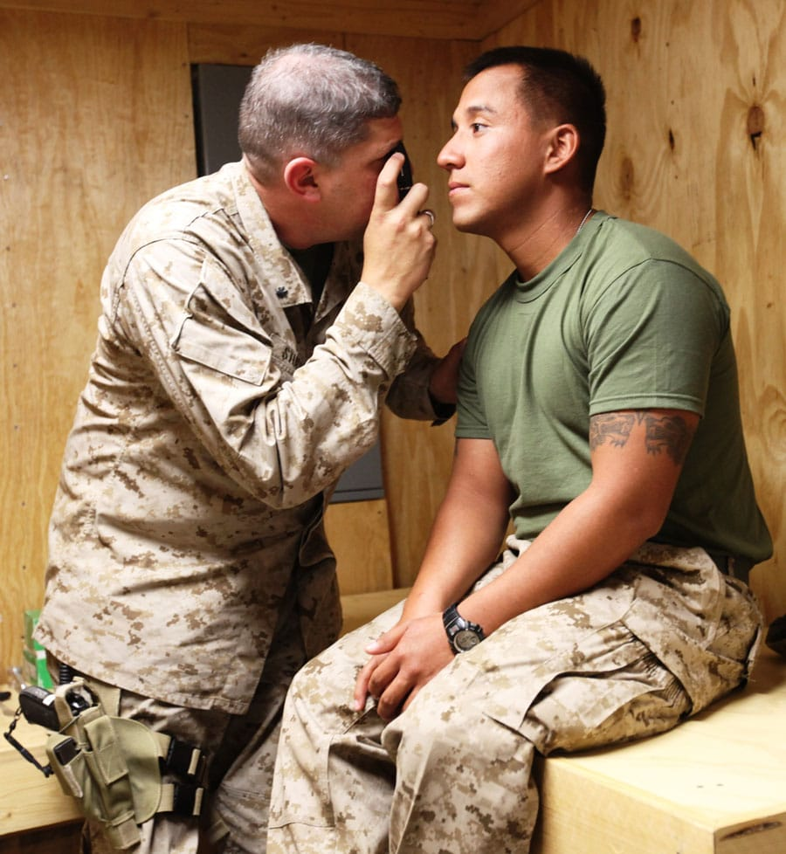

Post Concussive Syndrome (PCS)
Generally diagnosed if symptoms started at the time of injury and persist 3-mo post injury
Injury 3-days 3-weeks 3-months

Slide 13
Recovery Concepts
Neuroplasticity
Interdisciplinary Team
Treatment Approach at MIBH
Discipline Roles
Crossover / Communication

Slide 14

Neuroplasticity
How can Rehabilitation Help?
Neuroplasticity is the brain's ability to reorganize itself by forming new neural connections and reshaping existing ones.

Slide 15

Interdisciplinary Rehab – the MIBH Model of Care
Physician
Integrative Therapies
Behavioral Health
Clinical Pharmacy
Physical Therapy
Family Education
Animal Assisted Therapy
Healing Arts Therapy
Speech Language
Pathology
Case Management
Neuropsychology
VA Liaison
Nutrition
Veteran Programs
Community Resources

Slide 16
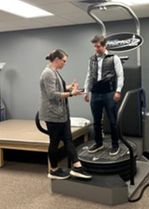
Physical Therapy
Vestibular/balance and visual symptoms are often one of the hallmarks of blast injury
These can go undetected for many people because the central nervous system often accommodates, resulting in avoidance of triggers (busy areas, grocery stores, driving, reading).
These symptoms require specific, professional evaluation and treatment
Sensory Integration: The process by which the brain receives, organizes, and interprets information from the senses. It allows us to make sense of our surroundings and respond appropriately.

Slide 17
Speech-Language Cognitive Therapy (SLP)
Everyday Thinking
Tinnitus
Communication Changes
Finding words
Misunderstanding others
Avoiding crowds
Hearing loss
Memory
Auditory Processing
Attention
Organization
Processing
Background Noise

Slide 18

Medical Provider
Neurology
Physical Medicine & Rehabilitation
Expertise in evaluating and treating people with brain conditions that may affect their emotions, physical and/or cognitive skills.
Neurological exam during evaluation
Utilize appropriate medical tests (MRI, EEG, etc.) to inform the assessment and treatment
Assess and treat sleep and headaches
Monitor co-occurring medical conditions

Slide 19
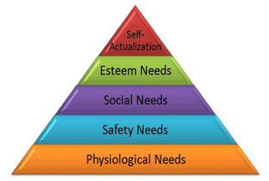
Emotional and Behavioral Health
Understanding your Emotional Heath can Optimize
Overall Performance
TBI and Emotions
Emotional Regulation
Self Awareness Behavior / Impulsivity
Fatigue Management / Energy Allocation
Exacerbation of Preexisting Psychological Issues
Co-existing Life Stressors
Stress Reduction
Trauma / Safety
Growth Mindset
To improve performance, relationships, and overall quality of life
Notes:
Using difficult life experiences to grow from

Slide 20
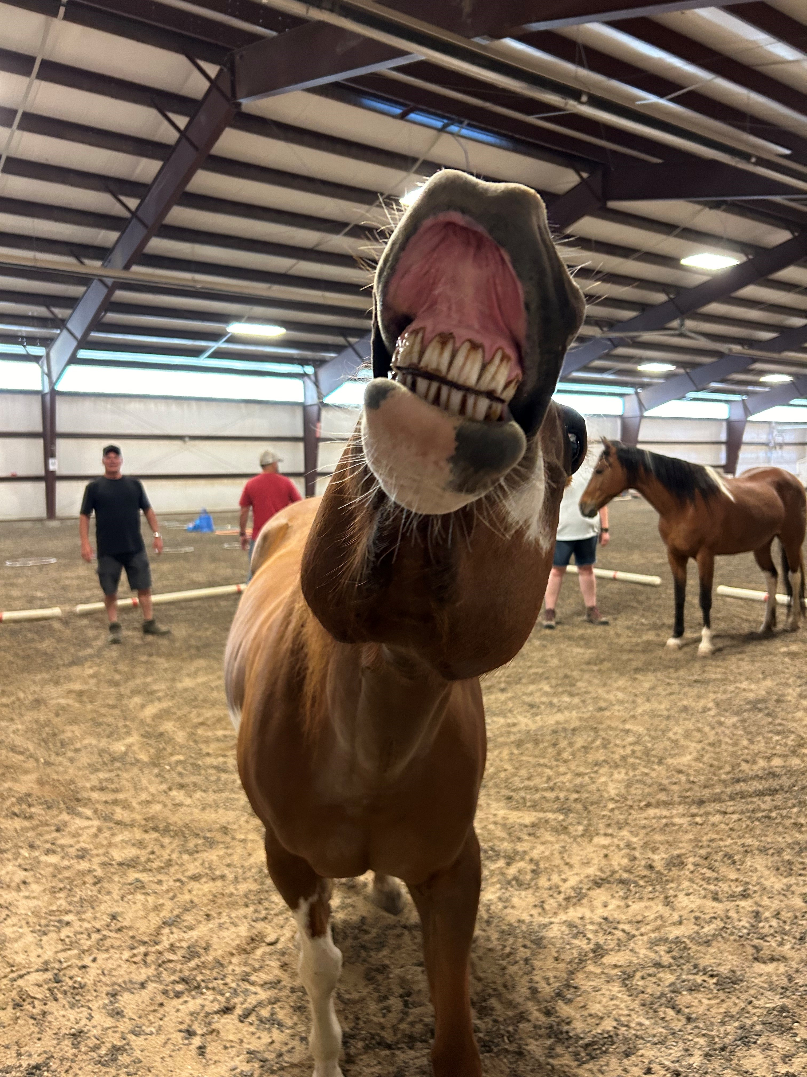
Integrative Therapies
Art Therapy
Equine Therapy
Mindfulness
Self-Regulation
Downregulation Tools

Slide 21

Family Program (optional)
Why is this important?
Virtual Education
    TBI 101
    PT, SLP, BH

Slide 22
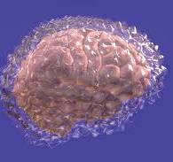
Prevention
Take control of what you have control of:
Protective equipment
Psychological Health
Sleep
Minimize stress
Downregulation
Optimize nutrition
Moderation of habits

Slide 23
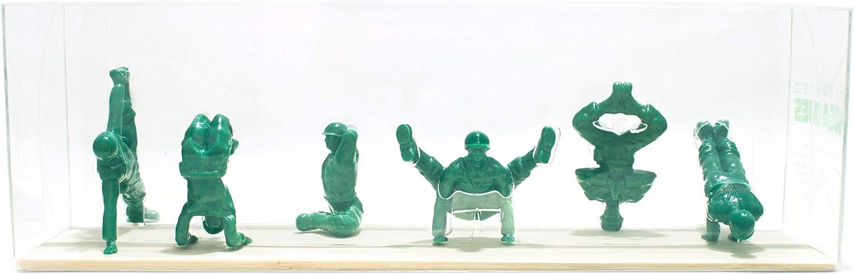
Tina Fanello, LCSW
MIBH Associate Director of Clinical Operations
tina.fanello@cuanschutz.edu

