Slide 1





https://www.cu.edu/employee-services/get-your-w-2/#tabs-1

Slide 2

https://web.cvent.com/event/6f6ccc1a-f566-4b46-86b3-eaedbce63208/regProcessStep1

Slide 3

https://www.cu.edu/employee-services/collaborative-hr-services/cu-campuses/famli-fml-and-parental-leave

Slide 4
CU’s paid medical and family leave program marks one year-FAMLI Webinars now available
Attend a leave information webinar
The Employee Services Leave Team is hosting a series of optional training sessions that will alternately address the needs of different audiences —Supervisors and Employees.
Employees:
May 13, 2025 — 11:30 a.m. – 12:30 p.m.
Aug. 12, 2025 — 11:30 a.m. – 12:30 p.m.
Nov. 11, 2025 — 11:30 a.m. – 12:30 p.m.
Supervisors:
March 11, 2025 — 11:30 a.m. – 12:30 p.m.
June 10, 2025 — 11:30 a.m. – 12:30 p.m.
Sept. 9, 2025 — 11:30 a.m. – 12:30 p.m.
Dec. 9, 2025 — 11:30 a.m. – 12:30 p.m.

Slide 5

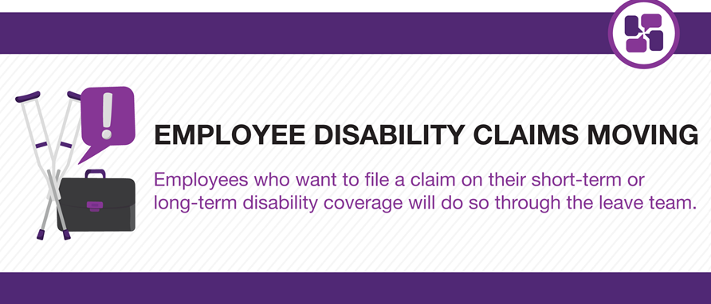

Slide 6
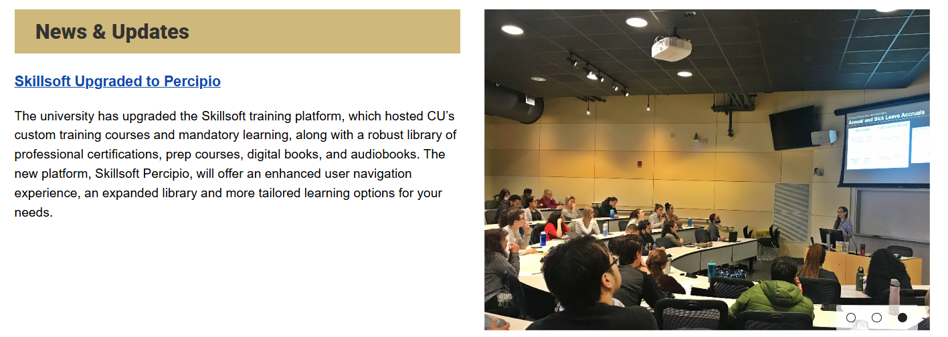

Slide 7
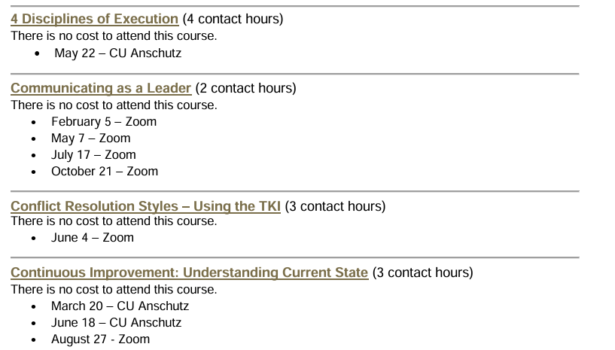
CU 2025 Training Schedule Now Live
https://www.cuanschutz.edu/offices/human-resources/learning-development

Slide 8
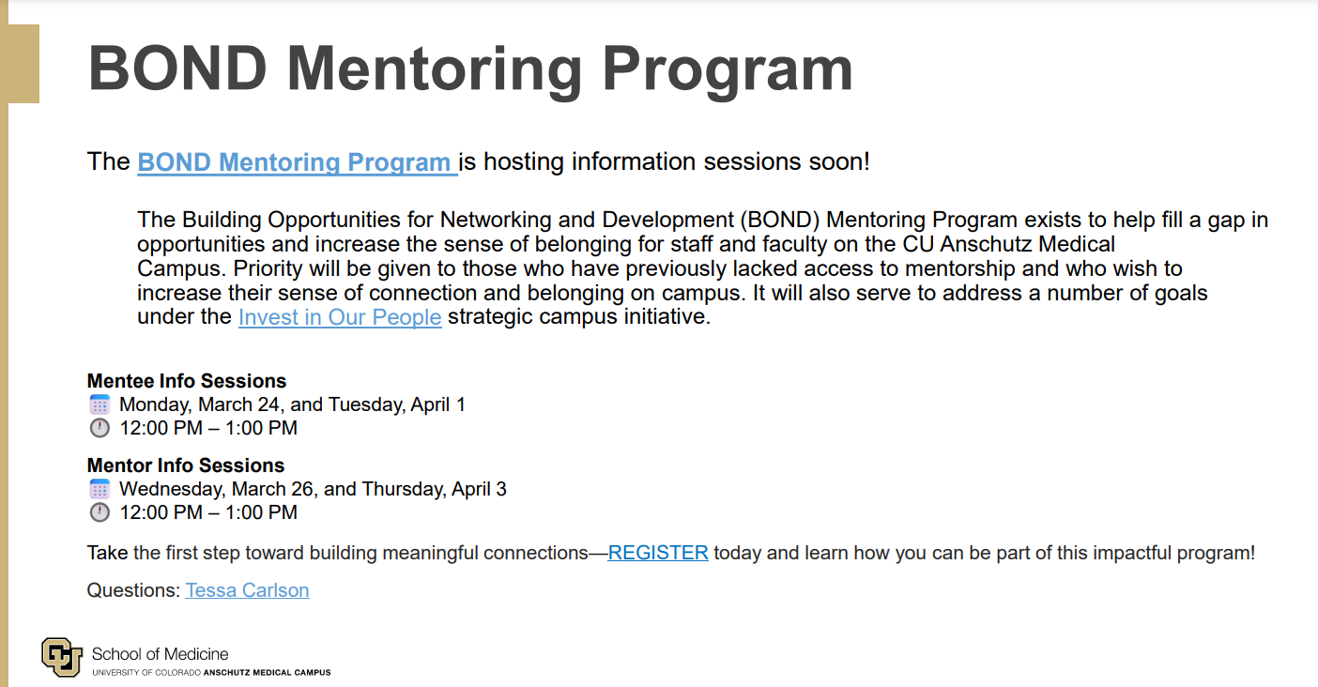

Slide 9
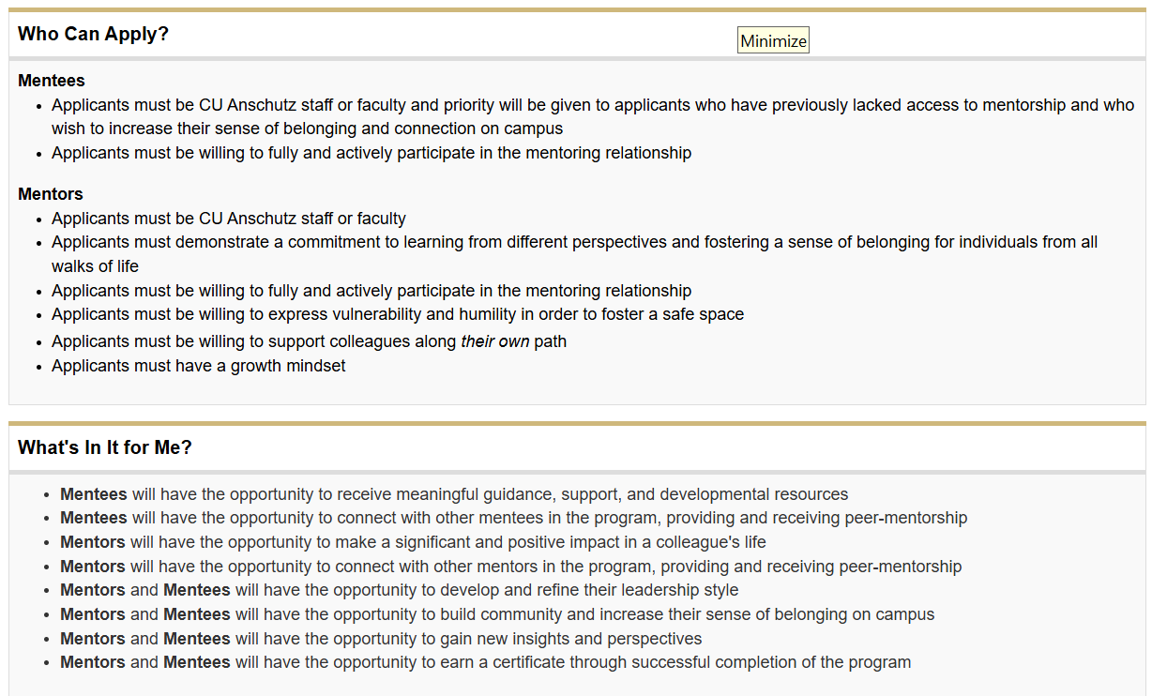
https://www.cuanschutz.edu/offices/access-engagement/programs-and-initiatives/access-and-engagement/bond-mentoring-program

Slide 10
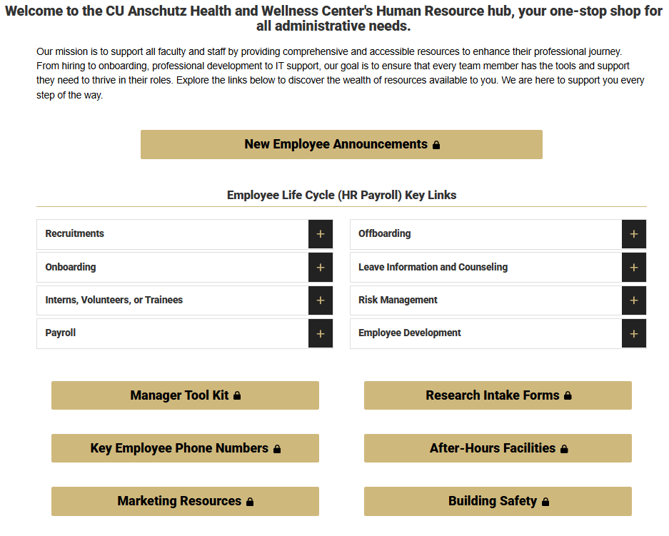
https://medschool.cuanschutz.edu/health-and-wellness/home/faculty-staff-resources

Slide 11
Wishing Lora Mihelic a Wonderful Retirement (effective 3/1/25)!
Dear Lora,
As you step into this new chapter of your life, we wanted to take a moment to express our deepest gratitude for the years of dedication and hard work you have contributed to the Anschutz Health & Wellness Center.
Thank you, Lora, for everything. Here's to a retirement filled with happiness and new adventures!
With Warmest Regards,
All the folks from the CU Anschutz Health & Wellness Center

