Slide 1





https://www.cu.edu/employee-services/open-enrollment
CU Anschutz: 2:30 - 6:30 p.m. April 30 at Krugman Conference Room, Research 2 Building

Slide 2

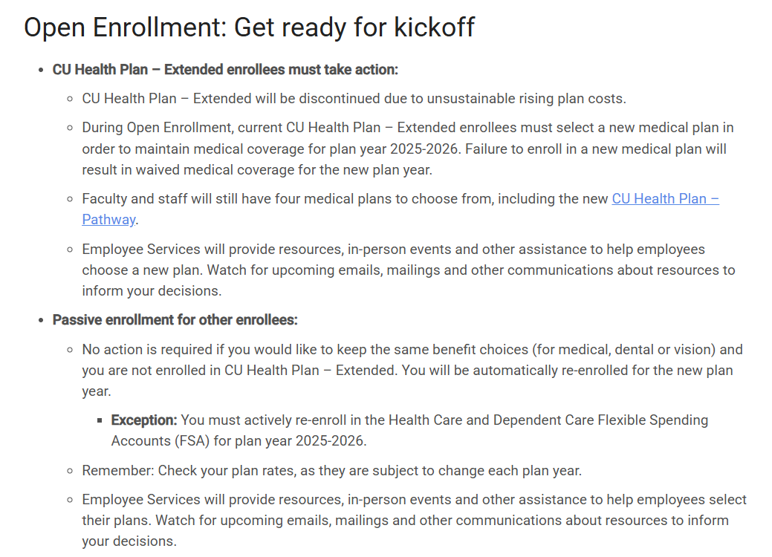

Slide 3
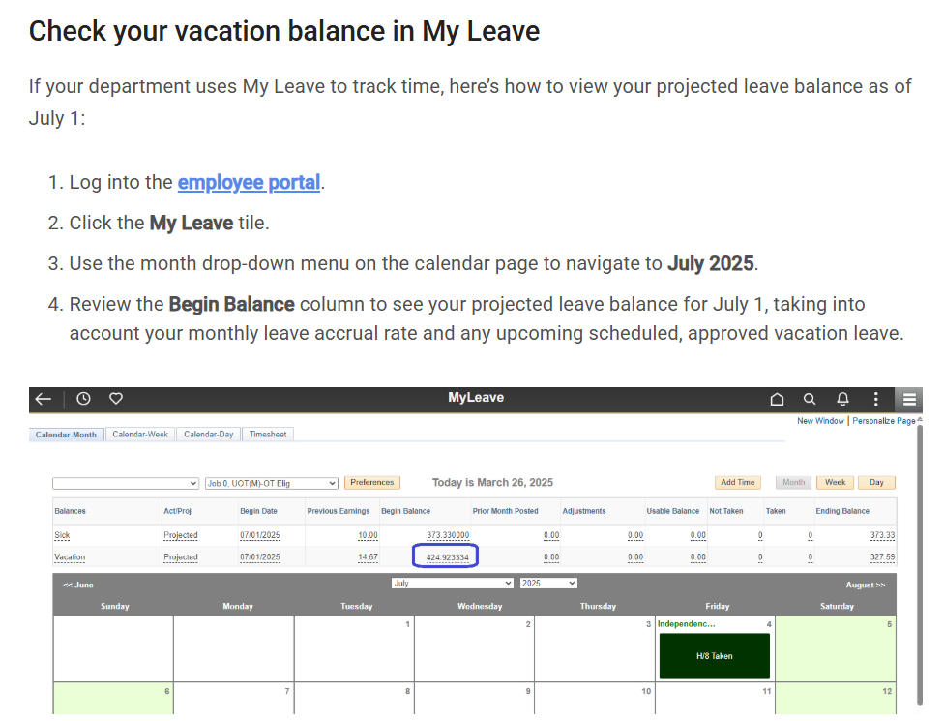
www.cu.edu/ope/aps/5062

Slide 4
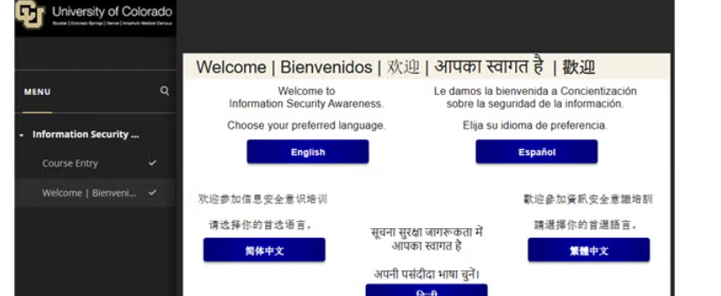
https://www.cuanschutz.edu/offices/human-resources/learning-development/required-training

Slide 5
Did you know:
There’s a CU ANSCHUTZ campus community newsletter? Your go-to source for campus updates, events and stories that matter to our campus community.
Bookmark for federal transition updates: A resource page where you can find updates, university statements, contacts and more. https://www.cuanschutz.edu/federaltransition
Don’t forget that CU Celebrates! is now live and ready to use!
You can log in to your account here
Please remember to also regularly check our CU AHWC Intranet for the most up-to-date guides, processes, updates etc.
PERK UP FOR SPRING-Employee perks are frequently being added to CU Advantage: https://advantage.cu.edu/

Slide 6
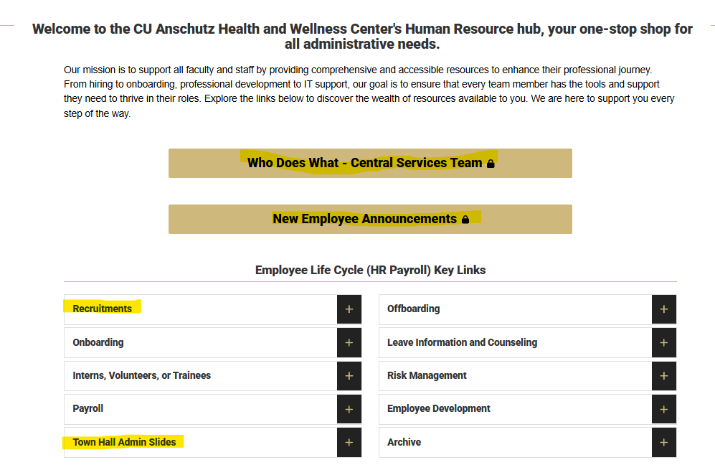
Updates:
https://medschool.cuanschutz.edu/health-and-wellness/home/faculty-staff-resources

Slide 7
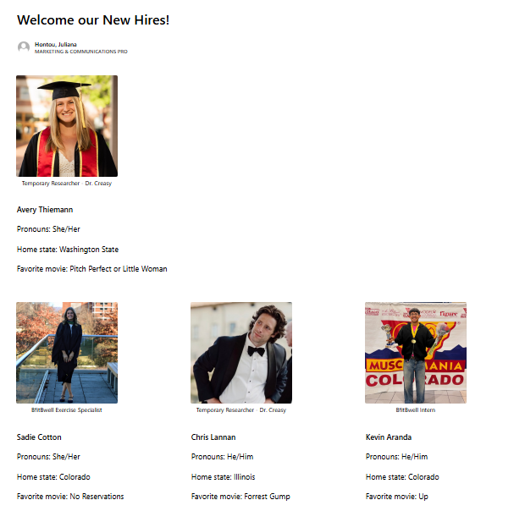
https://medschool.cuanschutz.edu/health-and-wellness/home/faculty-staff-resources

