Slide 1
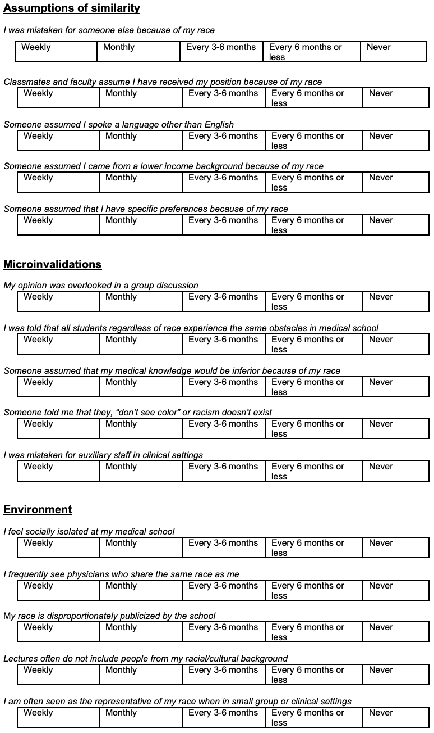
Racial and Ethnic Microaggressions in Medical School and its Impact on Student Perceptions of their Learning Environment - creating an assessment tool Eman Mesgina, Eric Wagner, Regina Richards PhD.
Background
Novel Survey Tool
Significance
The enrollment, graduation, and advancement of underrepresented minority medical students (URM) has become an increasingly important subject as the United States continues to diversify. Despite certain efforts to increase enrollment, numbers have remained stagnant and many disparities among performance and experience have been identified between URM’s and their white counterparts. Recent focus has emphasized the impact of microaggressions on racial minorities and the cumulative burden they can have in impacting learning and attitudes. To date, very few studies have investigated the frequency or type of microaggressions in the medical school educational or clinical setting, likely due to the lack of a well-designed tool to assess these metrics. This study aims to create a novel survey tool based off the validated REMS tool specific to the medical school environment. This tool can be used in the future to quantify the difference in frequency and types of microaggressions occurring in the medical school environment and its impact on medical student perceptions of the learning environment.
Creation of a survey assessing microaggression frequency and its tangible impact on student learner perceptions is a novel pursuit necessary in promoting awareness of certain harmful behavior and how we address it. By quantifying these common day interactions in different institutions and having a nationally standardized tool, medical schools can actively plan and address concerning trends they see in their programs.
Next Step Implementation
Next steps of this tool first include internal and then external validation, with the first sets of data collected at the University of Colorado School of Medicine (potential future MSA). However, this is outside of the scope of this study. After validation, the tool can be used as the gold standard for assessing racial microaggressions and their impact on medical students across the nation. The simplicity of this survey makes it easy to be widely distributed. Additionally, this means the tool can even be used multiple times at the same institution to assess progress and/or areas needed for growth. Finally, it will empower those from marginalized communities and assist them in obtaining tangible data behind their narratives demonstrated in numerous studies. As more data is generated and more dialogue is promoted around microaggressions and their impact, slowly American medical education can chip away at deeply rooted systemic biases that are directly reducing the retention students from minority backgrounds and thus decreasing diversity in medicine.
Methods
The survey-based questions were developed after extensive literature review and further focus on the Racial Ethnic Microaggressions Scale (REMS) and the Racial microaggression scale. As REMS is currently recognized as the gold-standard tool, questions were based within this validated framework. This was accomplished by focusing on three major categories of the REMS tool: assumptions of similarity, microinvalidations, and environment.
Key Concepts
Microaggression: “brief, everyday exchanges that send denigrating messages to certain individuals because of their group membership”.
The taxonomy of microaggressions can be broken down into three primary types of attacks including microassaults (conscious, deliberate, and either subtle or explicit racial biased attitudes, beliefs, or behaviors), microinvalidations (communication that exclude, negate or nullify thoughts, feelings, and experiences of people of color), and microinsults (communications that convey rudeness and insensitivity to a person’s racial heritage).
References
1. Iten A Orom H, Semalulu T, Underwood W. The Social and Learning Environments Experienced by Underrepresented Minority Medical Students. Academic Medicine. 2013;88(11):1765-1777.
2. Acosta, D. A., MD, Poll-Hunter, N. I., PhD, & Eliason, J., EdM. (2017). Trends in Racial and Ethnic Minority Applicants and Matriculants to U.S. Medical Schools, 1980–2016. Association of American Medical Colleges, 17(3). Retrieved June 25, 2019
3. Odom, K. L., Roberts, L. M., Johnson, R. L., & Cooper, L. A. (2007). Exploring Obstacles to and Opportunities for Professional Success Among Ethnic Minority Medical Students. Academic Medicine, 82(2), 146-153.
Notes:
1

