Slide 1
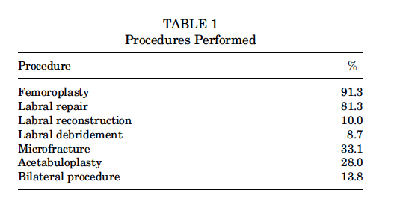
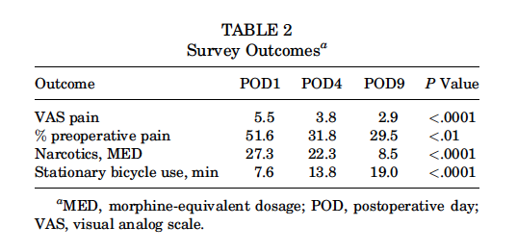
Pain Scores and Activity Tolerance in the Early Postoperative Period After Hip Arthroscopy
Laylaa Ramos, MS, Matthew J. Krautler, MD, Eric Marty, BA, K. Linnea Welton, MD, Tigran Garabekyan, MD, and Omer Mei-Dan, MD
Department of Orthopedics
University of Colorado School of Medicine, Aurora, Colorado, USA
Introduction
Results
Discussion & Conclusion
Hip arthroscopy has increased by 365% in the past decade¹
Standardized data on post-operative pain scores and activity level are lacking
Over 25% of patients receive opioid analgesic prescriptions for more than 3 months after hip arthroscopy and orthopedic surgeons are the third most common prescribers of narcotic medications^{2. 3, 4}
Purpose of study: To quantify narcotic consumption and use of a stationary bicycle in the early post-operative period after hip arthroscopy
Hypothesis: Patients can significantly reduce narcotic usage and increase stationary bicycle time in the early post-operative period after hip arthroscopy
A total of 212 patients enrolled in this study
72% women and 28% men with a mean age of 35.4 years
Femoroplasty was the most common procedure performed
A gradual and significant decline in patients’ reported pain levels and narcotic use, with a high level of activity tolerance, was noted in the post-operative period
We recommend a postoperative prescription of 20 tablets of 5 mg oxycodone or Percocet (5 mg oxycodone/325 mg acetaminophen) after hip arthroscopy using our surgical technique
The amount and type of prescribed narcotics must be individualized to patient and procedure specific factors, taking into account pre-operative narcotic use
Study limited by single-surgeon and single-technique
Patients can expect a rapid decrease in narcotic consumption along with a high degree of activity tolerance in the early postoperative period after hip arthroscopy
Pain levels (POD1, 5.5; POD4, 3.8; POD9, 2.9; P < 0.001) and the percentage of preoperative pain (POD1, 51.6%; POD4, 31.8%; POD9, 29.5%; P < 0.01) significantly decreased over the study period
The quantity of narcotics used per day (reported in MED) significantly decreased (POD1, 27.3; POD4, 22.3; POD9, 8.5; P < 0.0001)
By POD4, 41% of patients had discontinued all narcotics, and by POD9, 65% of patients were completely off narcotic medication
Patients significantly increased the number of minutes spent cycling per day (POD1, 7.6 minutes; POD4, 13.8 minutes; POD9, 19.0 minutes; P < 0.0001)
23.8% of patients had an existing narcotic prescription preoperatively for the indicated hip prior to date of service
Patients who received a preoperative narcotic prescription for the affected hip were significantly more likely to require an additional post-operative narcotic prescription (P < 0.001)
Average total narcotic consumption per patient POD1-9 was 136 MEDs or 91mg oxycodone
Methods
Study Design: Prospective Case series; Level of evidence, 4
Patients undergoing primary hip arthroscopy by a single surgeon between April 2014 and August 2018 were included in the study
Prescribed 40-60 tablets of 5 mg hydrocodone/325 mg acetaminophen, 5 mg oxycodone/325 mg acetaminophen, or 2 mg hydromorphone
Encouraged to bear weight as tolerated, utilizing crutches, during the first 10-14 days post-operatively (Exceptions: Microfracture, large cam resection)
Instructed to use stationary bicycle no later than 24 hours post-operatively and continue use through first 4 weeks, increasing cycling time each day
Patients were asked to complete a written survey reporting pain level on visual analog scale (VAS), total minutes spent riding stationary bike, and number of tablets taken for narcotics POD1 to POD9
Statistical Analysis: ANOVA, Tukey-Kramer post hoc analysis, student t test, and 2-proportion z test
References
1. Montgomery SR, Ngo SS, Hobson T, et al. Trends and demographics in hip arthroscopy in the United States. Arthroscopy. 2013;29(4):661-665.
2. Anciano Granadillo V, Cancienne JM, Gwathmey FW, Werner BC.
Perioperative opioid analgesics and hip arthroscopy: trends, risk factors
for prolonged use, and complications. Arthroscopy. 2018;34(8):
2359-2367.
3. Morris BJ, Mir HR. The opioid epidemic: impact on orthopaedic surgery.
J Am Acad Orthop Surg. 2015;23(5):267-271.
4. Volkow ND, McLellan TA, Cotto JH, Karithanom M, Weiss SR. Characteristics of opioid prescriptions in 2009. JAMA. 2011;305(13):
1299-1301.
5. Welton KL, Jesse MK, Kraeutler MJ, Garabekyan T, Mei-Dan O. The
anteroposterior pelvic radiograph: acetabular and femoral measurements
and relation to hip pathologies. J Bone Joint Surg Am. 2018;
100(1):76-85.
Acknowledgements
Thank you to Dr. Omer Mei-Dan, Laylaa Ramos, and the rest of the co-authors for making this study possible
Also special thanks to the Department of Orthopedics at the University of Colorado

