Slide 1
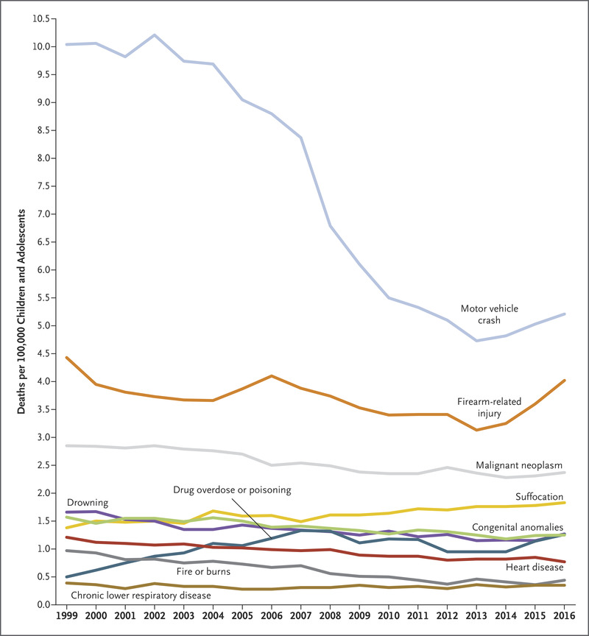
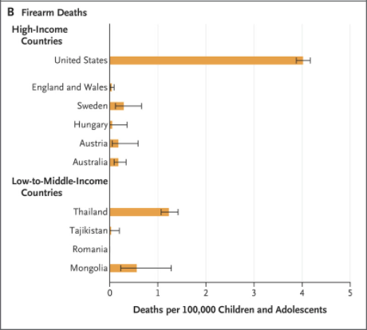
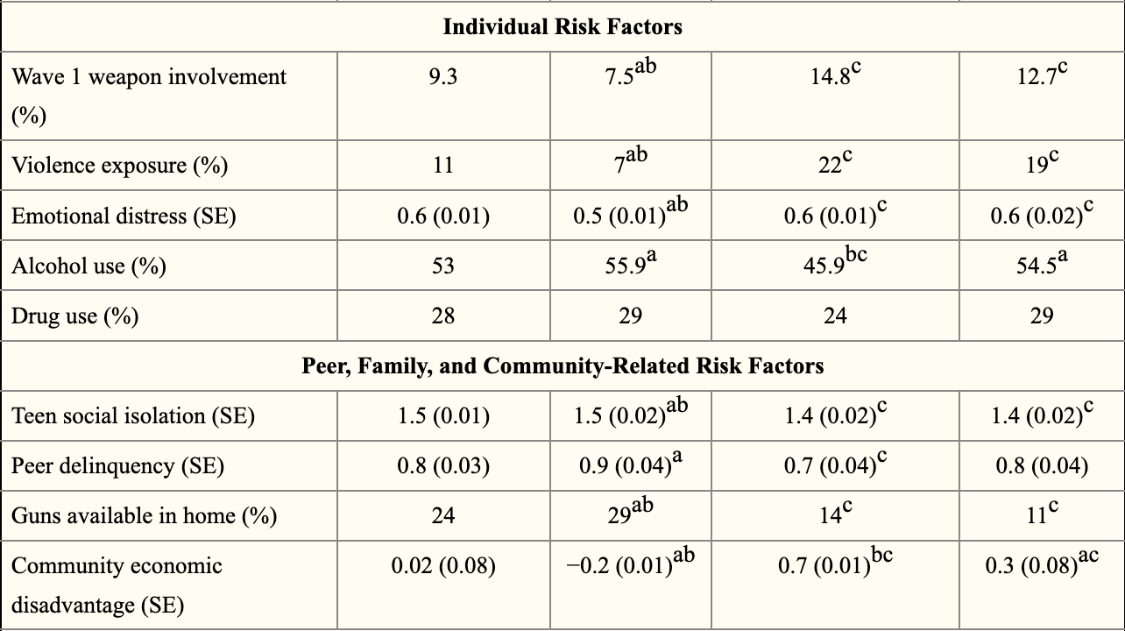
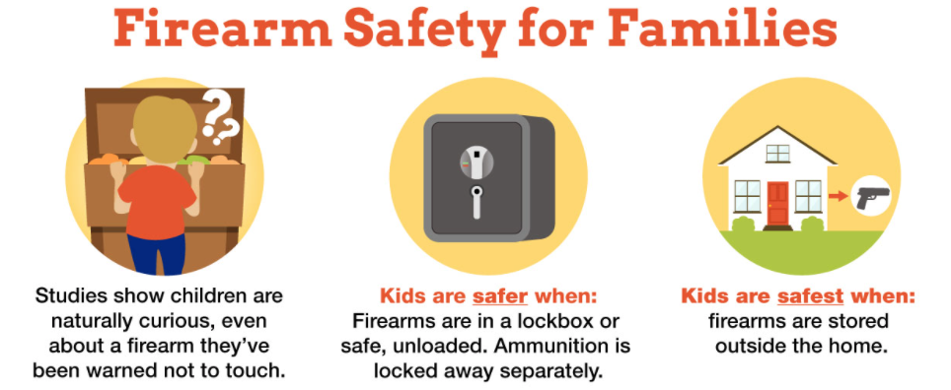
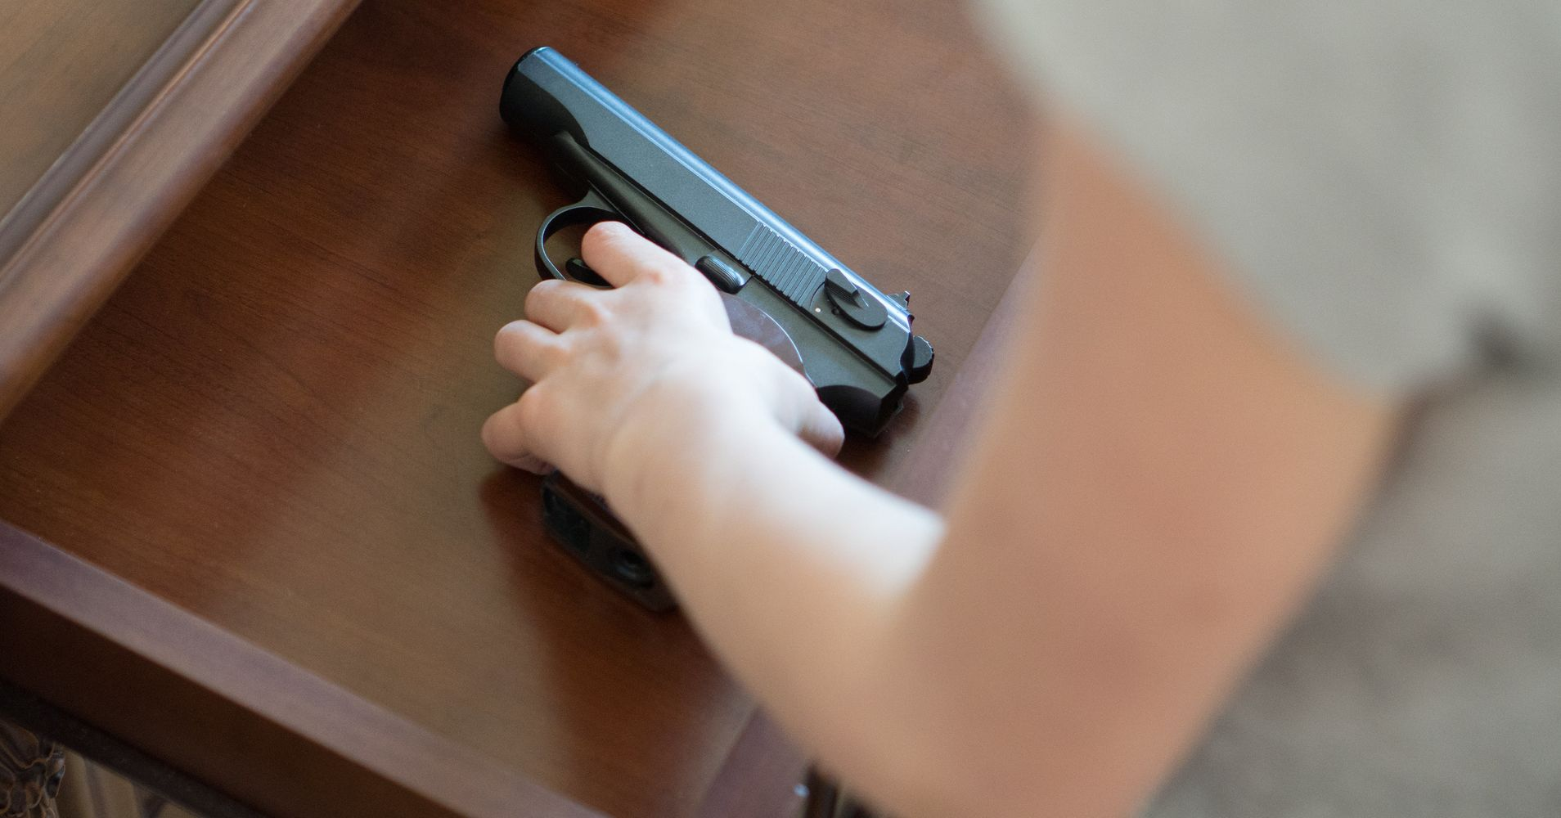
RETROSPECTIVE ANALYSIS OF UNDERSTANDING FIREARM VIOLENCE PREVENTION AFTER SAFETY PRESENTATION IN A COMMUNITY-BASED SETTING
Eddie Soto & Haydar Ibrahim, B.S. MD candidates, University of Colorado School of Medicine, Class of 2022
Faculty Sponsor, Dr. Kristine Rodrigues, MD
Abstract
Methodology
Results
Conclusion
Firearm-related deaths in the United States are the third leading cause of overall death among children and the United States continues to have the highest rate of firearm-related injuries compared to other industrialized countries⁴. Roughly 1/3 of U.S. homes with children contain firearms. In 2017, at least 285 children got ahold of a gun and inadvertently shot themselves or someone else. Teenagers are at a higher risk for suicide when there is a gun in the home. This project aims to see if giving a presentation on gun violence prevention and facilitating a role-play scenario within the community will increase knowledge of this topic.
The underlying question is whether a safety presentation and role-play scenarios on gun violence prevention will increase knowledge in the topic and prompt parents to ask about firearm storage or even removal.
The presentation includes:
Statistics on accidental firearm deaths and youth
Statistics on the association of gun ownership and suicide
Statistics on the relationship of safe storage and accidental firearm deaths
Recommendations from the American Academy of Pediatrics
Resources on firearm violence prevention and suicide.
Our recommendations include:
If a gun is in the house, always keep it unloaded and locked
It should be kept out of reach and sight of children
Keep ammunition and guns locked in separate locations, not together.
Before visiting friends and relatives, ask if they have guns in their homes. If so, make sure they keep their guns unloaded and locked as well
After the brief power-point presentation and role-play scenario, a survey will be given to participants who consent to the study.
The survey will be a retrospective pre-post survey containing 7 questions about the presentation on gun violence prevention.
Age, sex, race/ethnicity, number of children in household, and gun ownership will be collected for demographics of respondents.
The presentation and survey collection will be done in various community health fairs around Colorado. Participation and survey completion will be voluntary.
The target population will be parents attending Colorado Health Fairs
The measurement of knowledge will be analyzed by using a paired sample t-test
Due to the pandemic, our in-person implementation of our survey has been postponed.
We are planning on implementing our intervention and survey at the Warren Village social housing community.
Warren Village is a social housing facility that houses survivors of domestic and intimate partner violence and their children. We chose this community as it houses a population that is racially/ethnically diverse and was identified to us as an at-risk population for gun violence
In the meantime, we have been giving telehealth talks to parents regarding mitigation of youth gun violence risk.
Because we haven’t been able to focus group our survey in person, we only have anecdotal evidence behind our outreach
Parents have echoed that our presentation has conveyed knowledge that they previously did not know. One parent was taken aback at the fact that children as young as the age of 3 have the strength needed to pull the trigger on a firearm. They also acknowledge the issue is much more serious than they previously thought.
Throughout this project, we have learned how important this topic is to prevent the deaths of otherwise completely healthy children. We are now aware that guns killed more children and teens than cancer, pneumonia, influenza, asthma, HIV/AIDs, and opioids combined this past year. Not only is this problem an emergency for all children, but it has been proven to disproportionally affect Black and Latinx children of color. Black and Latinx children and teens had the highest gun death rate in 2019 and were four times more likely to die by gun violence compared to their white peers.
As two medical students of color, this fact haunts us more than any we’ve learned. This is a primary motivation for us, as this problem needs to be addressed upstream and handled at a population level. This problem has been worsened due to the COVID-19 pandemic, as shelter-in-place orders have led to major spikes in accidental shootings at home by children.
We have seen those social determinants of health already affecting Black and Latinx populations have been heightened during the pandemic—gun violence being no different. Through this work, we have gained even more passion for working with these populations and addressing gun violence with health literacy and advocacy. Our goal is to gather data on how best to engage with these populations when covering this topic and further adjust the way we deliver this material. We hope to better ourselves as providers and provide even better care to the communities we serve
Introduction
Literature within the field of gun violence shows that children are disproportionally affected.
Within youth, Latinx and African American youth are affected at the highest levels.
Our background in working with similar youth at the Vickers Boys and Girls club inspired this project.
Due to this background, we saw that this community desperately needed healthy literacy knowledge on gun violence prevention especially when it came to youth
Acknowledgements
Thank you to Dr. Kristine Rodrigues with her pediatric expertise with which this project would be impossible. Thank you to the faculty at CU SOM and the families at Warren Village.

