Slide 1
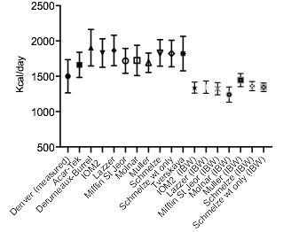
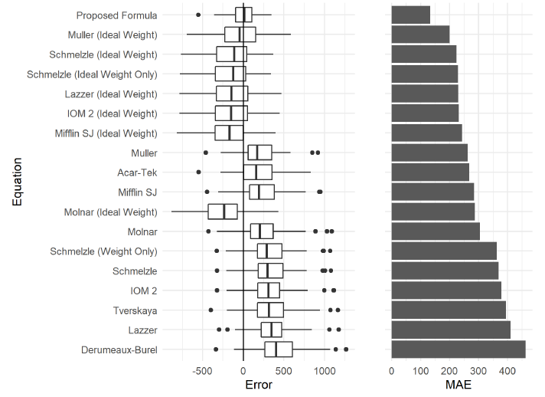
Accuracy of Current Equations and Development of
a New Predictive Equation for Resting Energy Expenditure
for Overweight and Obese Adolescents
Steve Haberkorn^{1*} and Madison Harrison^{1*},Cameron Severn², Laura Pyle^{3,4}, PhD, Yesenia Garcia Reyes³, MS,
Kristen J Nadeau³, MD, Melanie Cree-Green³, MD PhD, Amy Rydin³, MD
Children’s Hospital Colorado | University of Colorado Anschutz Medical Campus, Aurora, CO
*Joint first author, ¹University of Colorado SOM, ²Dept of Biostatistics and Informatics, ³Division of Pediatric Endocrinology, ⁴Dept of Pediatrics
Background
Results
Conclusions Part 1
Knowledge of resting energy expenditure (REE) is a critical component for dietary counseling to achieve weight loss
Given the clinical inaccessibility of indirect calorimetry (IC), predictive equations have been developed to help estimate measured REE (mREE)
Existing equations have been developed following ≤ 30 minutes of supine rest, rather than a gold-standard diet and activity-controlled inpatient overnight setting
Aims of original study: 1) Compare mREE after an overnight inpatient monitored rest with predicted REE (pREE) using published equations and 2) develop a new predictive equation based on strictly controlled mREE
Current pREE varies from mREE in overweight/obese adolescent females
This difference is possibly due to the outpatient setting of IC for pREE
Our new predictive equation allows for more accurate estimation of REE and provides improved information on energy needs in this population
Limitations
Developed equation may not be generalizable to male and female adolescents
Reflects Denver race/ethnicity demographics
Figure 1: Measured vs predicted REE
Methods
Secondary analysis of overweight and obese female participants (Table 1)
Monitored, inpatient 12-hour fast prior to early morning mREE
Body composition, with dual X-ray absorptiometry (DXA), fasting labs
Ten predictive equations from the literature were used to calculate pREE for each subject and performance was evaluated using mean absolute error (MAE)
New predictive equation developed using backward stepwise model selection with a development cohort (n=96) and validated with test cohort (n=46), with participants’ data divided by random selection
Variables considered for the new equation included: body mass index (BMI), height, weight; waist circumference; age; ethnicity; fat mass, fat free mass from DXA; fasting glucose, insulin or free fatty acids
Future Directions
Current pREE equations are inaccurate, resulting in erroneous calorie counseling for overweight/obese adolescents
Goal to develop a novel pREE equation with improved accuracy for broad range of patients of both sexes
To accomplish this, we will seek to create the largest research subject database to date of mREE’s from overweight/obese adolescents, using inpatient and outpatient IC results from multiple institutions nationally
Stage 1) Does geographic location matter?
Can IC data from various sites be combined and compared, or does that add new variables that must be incorporated into the pREE equation?
Compiling ~500 IC results across 5 institutions: CHCO, Univ of Minnesota, Univ of Tennessee, Vanderbilt, and NIH
Will compare geographic group results, using matched cohorts
Table 1: Characteristics of all participants
Variable | Participants (N=142)
PCOS status (n, %) | 110 (77)
Age (years) | 15.5 ± 1.8
Ethnicity (% C/H/B+O)
BMI (kg/m²) | 35.1 ± 5.2
BMI percentile | 97.7 ± 1.9
BMI z-score | 2.1 ± 0.3
Height (cm) | 163 ± 7
Weight (kg) | 94 ± 16
Waist circumference (cm) | 104 ± 13
Fasting glucose (mg/dL) | 88 ± 7
Fasting insulin (mIU/L) | 27 ± 14
Fasting free fatty acid (mmol/L) | 618 ± 157
Fat free mass (calculated kg) | 52.1 ± 7.7
Fat mass from DXA (kg) | 41.7 ± 9.4
Stage 1:
Does geographic location matter?
Location irrelevant
Stage 2:
No matching of subjects based on study site & no location variable in novel pREE equation
Location affects mREE
Stage 2:
Match subjects based on study site & incorporate geographic variables into novel pREE equation
Figure 2: Predictive value, using mean absolute error (MAE), of REE equations
Results
All 10 literature equations overestimated mREE with measured anthropometrics and underestimated mREE when ideal body weight (IBW) was used (Figure 1)
Predictive Value (Figure 2)
Best: Muller IBW formula (MAE: 199) and Schmelzle IBW (MAE: 223)
Least: Derumeaux-Burrel (MAE: 463)
New equation:
Stage 2) Can we develop a more accurate pREE equation?
Utilize mREE data from the 5 institutions to develop new pREE equation
NIH, Baylor,
Expand patient population to include metabolic disease, males and females, different geographical regions.
Compile ICC data from the various locations to create of more broadly applicable REE equation.
REE = 14.7 (height(cm)) + 25.121(BMI (kg/m2))
– 5.468 (waist circumference (cm)) – 1214.9

